Slide 1
Innovation Spaces: A Career in New Library Facilities
11/8/19
Matt Cook
Matt_Cook@Harvard.edu

Slide 2
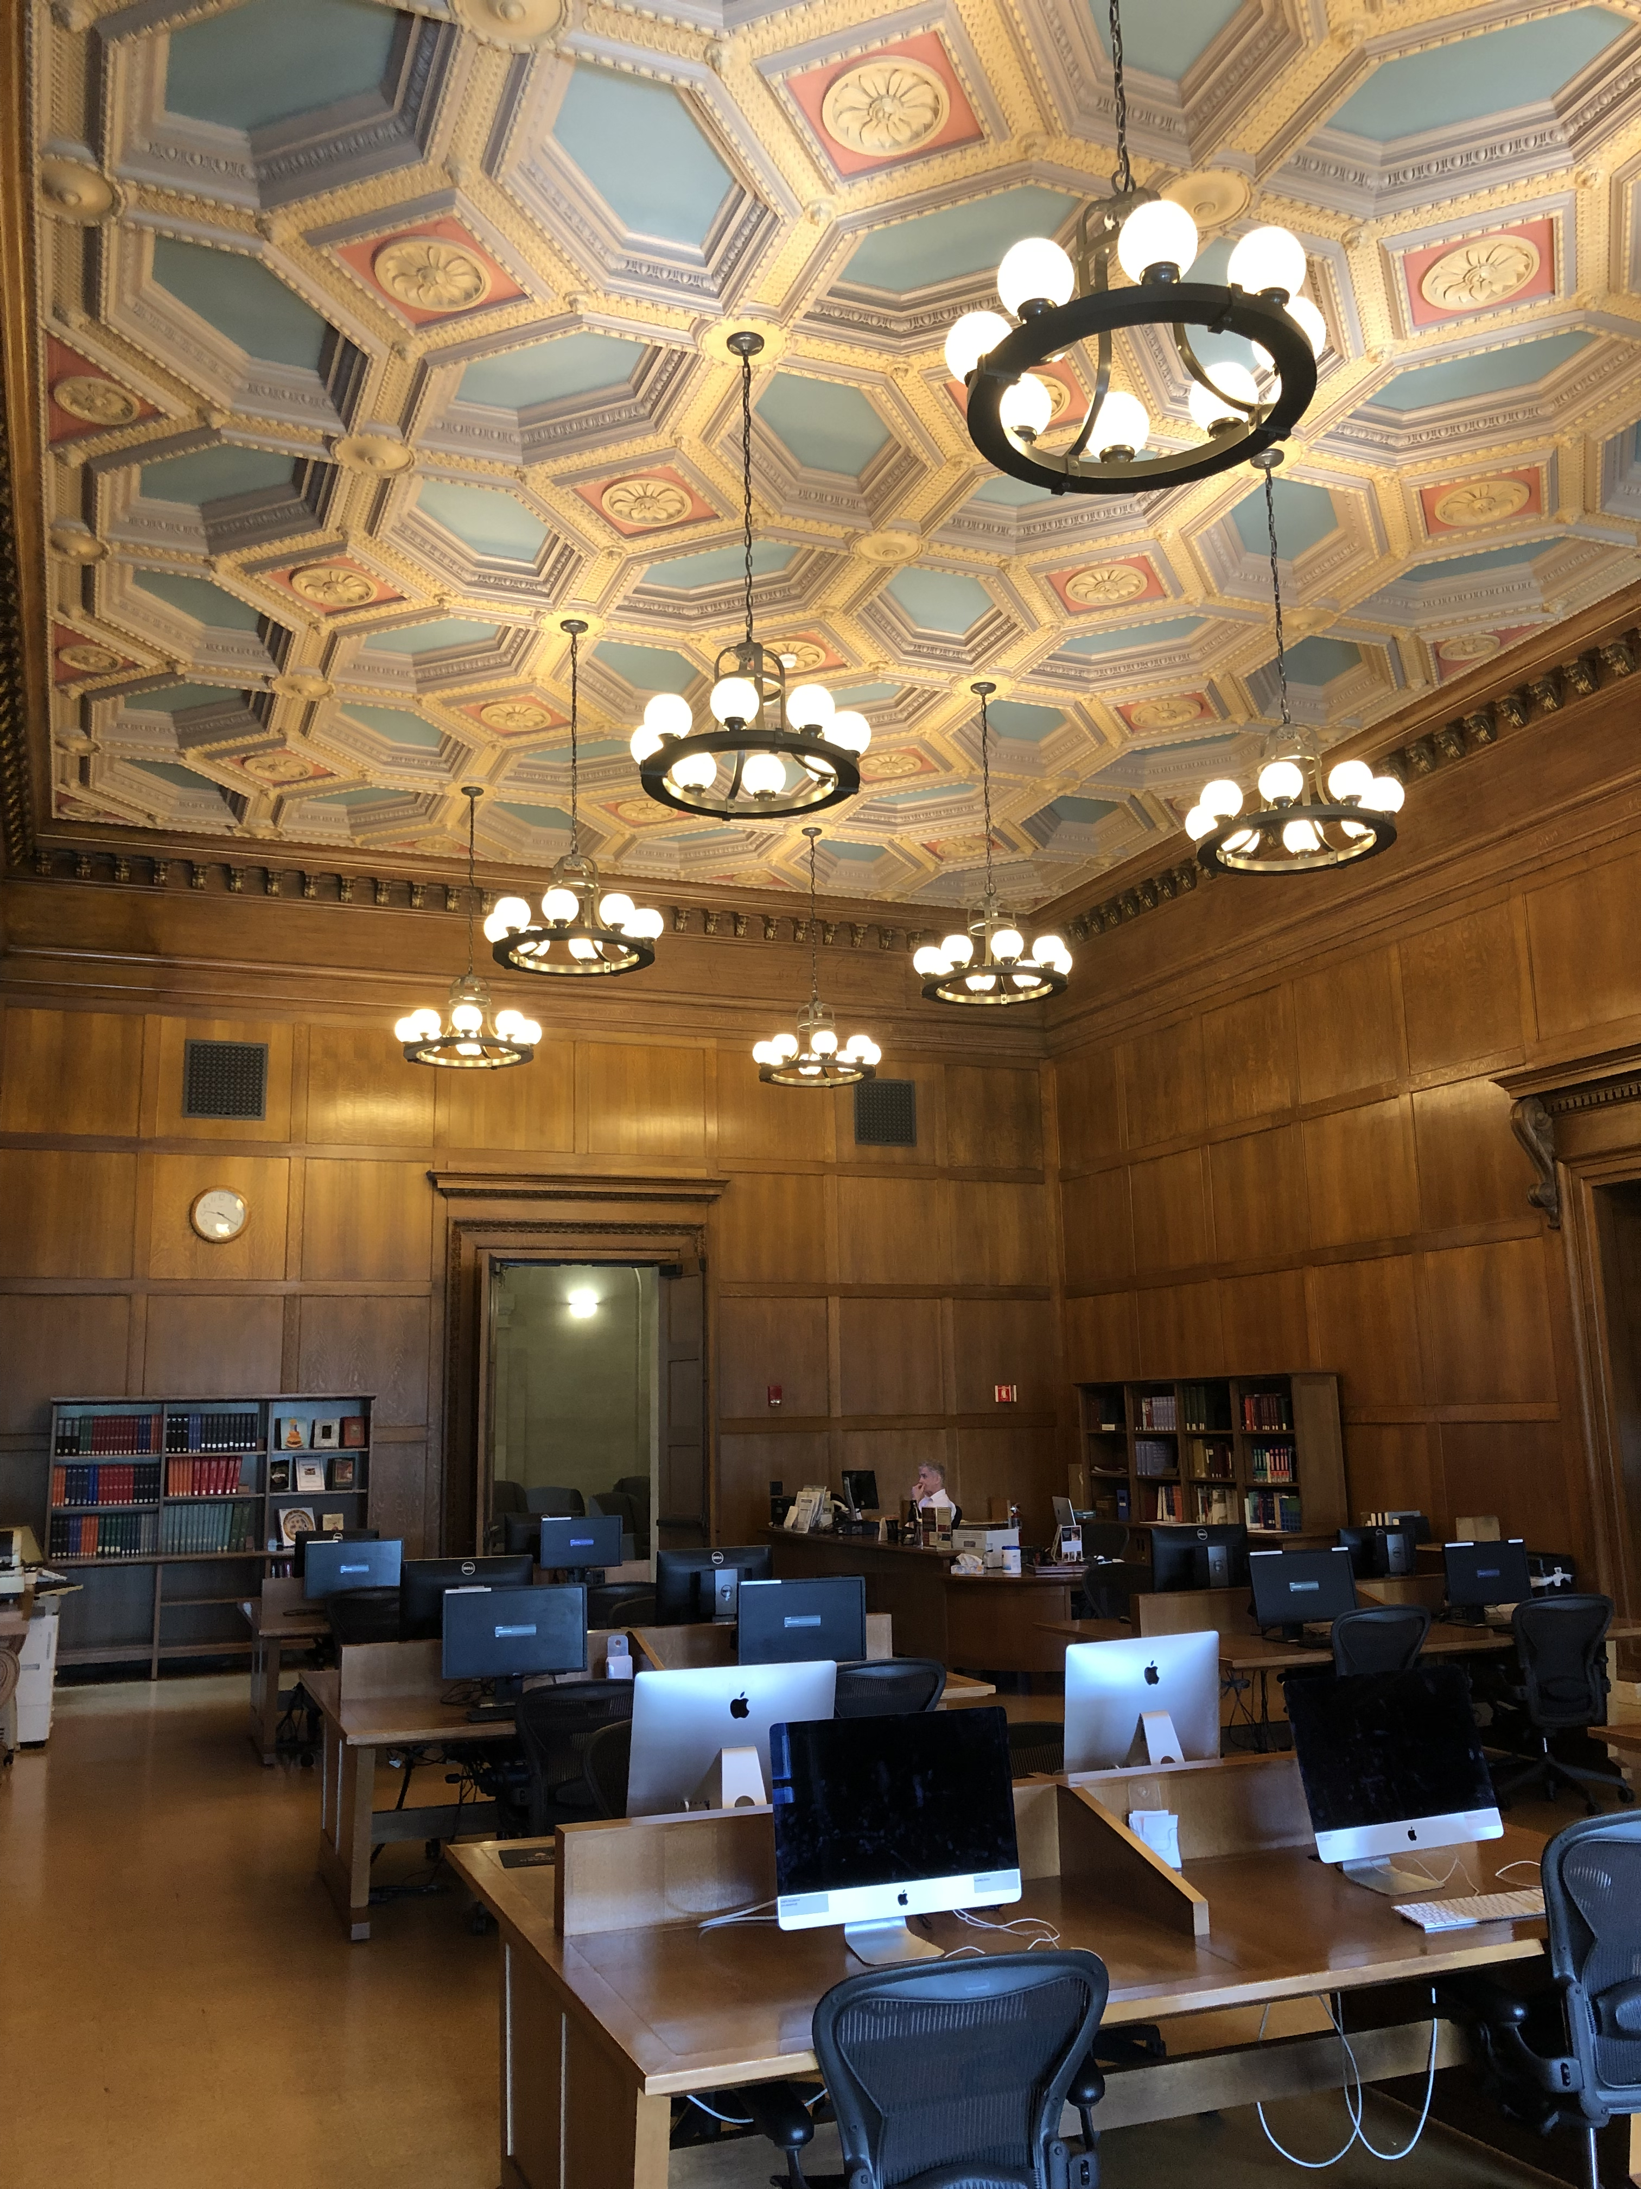
Overview
My career, presented in parallel with new library spaces
“Classic”, Commons, Makerspace, Incubator, The Next Thing (i.e. DS Studio)
Use cases, innovations, skills
“Innovations” = Opportunities to be creative and learn new skills

Slide 3
Goals for Today
Specific research and instructional integrations for innovation spaces (i.e. use cases)
Skills associated with new spaces and new positions (i.e my personal experiences + anecdotes)
Variety and scope of “Innovation Spaces” in 21st century Libraries

Slide 4
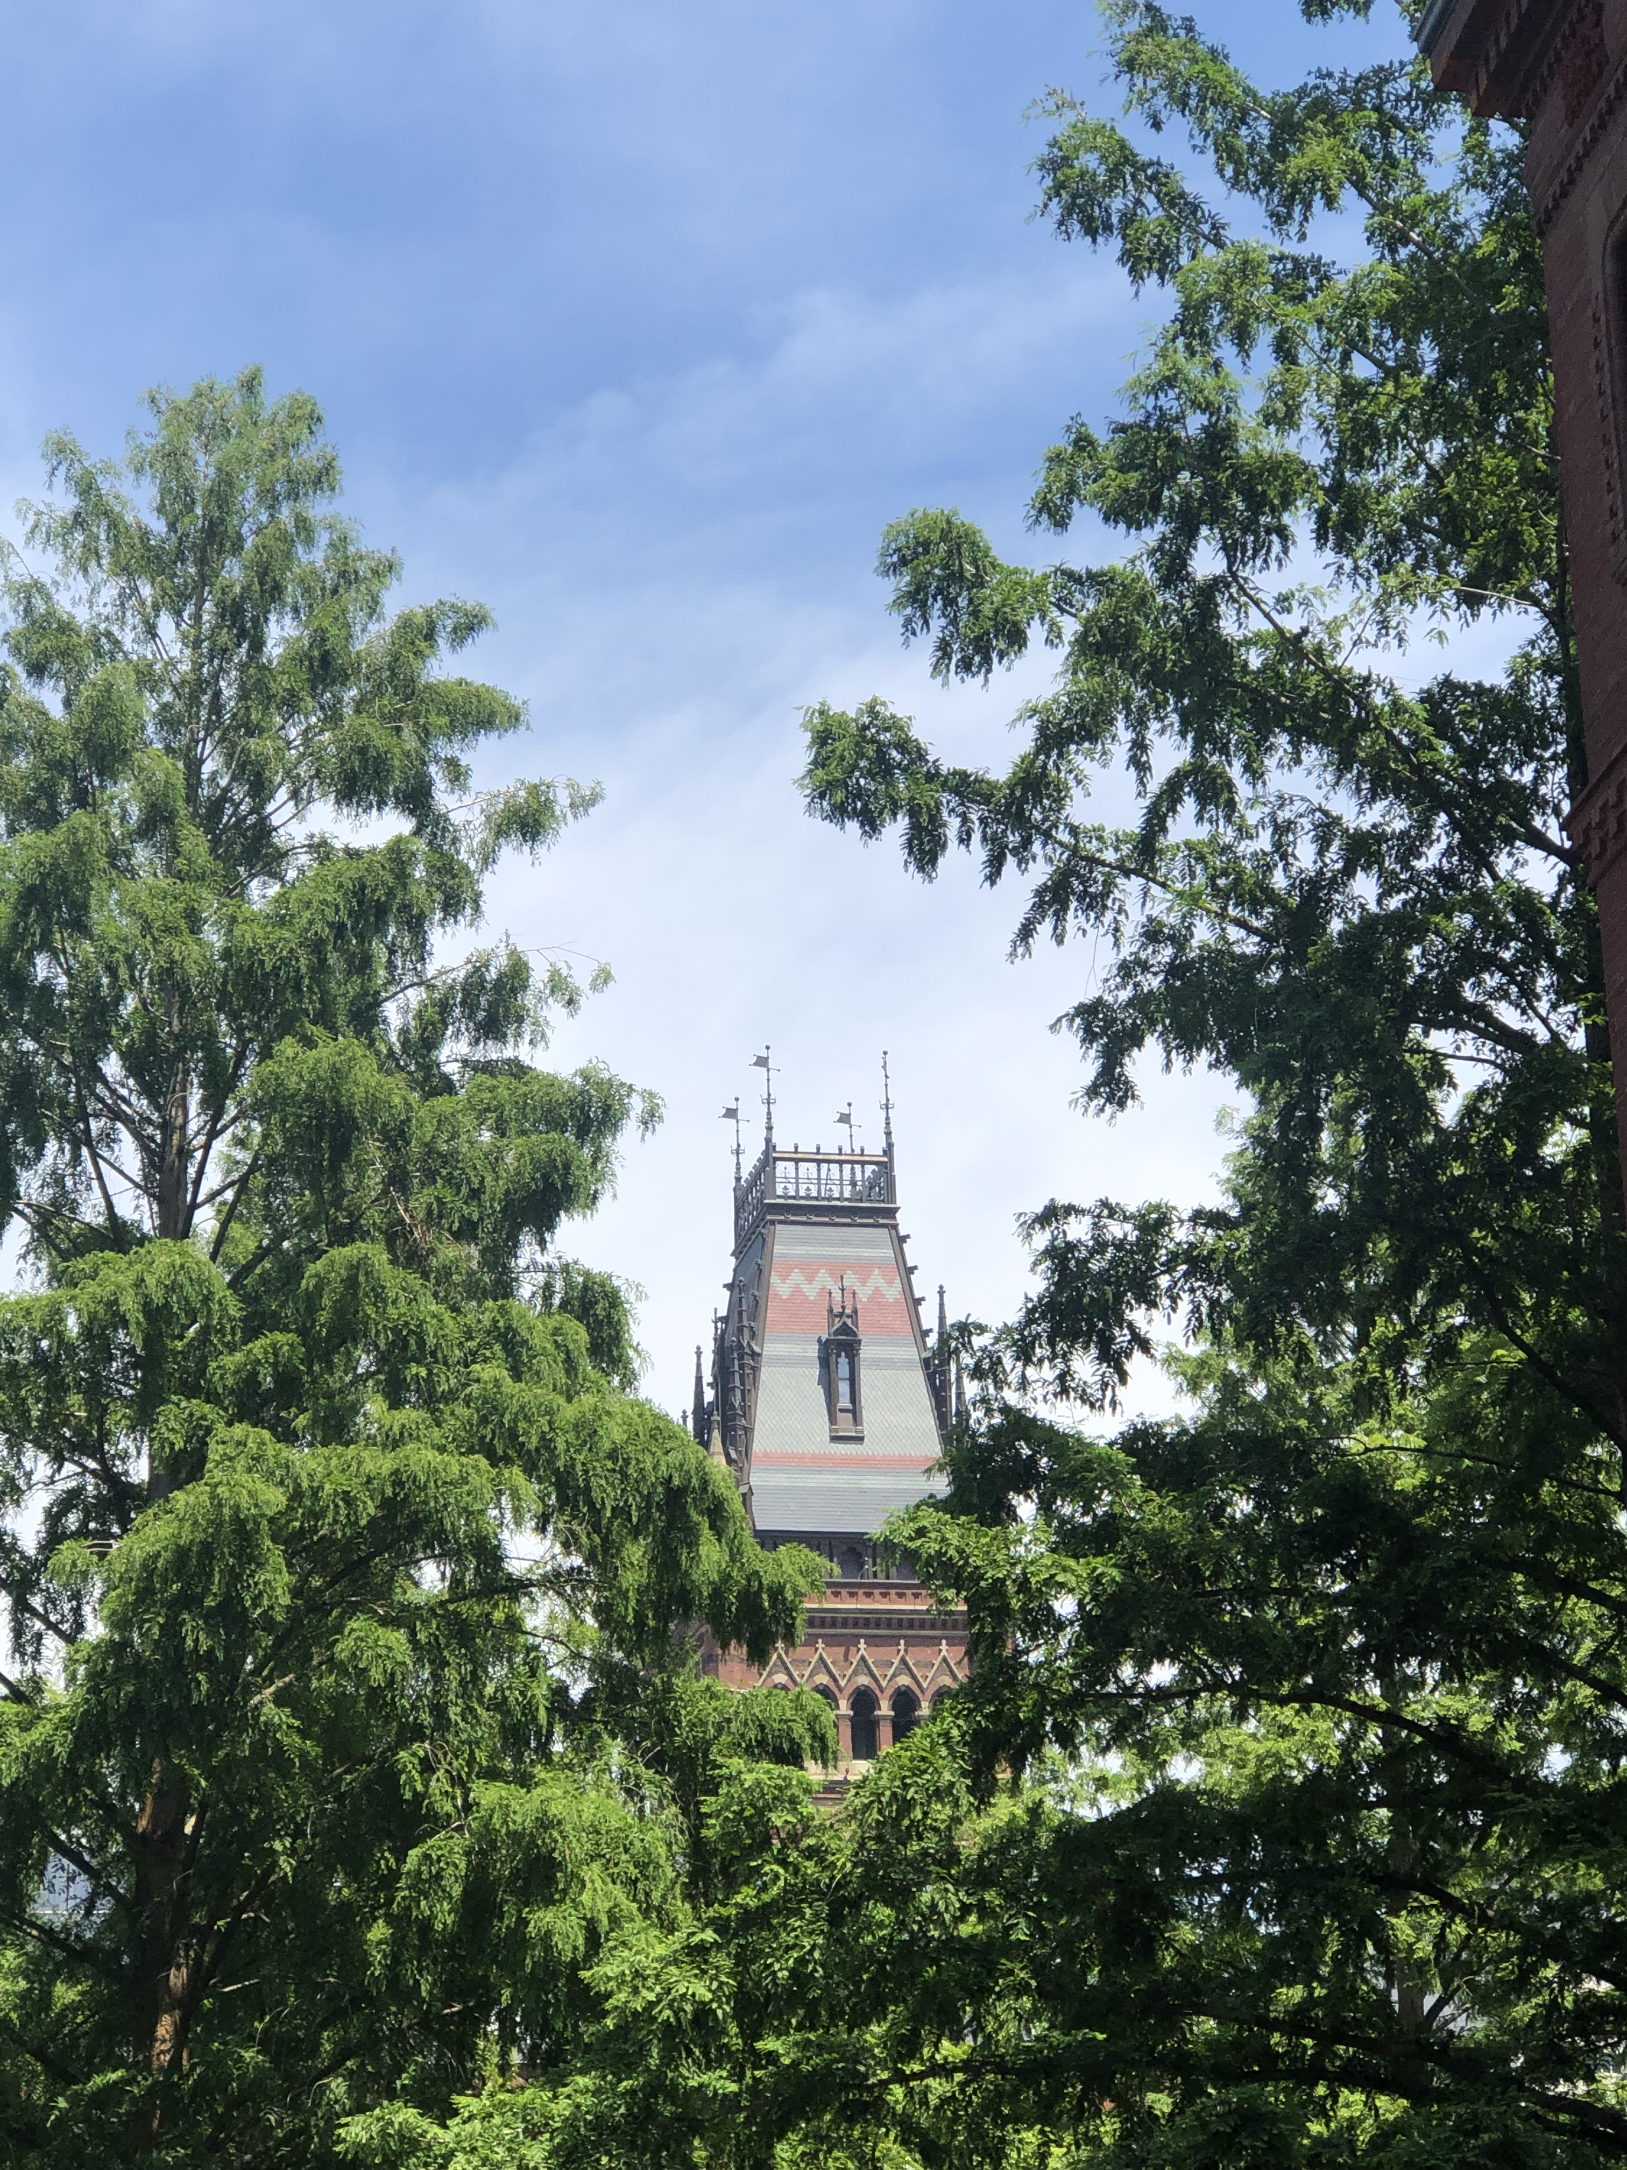
Notes & Caveats
All images mine (except noted)
Inheriting Spaces
Simplistic characterizations & Descriptions
Staffing is critical
Could have been the focus of the talks
See: Cited Material
Cook, Matt. "Virtual serendipity: preserving embodied browsing activity in the 21st century research library." The Journal of Academic Librarianship 44, no. 1 (2018): 145-149.

Slide 5
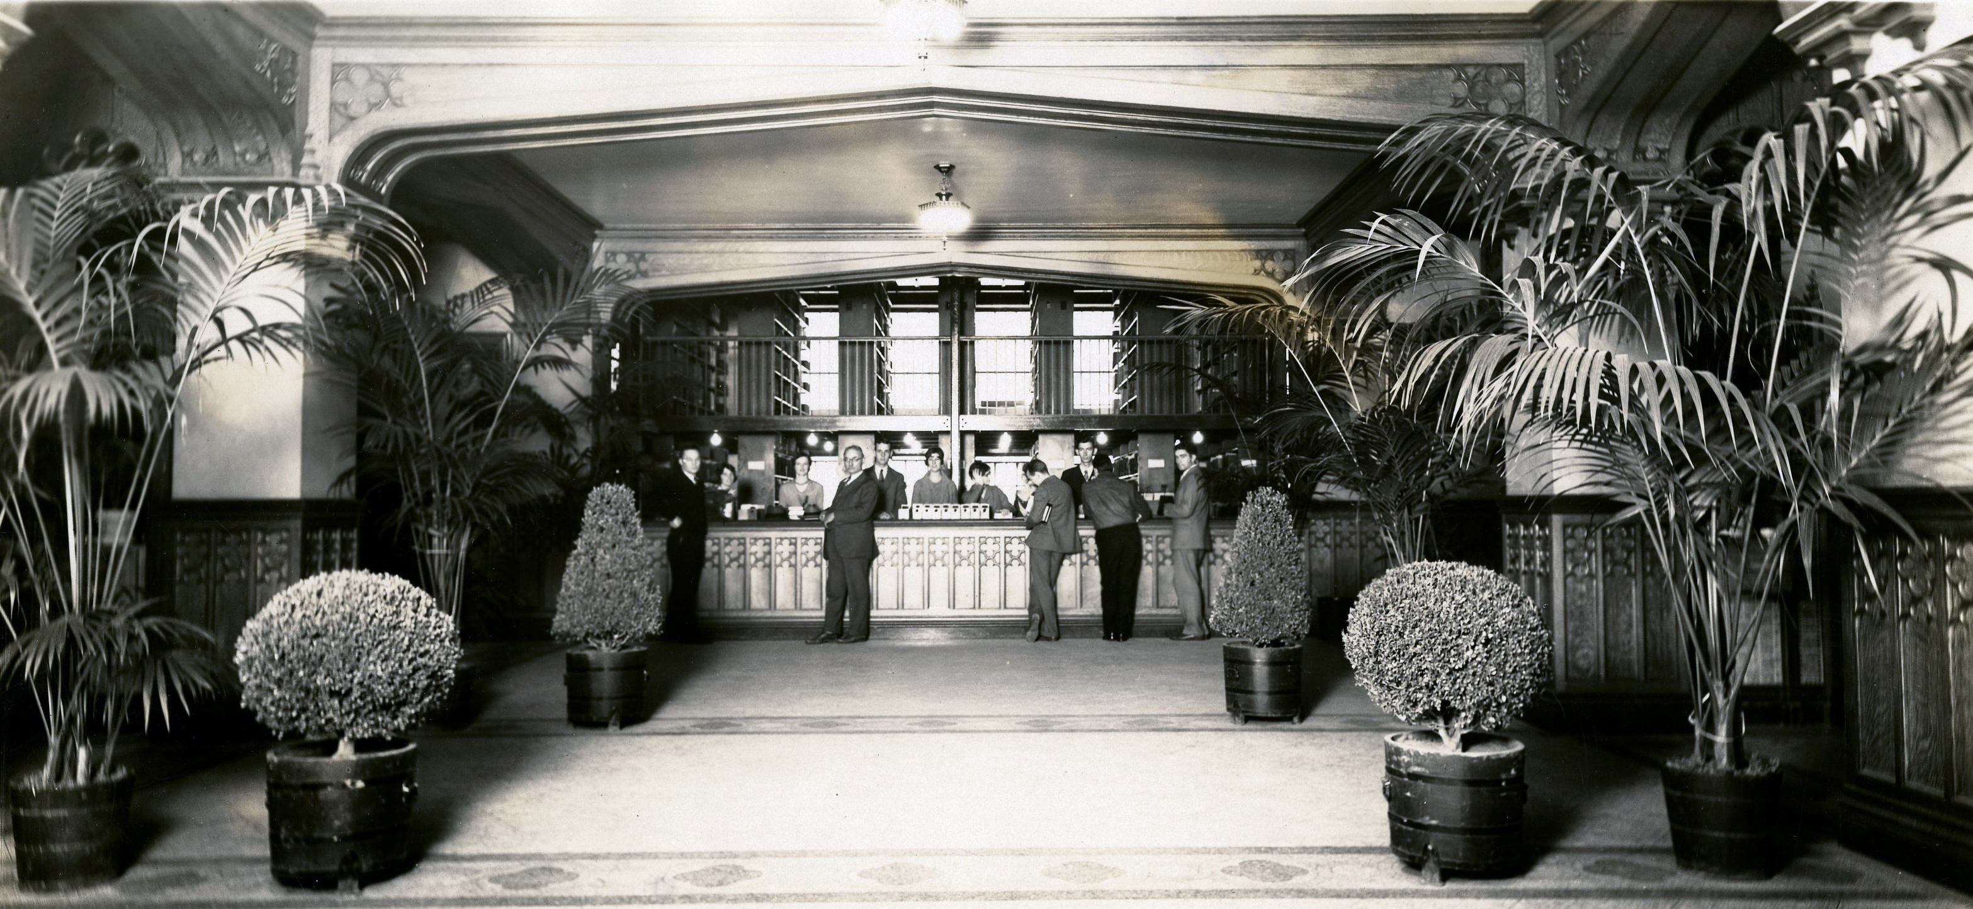
The Classic
Credit: University of Oklahoma Libraries
Notes:
The Pref

Slide 6
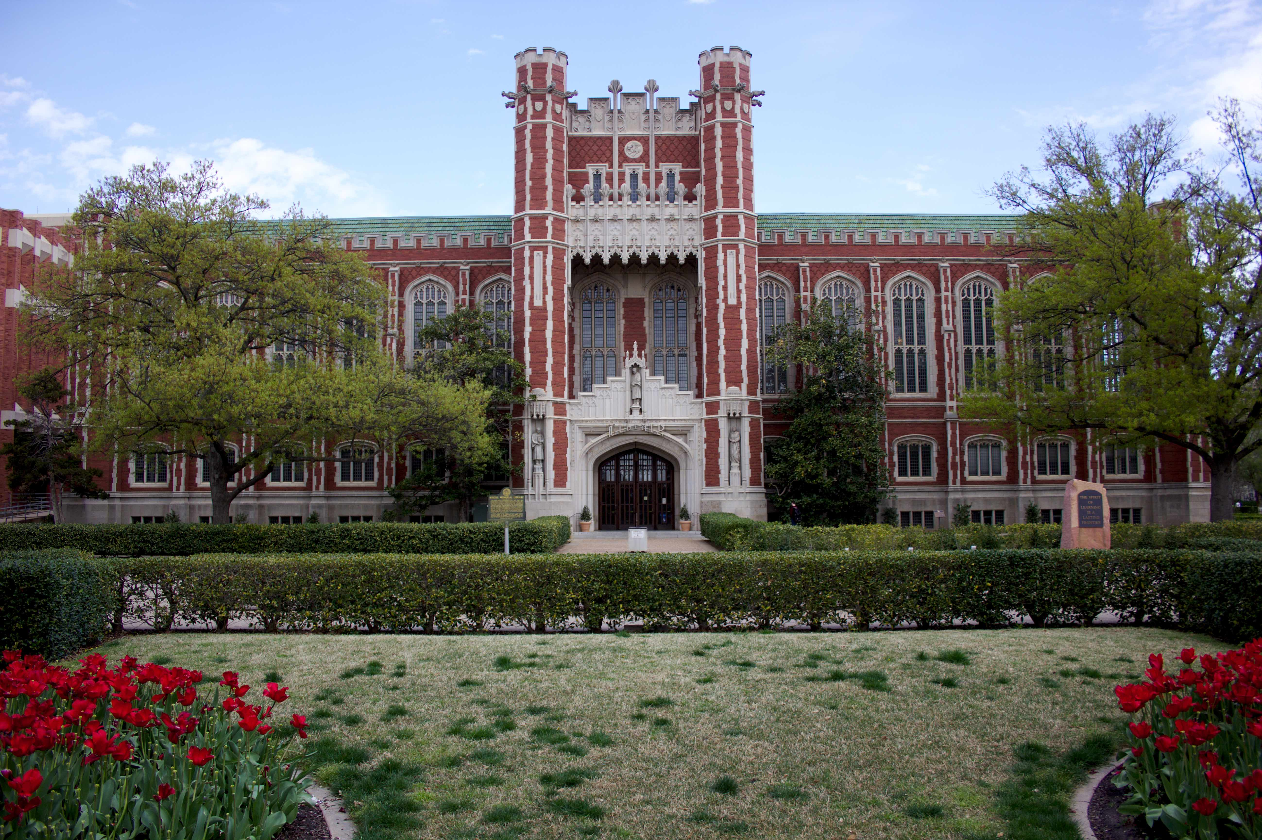
Background
Extended Cognition
Student employment
Night Circulation Supervisor
Credit: University of Oklahoma Libraries

Slide 7
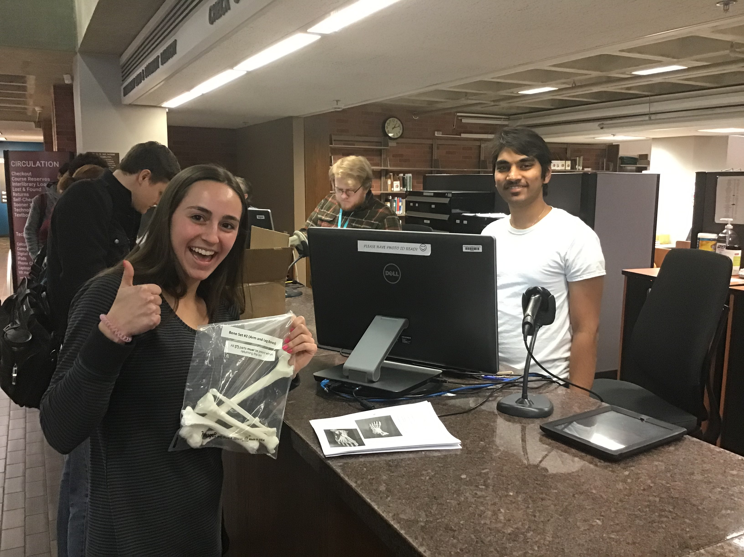
Use Cases
Circulating new material types
Telescope
A/V equipment
Bone bags
Textbook Reserves
Cook, Matt, and Jen Waller. "Banned Objects Week: A Preemptive Defense of Intellectual Freedom in Twenty-First-Century Libraries." Journal of Intellectual Freedom and Privacy 3, no. 1 (2018): 5.

Slide 8
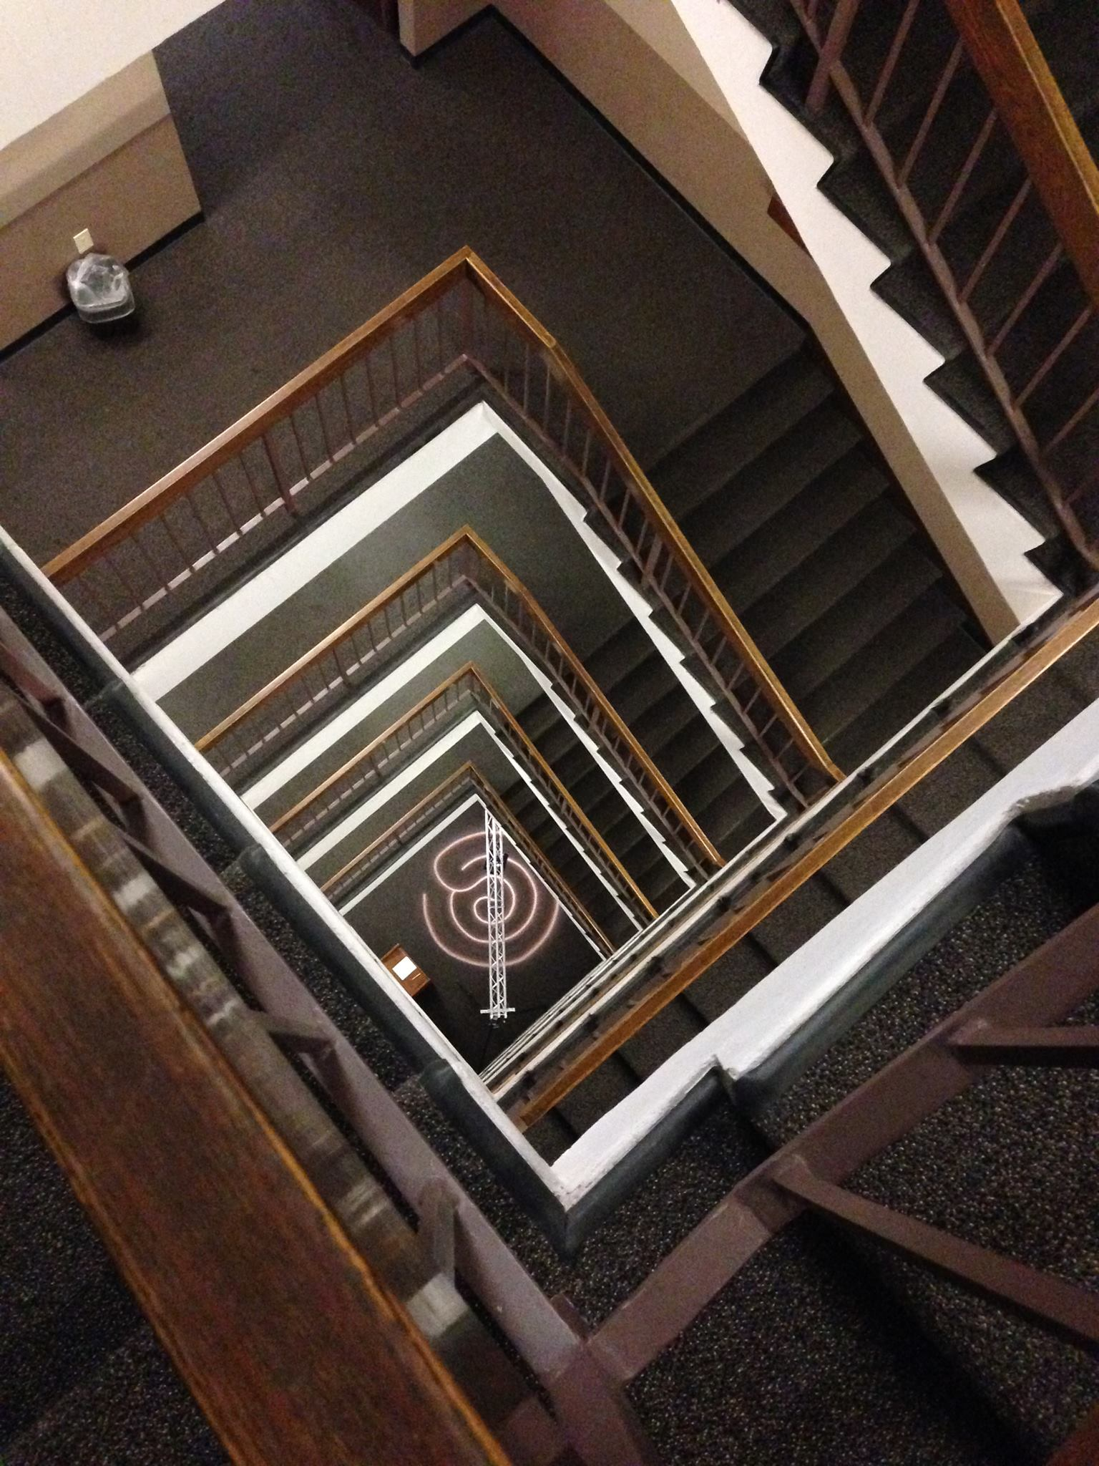
Innovation
Sparq Labyrinth
R&D
User Testing
Press
Nationwide deployments
UMass
OU-Tulsa
CUNY
Cook, Matt, and Janet Brennan Croft. "Interactive mindfulness technology: A walking labyrinth in an academic library." (2015).

Slide 9
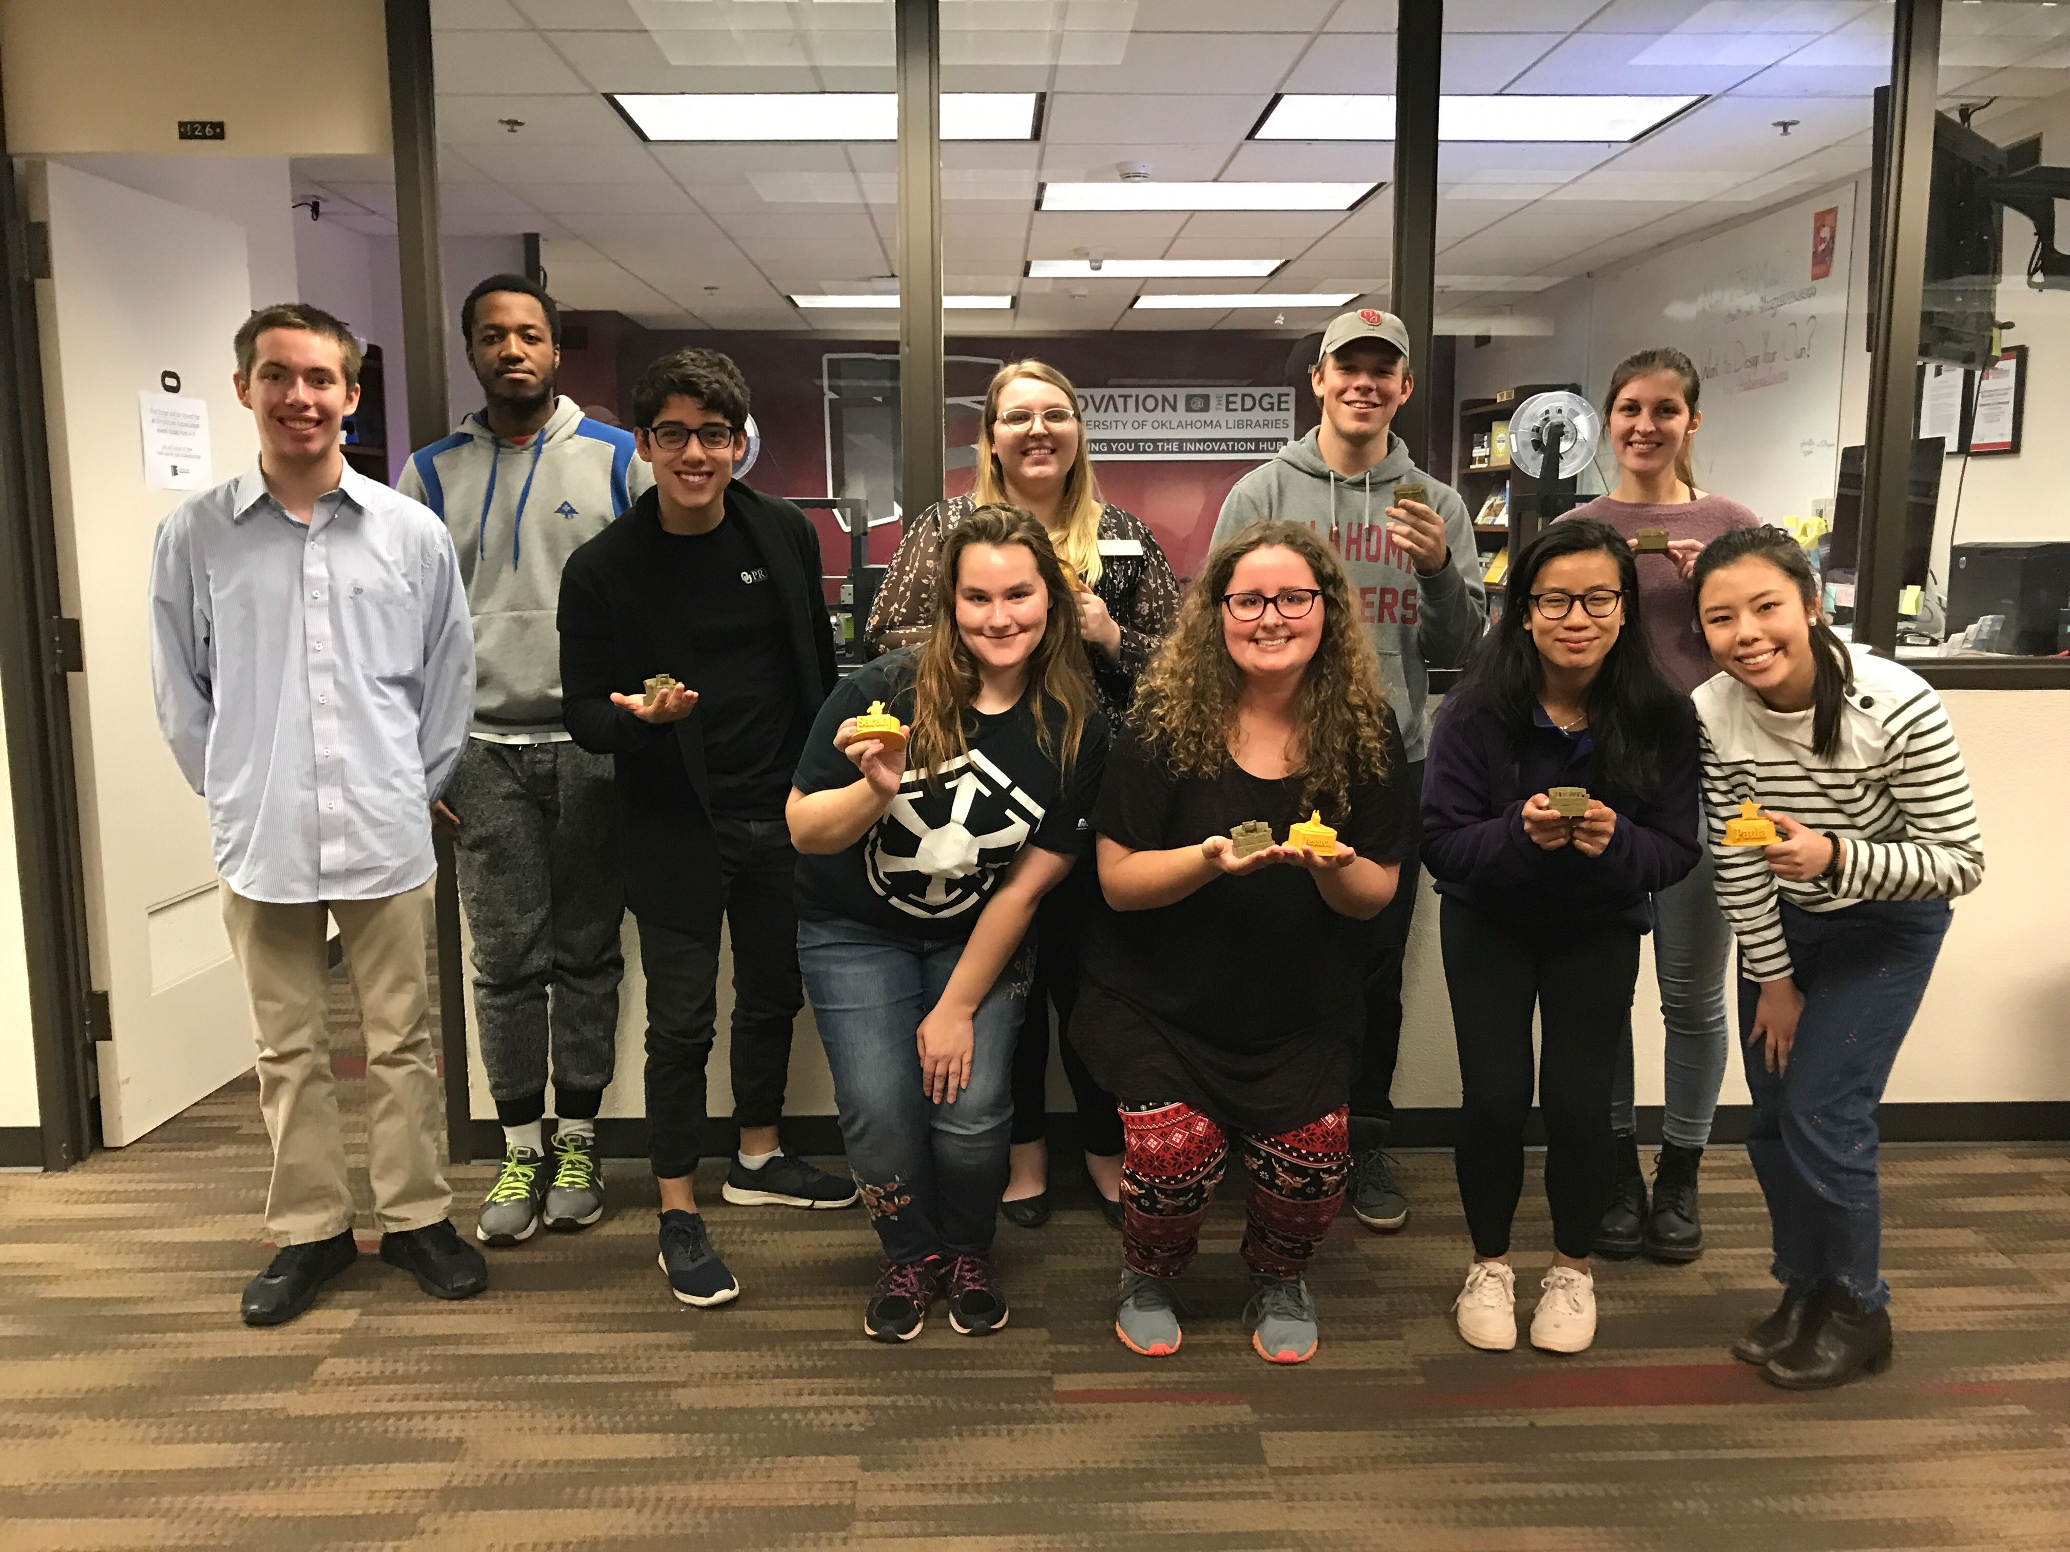
Skills
Student employee management
Hiring/firing/training/mentoring
Composure!
Public spaces = you never know
Security + Natural disasters
Technology troubleshooting
Frontline librarianship
In demand items
Traffic patterns
Stress levels

Slide 10
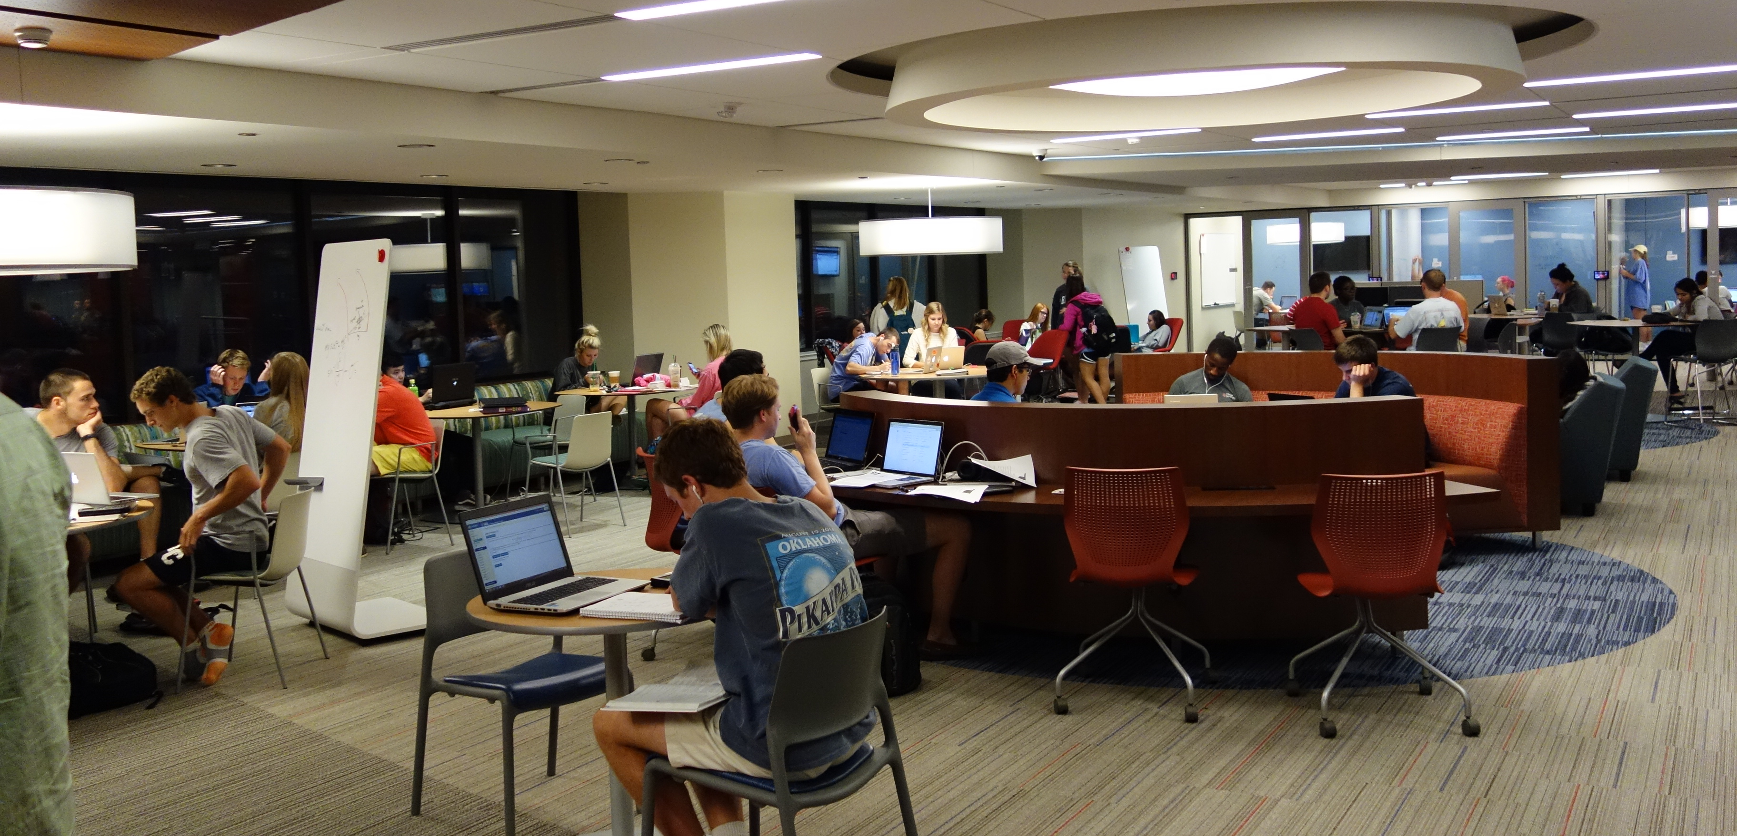
The Commons
Notes:
Pref

Slide 11
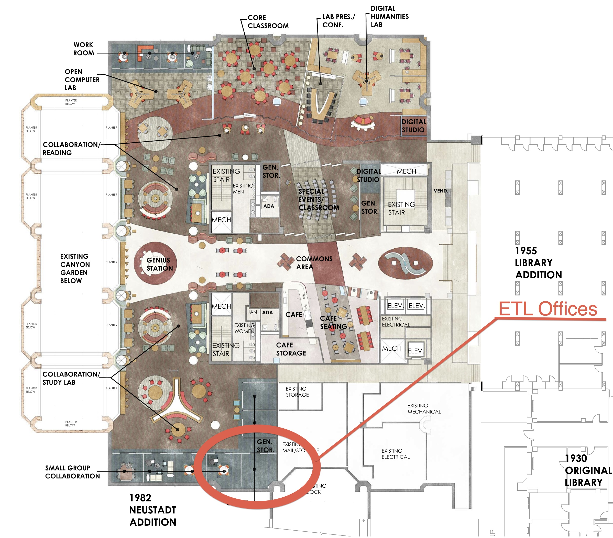
Background
The Space
Writable surfaces
No straight lines
Flexible seating
DSL, Community Room, Bookmark Café, group study rooms, monitors
Cross Pollination
Third Space
Noisy and open late!
Coffee and soft seating
Credit: University of Oklahoma Libraries

Slide 12
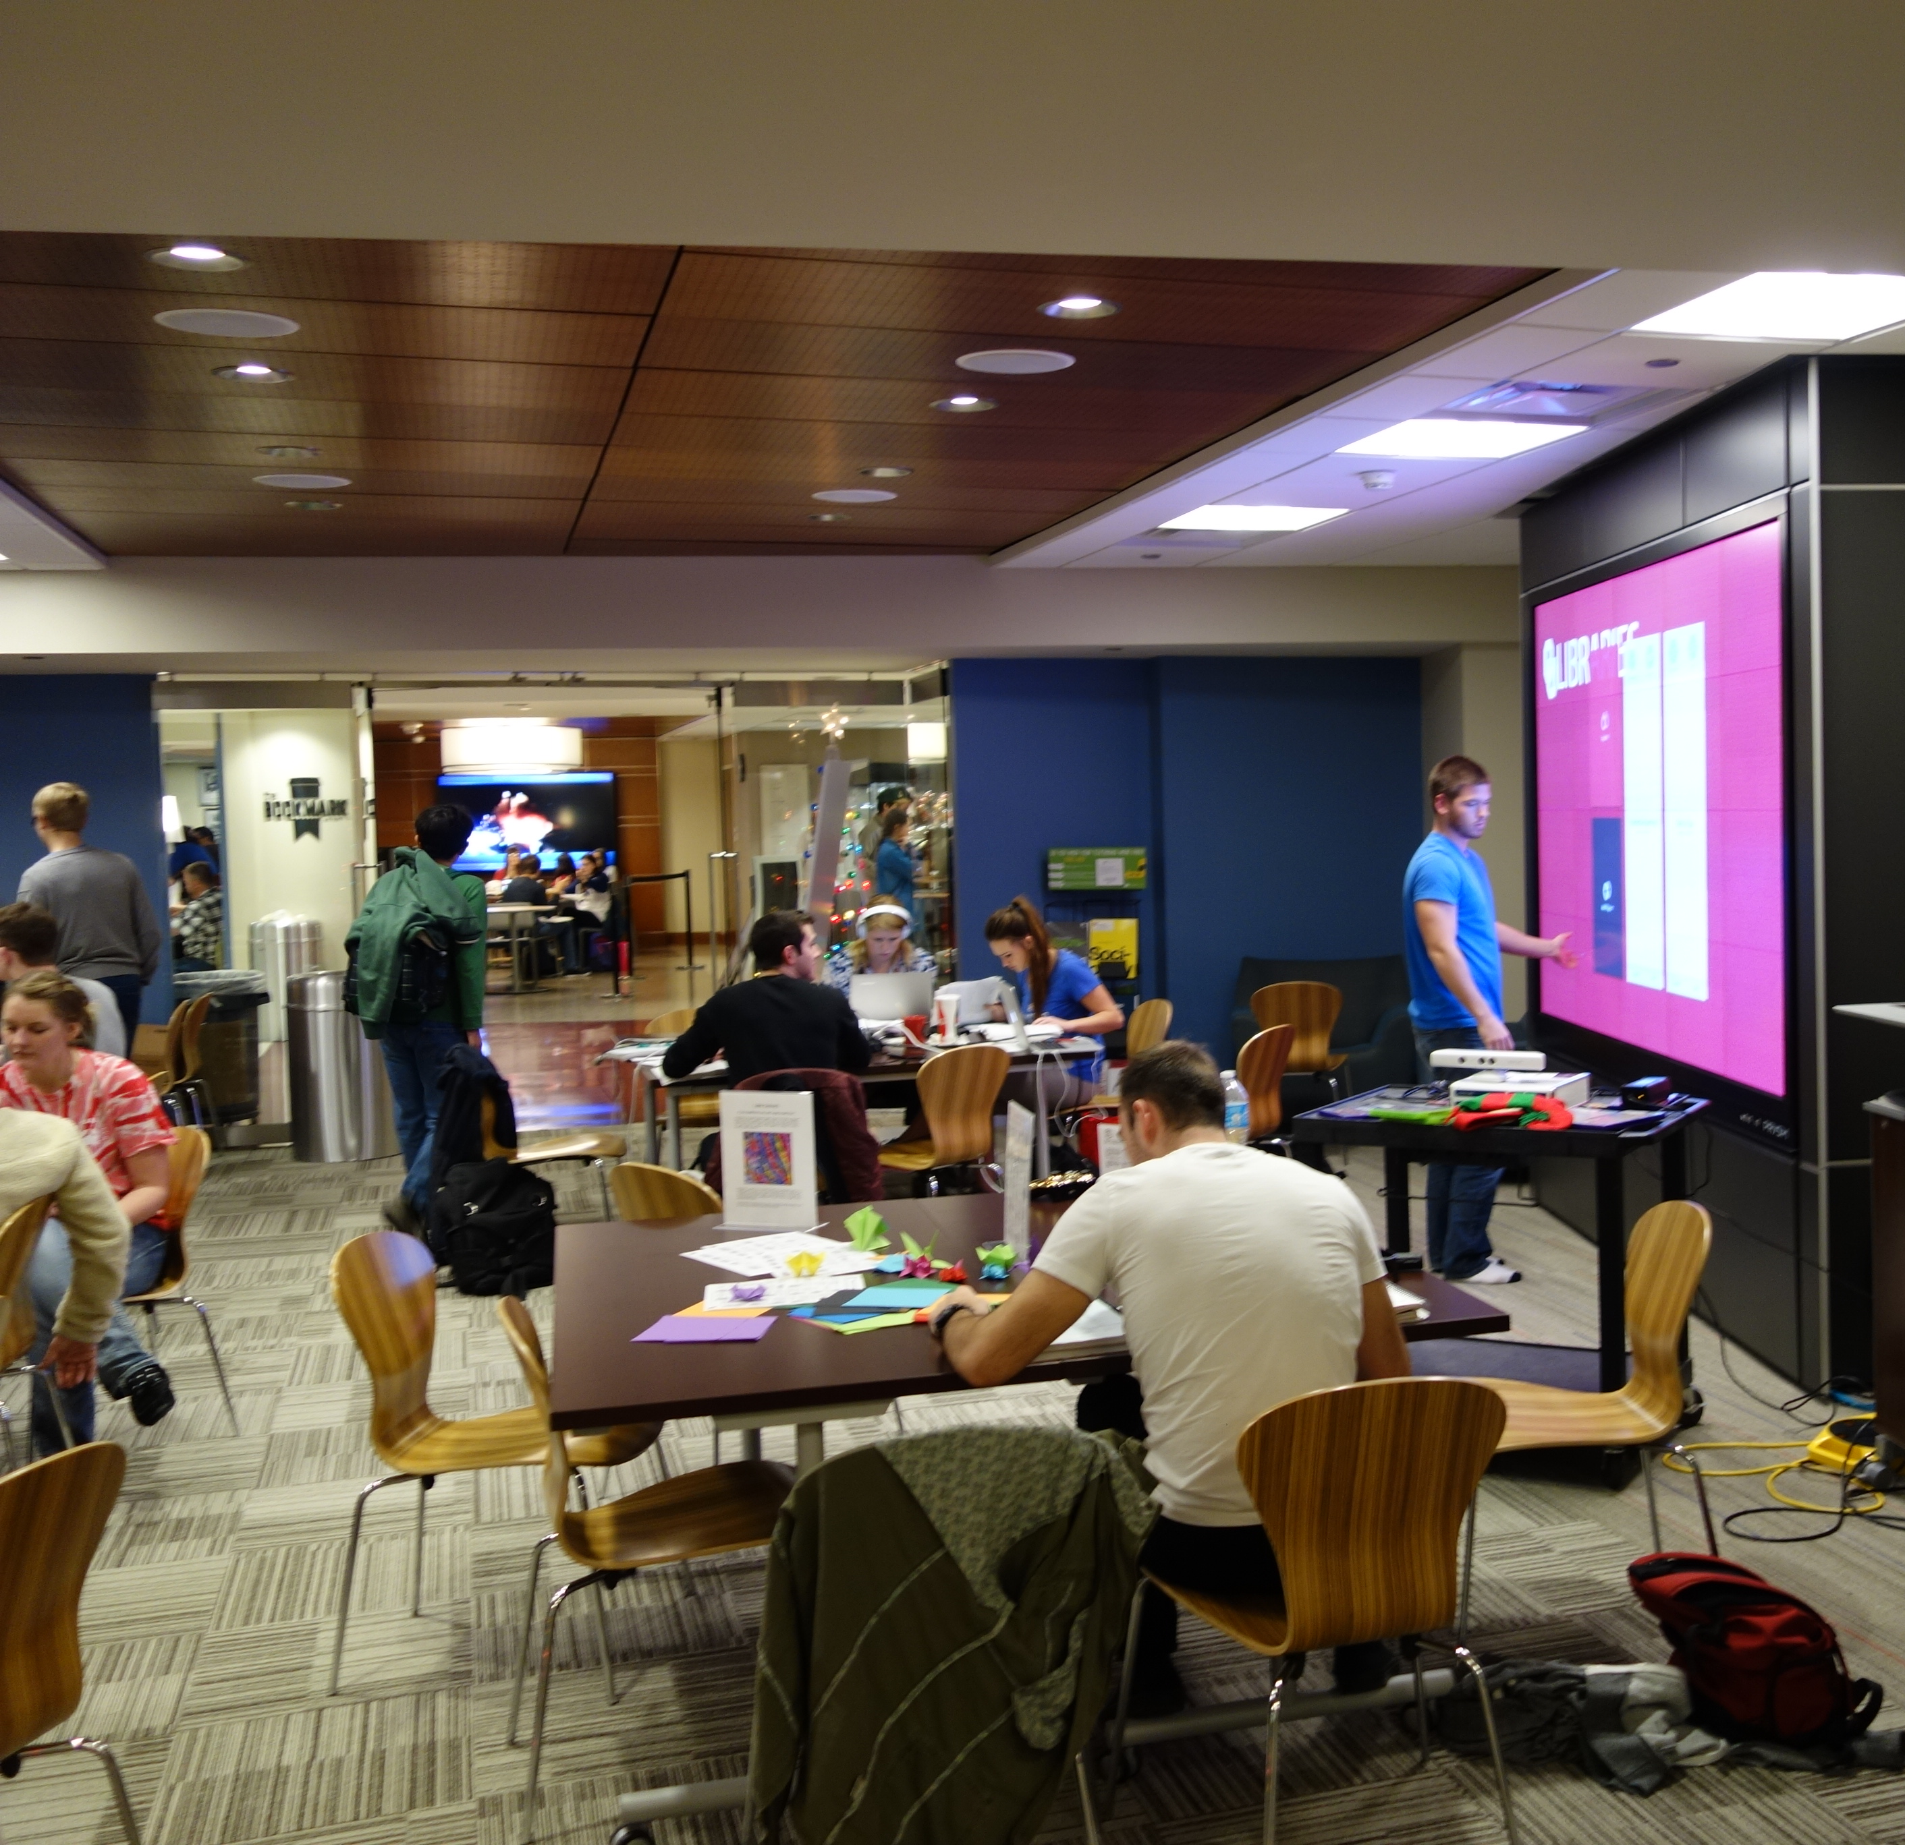
Use Cases
Community events
Local government
Scholarly grants
Student activities
Group study (for students)
Reserve-able online/in person
Variety of furniture
Onsite technologies
Prysm display
Mac workstations
Crestron panels

Slide 13
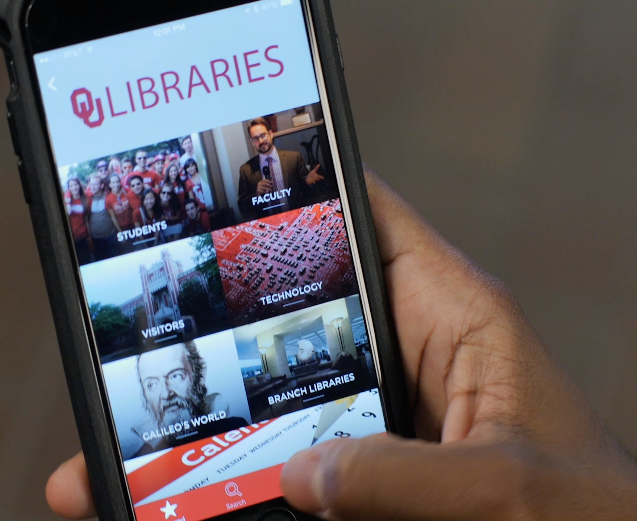
Innovation
OU Libraries NavApp
Turn-by-turn, indoor navigation
Bluetooth beacons
1-3 meter accuracy
Hyper-Local Content
Includes accessibility and natural disaster functionality
Stacks/LibGuide integration
Technology user guides
~3000 Users before sunsetting
Credit: University of Oklahoma Libraries

Slide 14
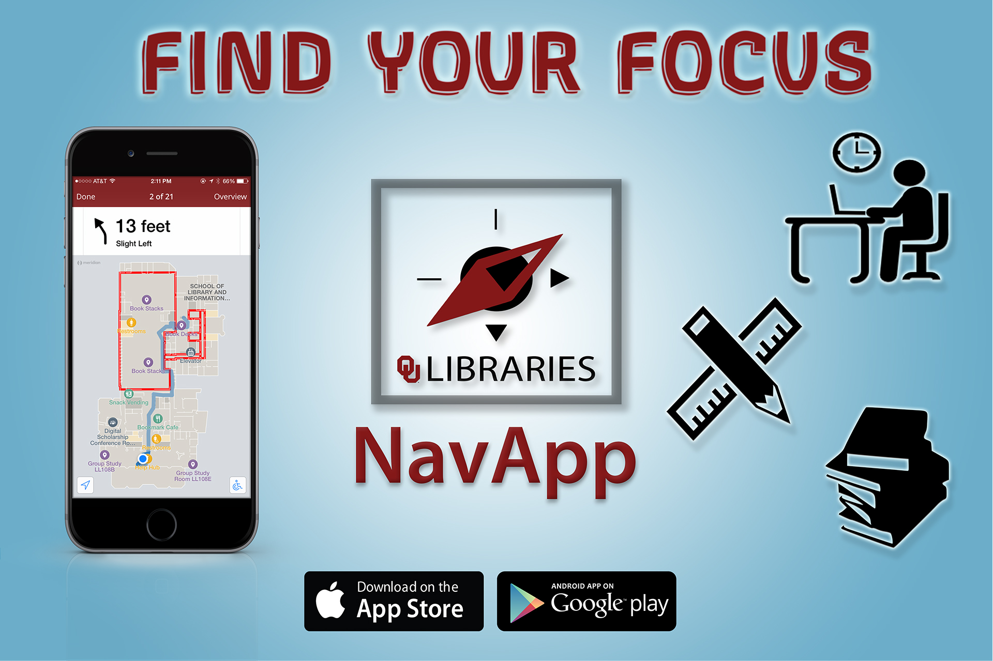
Skills
NavApp
“Emerging Technology”
Advertising
Vendor CFPs
Contests
Facilities maintenance
Scheduling, staffing, supporting events
Credit: University of Oklahoma Libraries

Slide 15
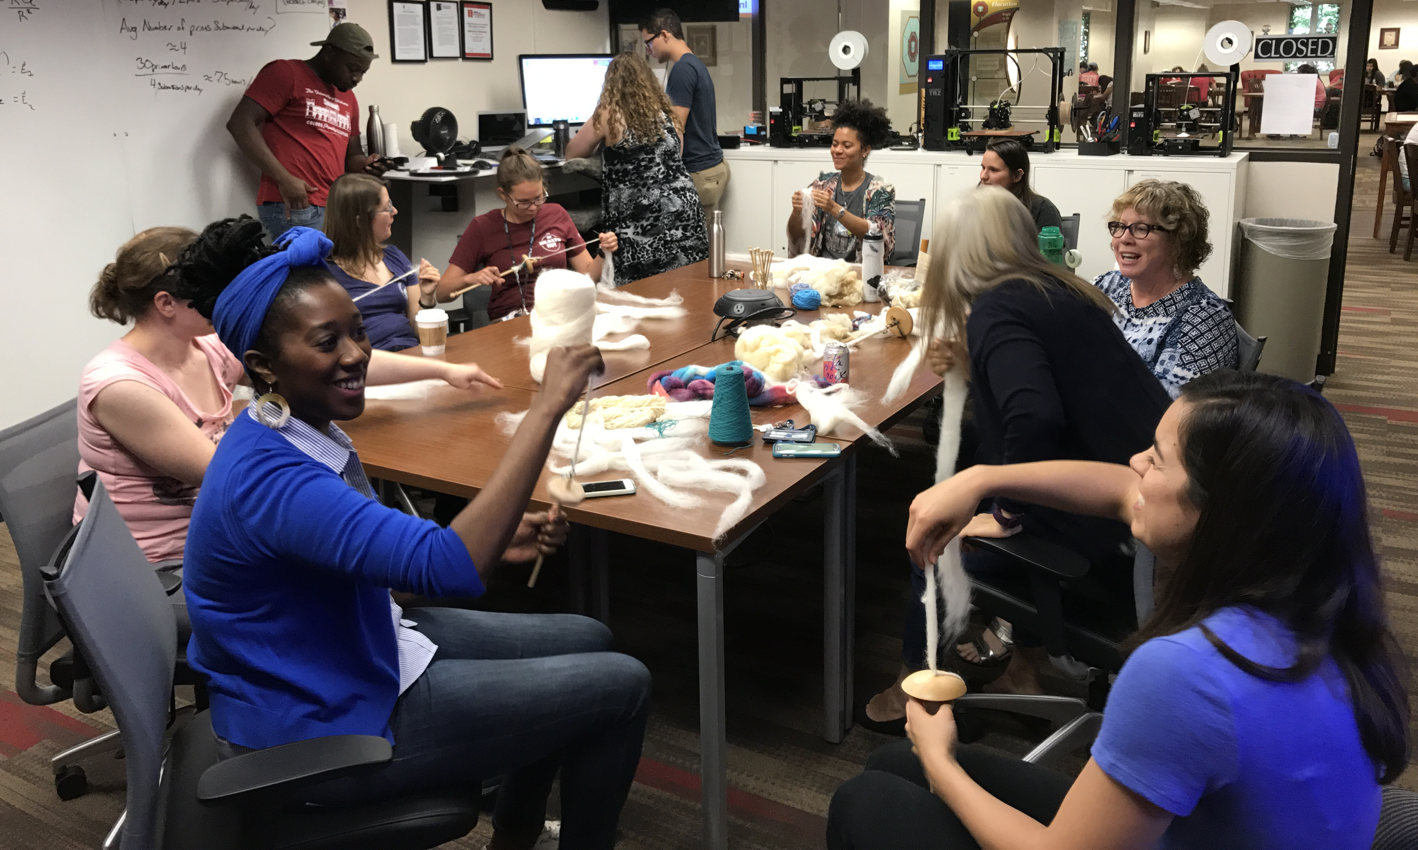
The Makerspace
Notes:
Pref

Slide 16
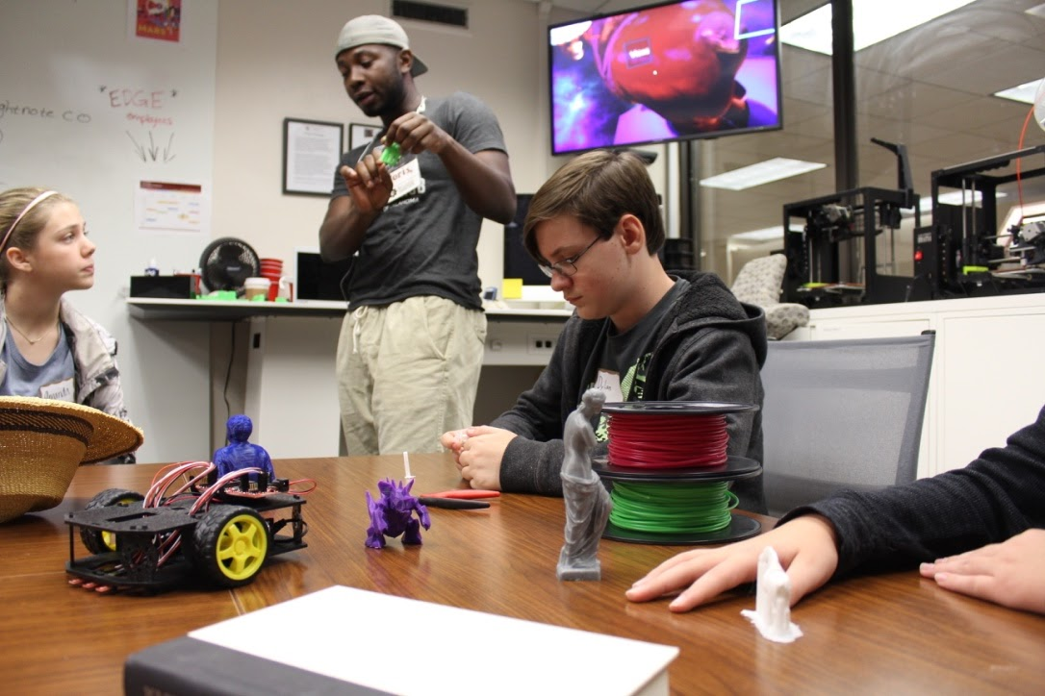
Background
Demystifying technology
Discipline agnostic
Entry-level workshops
Nothing dangerous
Customer-service oriented
Core Technologies
Microcontrollers
3D Printing
Virtual Reality

Slide 17
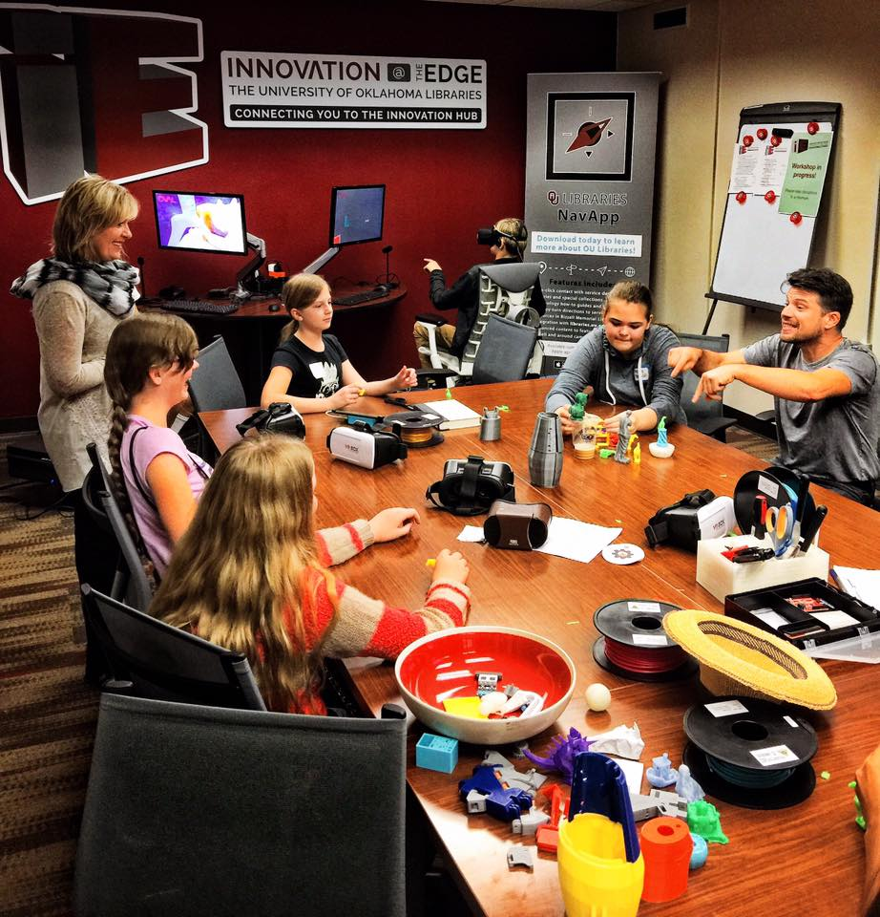
Use Cases
Course Integrations
25+ for-credit course modules per academic year
Outreach250+ unsolicited tech consultations
ArtEDGE
NPS/NPL
Onsite outreach
Rapid Prototyping
2000+ print submissions in 2018
Robotics, exhibits, etc.

Slide 18
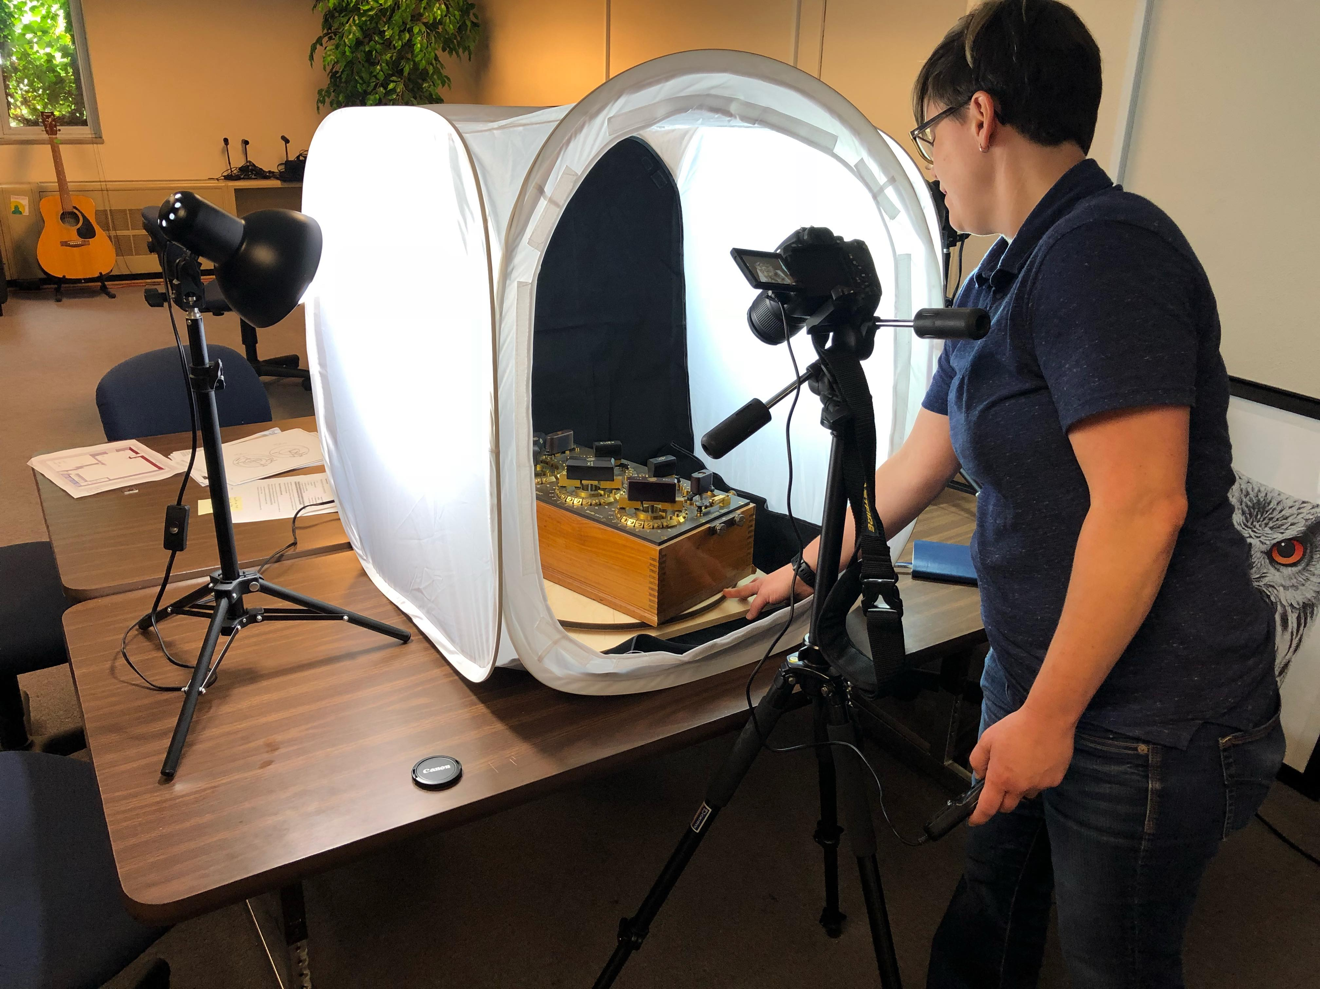
Innovation
3D Data Pipeline
Scanning as a service
Walk-in VR
https://github.com/OULibraries/OVAL2.0
Scaled (free) 3D printing
Portals Event Series
Archaic Cave
Palmyra
Sea Turtles of the World
Research
IMLS Lib3D/VR
ALA book Beyond Reality
Lischer‐Katz, Zack, Matt Cook, and Kristal Boulden. "Evaluating the impact of a virtual reality workstation in an academic library: Methodology and preliminary findings." Proceedings of the Association for Information Science and Technology 55, no. 1 (2018): 300-308.
Notes:
Lischer‐Katz, Zack, Matt Cook, and Kristal Boulden. "Evaluating the impact of a virtual reality workstation in an academic library: Methodology and preliminary findings." Proceedings of the Association for Information Science and Technology 55, no. 1 (2018): 300-308.

Slide 19
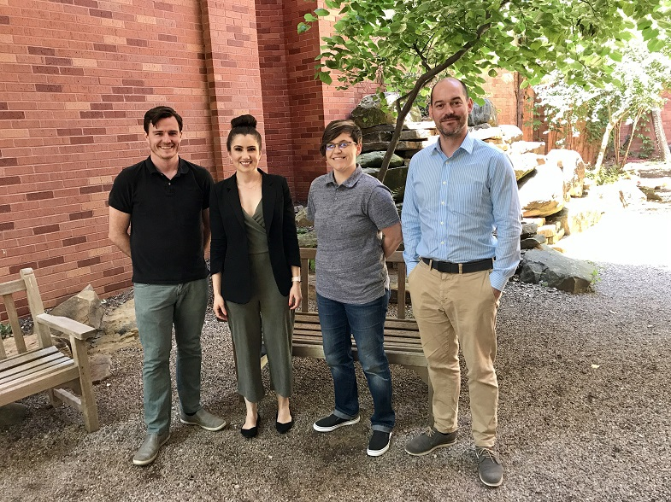
Skills
Building a Team
Hardware, software, outreach, theory.
Creative Generalists
Not all librarians
250+ unsolicited technology consultations per year
Private Sector, K12, non-OU
Cook, Matt, and Betsy Van der Veer Martens. "Managing Exploratory Units in Academic Libraries." Journal of Library Administration (2019): 1-23.

Slide 20
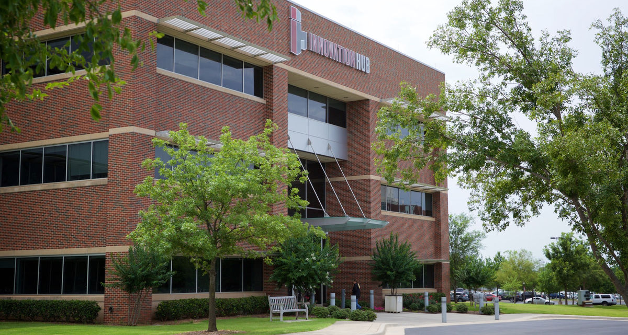
The Incubator
Credit: University of Oklahoma
Notes:
Pref

Slide 21
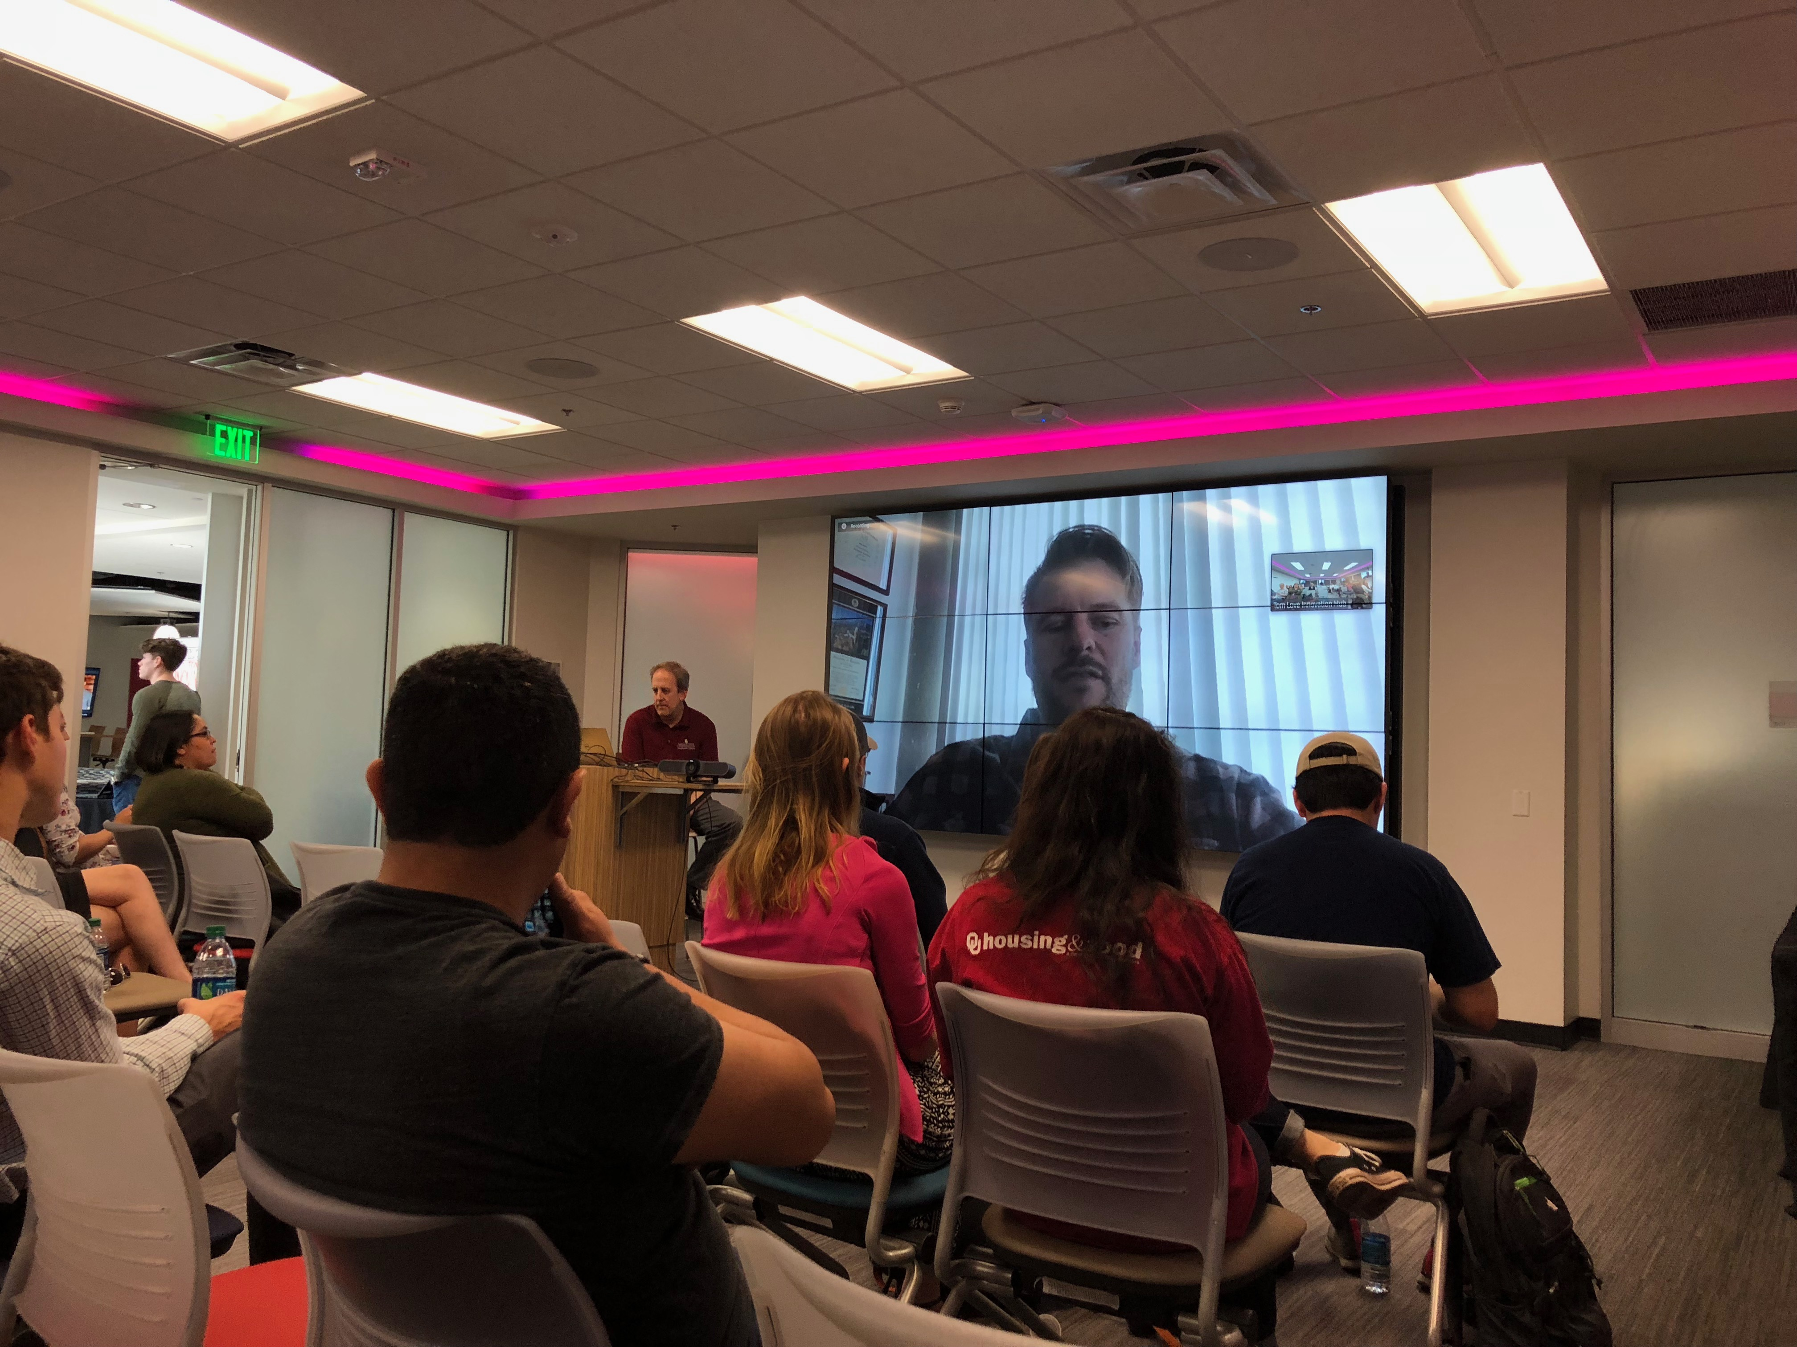
Background
Multi-College Space
Business
Engineering
Libraries
Entrepreneurial focus
OTD
CCEW
SBIR
Fabrication facilities
Heavier equipment

Slide 22
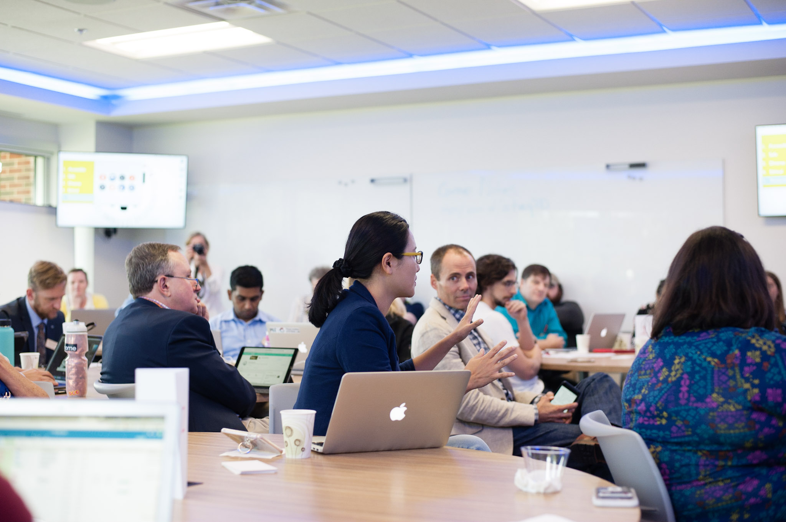
Use Cases
Prototyping
Wood/metal working
Laser cutting
3D printing
Electronics
Conferences
Course integrations
Grad Level
Credit: Ashley West Photography

Slide 23
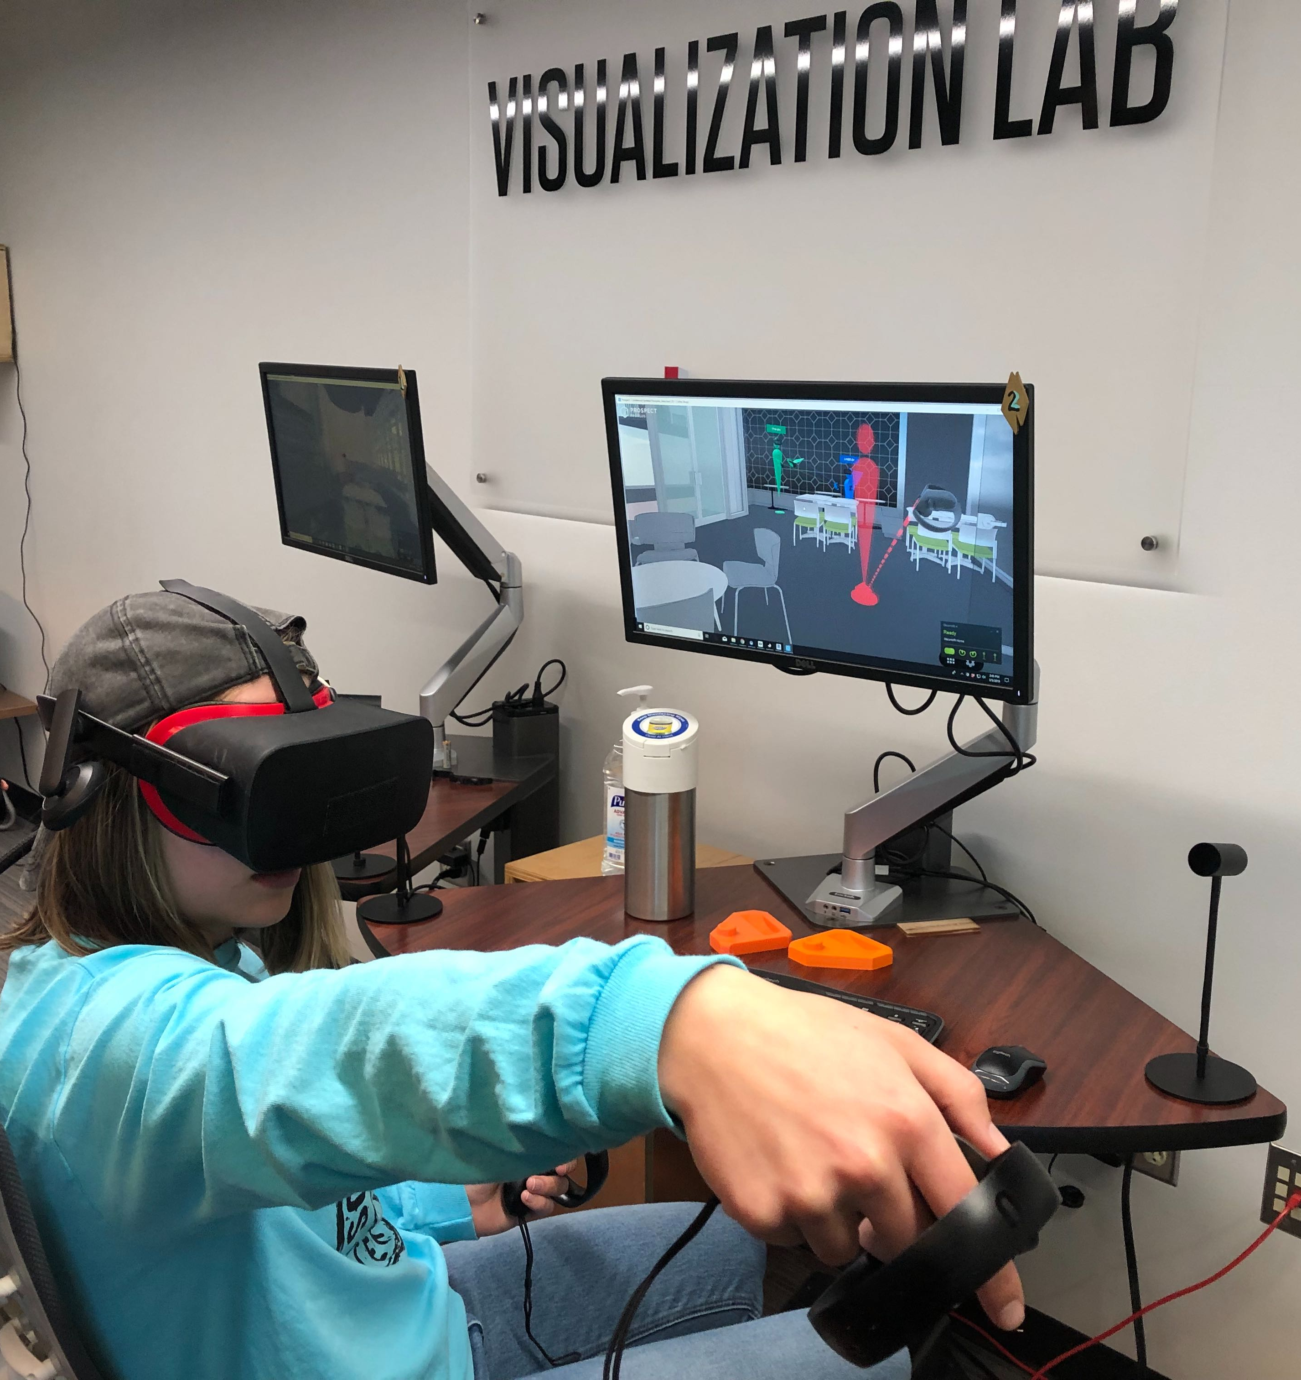
Innovation
VR-assisted pedagogy
Anthro 101, Biochemistry, Architecture Capstone, Medical Imaging
Working with faculty
Assessment metrics
Self-efficacy, Prior spatial abilities, Task performance, Economic analysis, Qualitative data (interviews)
Pober, Elizabeth, and Matt Cook. "Thinking in Virtual Spaces: Impacts of Virtual Reality on the Undergraduate Interior Design Process." International Journal of Virtual and Augmented Reality (IJVAR) 3, no. 2 (2019): 23-40.

Slide 24
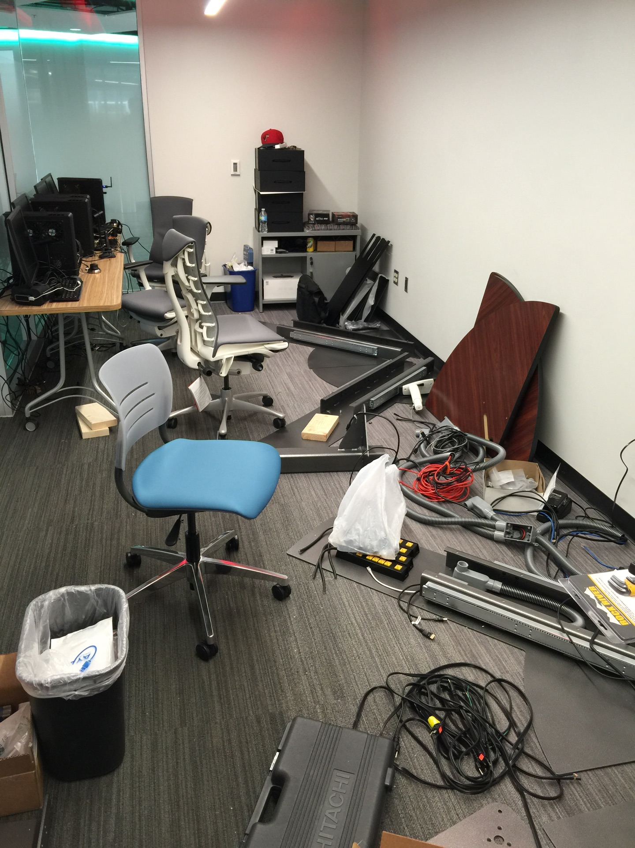
Skills
Hardware installation
Faculty Partnerships
Recurring integrations
Pedagogy and Assessment
Co-authorships and Co-Pis

Slide 25
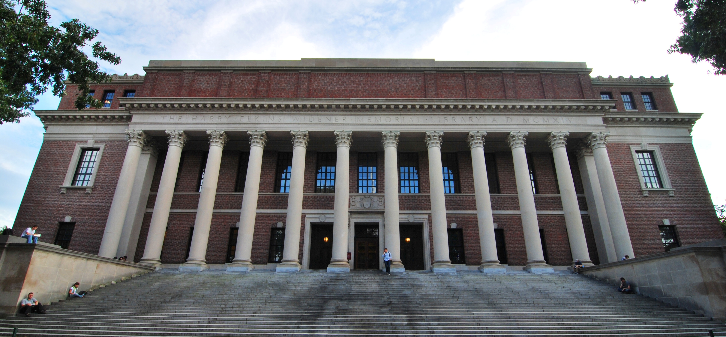
What’s Next
Credit: Harvard University
Notes:
Pref

Slide 26
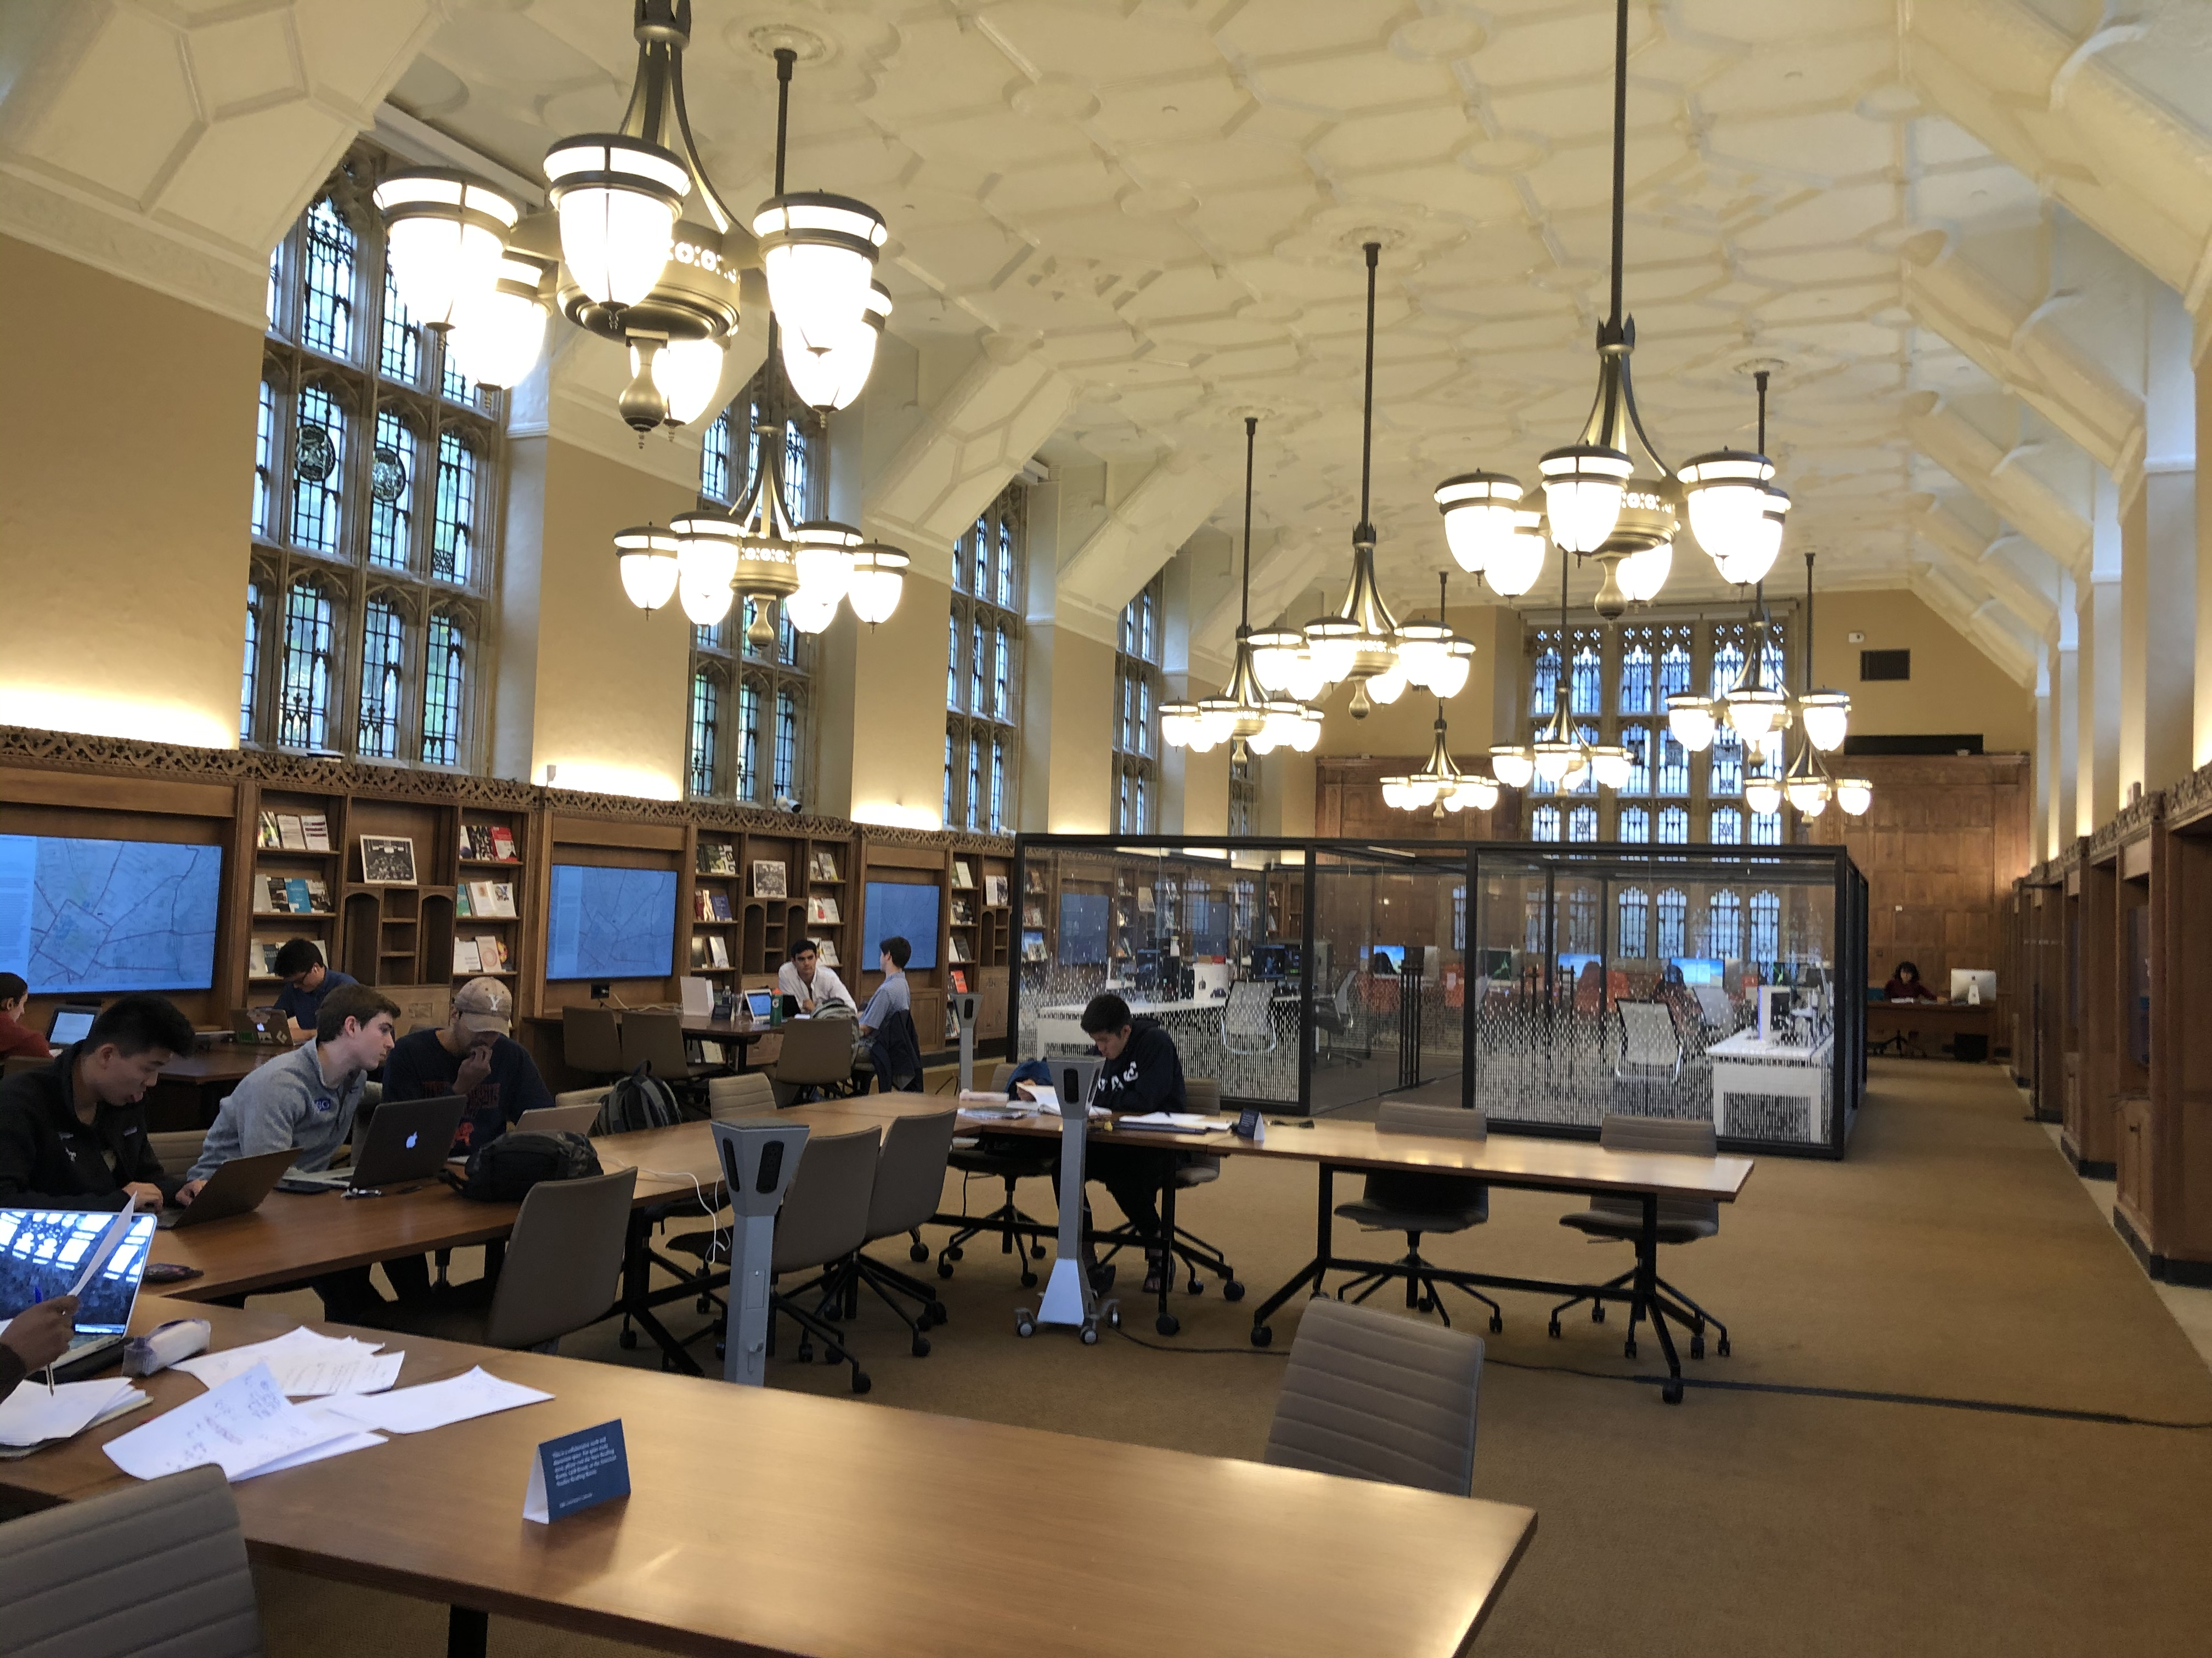
The Concept
Research data lifecycle
Faculty focus
Input/Output
Create, Understand, Share
Collections-oriented
“Demonstrator” projects
Central, location + concept
Connecting services/experts
Emergent Phenomena

Slide 27
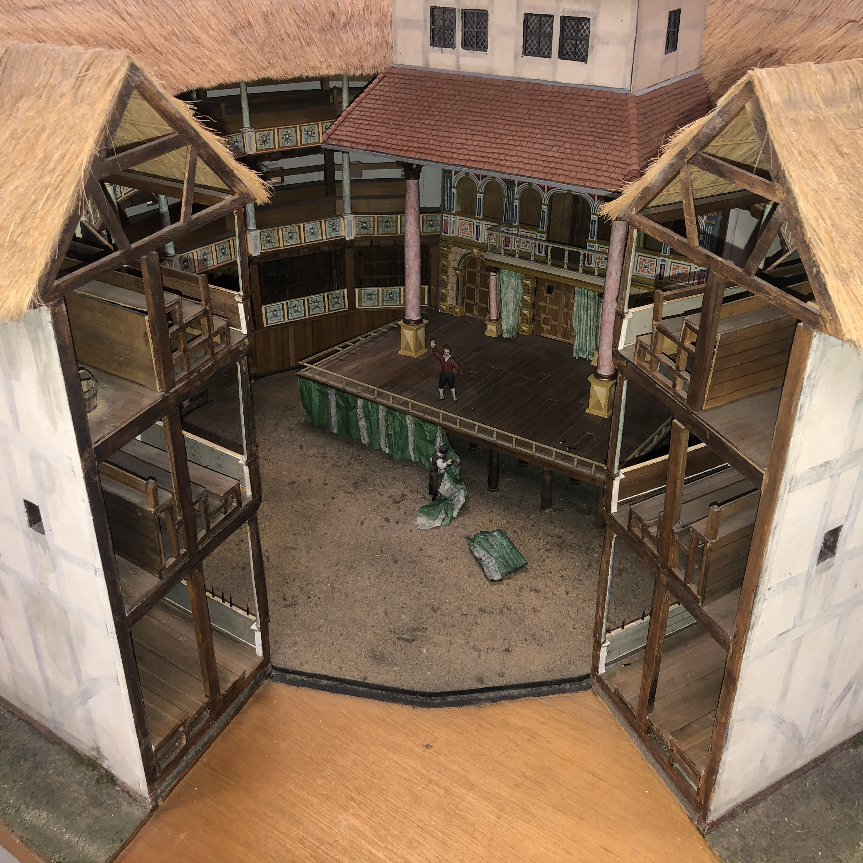
Use Cases
Artifact → Archive
Photogrammetry
AR/VR performance
Scalar and OSF deployment
Text → Web
Monograph OCR
Concept → Prototype
Electronics
3D printing
Sensors/Actuators

Slide 28
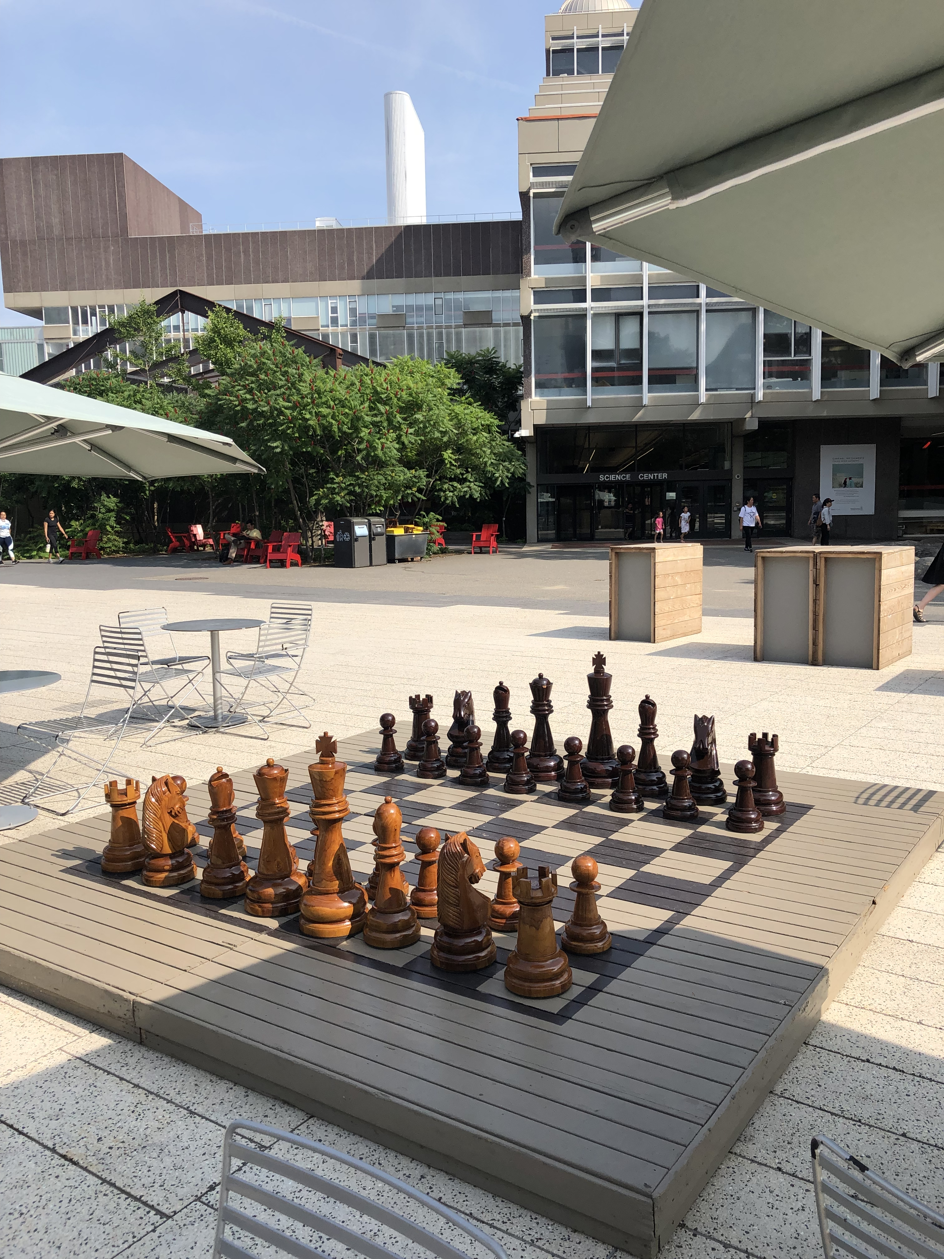
Skills
Institutional Knowledge
70 Libraries
700 FTE
400 year old institution
Emerging software tools
Computer vision/object recognition

Slide 29
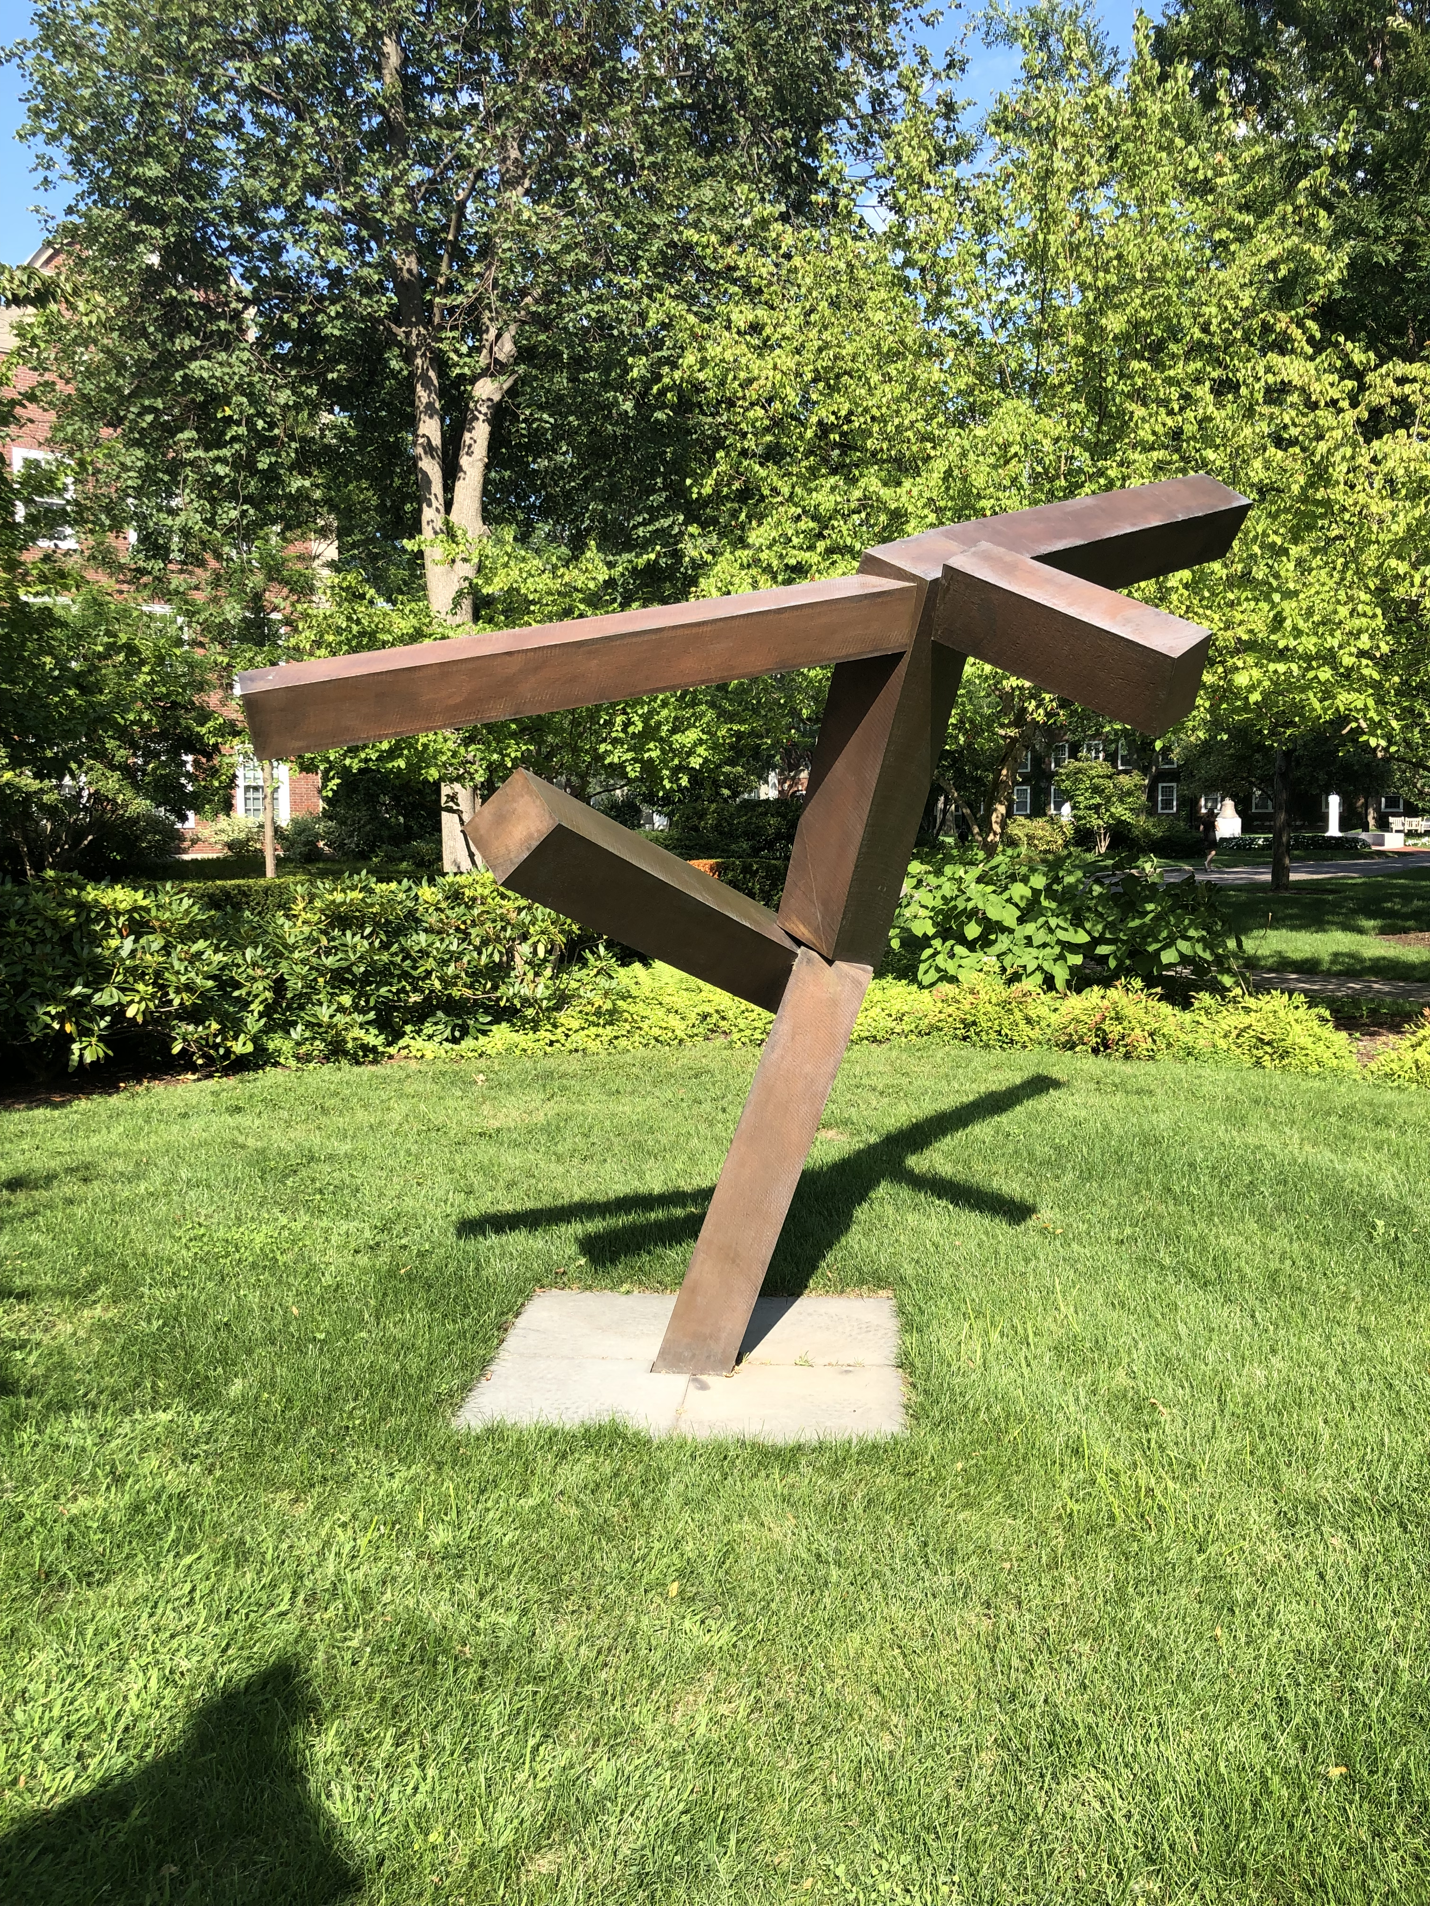
Takeaways
Management!
Faculty Partnership
Scaling Systems
R&D vs Support
Niche Applications
Knowledge Today

Slide 30
Thank you!
Matt Cook
Digital Scholarship Program Manager
matt_cook@harvard.edu
mncook.net

