Slide 1
Promoting Data Literacy Across Campus with Carpentries:
The Experience of
Three Librarians
Phillip Doehle, Kay Bjornen, & Madison Chartier
Edmon Low Library
Oklahoma State University

Slide 2
Outline
How The Carpentries improve data literacy
  What is data literacy?
  Why do students need data literacy?
  Learning through The Carpentries
  Exploring The Carpentries
History of the OSU Carpentries
  HPCC Launches the Carpentries
  How Carpentries came to OSU Libraries
  Current state of Carpentries at OSU
Future growth of the OSU Carpentries
  Improving instructor recruitment
  Diversifying lesson materials
  Encouraging Carpentry skills beyond Carpentry workshops
Summary

Slide 3
How the carpentries improve data literacy
Kay K Bjornen, PhD
Research Data Initiatives Librarian
Visiting Assistant Professor

Slide 4
What is Data Literacy?
“…knowledge and skills involved in collecting, processing, managing, evaluating, and using data for scientific inquiry.”
https://nnlm.gov/data/thesaurus/data-literacy

Slide 5
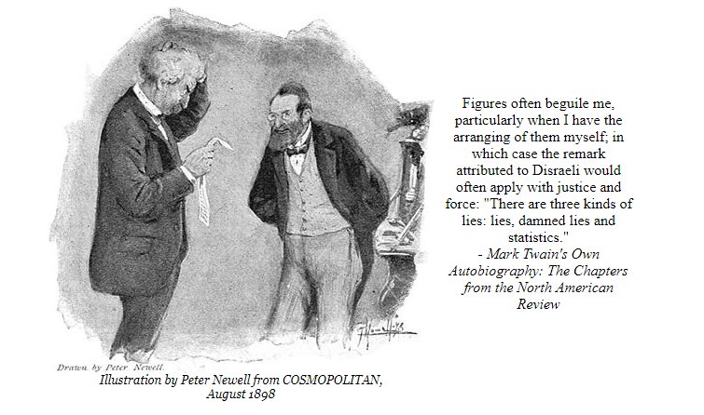
Mark Twain and Disraeli had it right!
http://www.twainquotes.com/Statistics.html
Notes:
We are bombarded with data and statistics and being data literate allows us to effectively interpret messages that may be slanted or just meaningless.

Slide 6
Why do Students Need Data Literacy?
1) To become competent data consumers
“…the number of abstracts in the database in 1957 was 2,232,688 and grew to 17,627,459 in 1997, a 690% jump. However, the growth slowed down in the last two years. The number of abstracts in 1999 was 19,029,012 and 19,754,012 in 2000, a growth of only 3.81%.”
Ibironke O. Lawal MA, BSc, PGDipLib (2001) Integrating Chemical Information into the Undergraduate Curriculum, Science & Technology Libraries, 20:1, 43-57, DOI: 10.1300/J122v20n01_03
Notes:
With regard to making an argument with data, this paragraph does it badly in so many ways.
Kind of makes an argument for “information literacy is not enough” because this is in the opening paragraph of an article entitled “Integrating Chemical Information into the Undergraduate Curriculum: Information Literacy and a Change in Pedagogy”. The author was trying to make the argument that information literacy is an important part of education and that chemical information is expanding rapidly. Or I think that is what he was trying to emphasize. However, the data that he used to make his point may be factually correct but the argument is lost because he compares numbers from a 40 year period to numbers from a 2 year period. Huh? It’s a textbook case of trying to make a case with statistics and failing miserably.
And by the way, a fast review of the literature around instruction of chemical information indicates that educators are not doing enough of that either.

Slide 7
Why do Students Need Data Literacy?
2) To enhance their job skills and employability
From a Forbes blog post: “Why All Employees Need Data Skills in 2019 (And Beyond)”
“Data isn’t used in a vacuum: it touches many other roles, and those employees need the literacy to handle it effectively.”
https://www.forbes.com/sites/laurencebradford/2018/10/11/why-all-employees-need-data-skills-in-2019-and-beyond/#5d3d7f21510f
Notes:
This Forbes blog post examines the increased use of data in a variety of roles within businesses. In order for the whole organization to be effective, everyone must be capable of using data to make decisions.

Slide 8
Greater exchange, storage & use of accessible data
An interdisciplinary workforce with new and evolving skills
Increasing analytical and computing power
More decision making based on data science techniques
https://royalsociety.org/-/media/policy/projects/dynamics-of-data-science/dynamics-of-data-science-skills-report.pdf

Slide 9
Why do Students Need Data Literacy?
More advanced skills are needed for research & graduate education:
  Documentation and metadata
  Version control
  Software for data analysis, cleaning & visualization
  Data preservation
Notes:
This Forbes blog post examines the increased use of data in a variety of roles within businesses. In order for the whole organization to be effective, everyone must be capable of using data to make decisions.

Slide 10
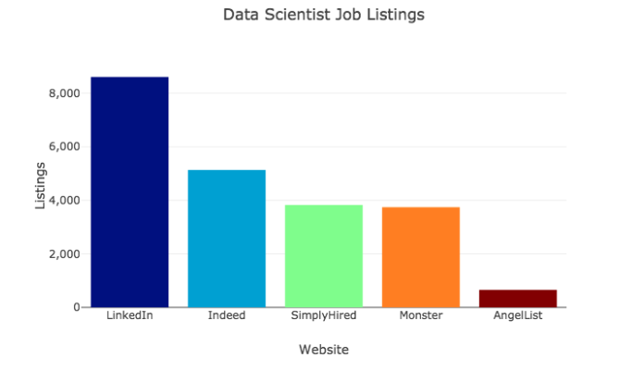
One Day’s Snapshot of Data Science Job Listings - October 10, 2018
https://towardsdatascience.com/the-most-in-demand-skills-for-data-scientists-4a4a8db896db

Slide 11
Dynamics of Data Science Skills: How Can All Sectors Benefit from Data Science Talent?
-A 2019 Report from The Royal Society
“In higher education further consideration is needed about how universities can teach data science effectively, and integrate it into university curricula as a developing and interdisciplinary set of skills and methodologies”
https://royalsociety.org/-/media/policy/projects/dynamics-of-data-science/dynamics-of-data-science-skills-report.pdf
Notes:
Studies have shown that faculty stru

Slide 12

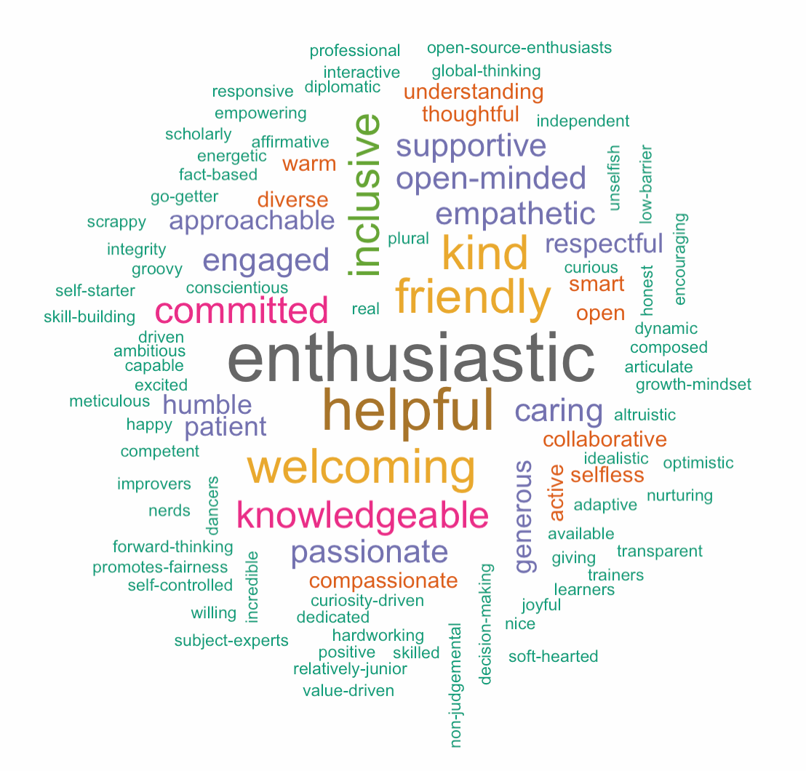
"Our vision is to be the leading inclusive community teaching computing and data skills.”
Accessible
Inclusive
Openly available
High-quality curricula
Volunteer driven
Certified instructors
Notes:
We are dedicated to providing a welcoming and supportive environment for all people, regardless of background or identity. By participating in this community, participants accept to abide by The Carpentries’ Code of Conduct and accept the procedures by which any Code of Conduct incidents are resolved. Any form or behaviour to exclude, intimidate, or cause discomfort is a violation of the Code of Conduct. In order to foster a positive and professional learning environment we encourage the following kinds of behaviours in all platforms and events:
Use welcoming and inclusive language
Be respectful of different viewpoints and experiences
Gracefully accept constructive criticism
Focus on what is best for the community
Show courtesy and respect towards other community members
If you believe someone is violating the Code of Conduct, we ask that you report it to The Carpentries Code of Conduct Committee completing this form, who will take the appropriate action to address the situation.

Slide 13
The Carpentries Code of Conduct
We are dedicated to providing a welcoming and supportive environment for all people, regardless of background or identity. By participating in this community, participants accept to abide by The Carpentries’ Code of Conduct and accept the procedures by which any Code of Conduct incidents are resolved. Any form or behaviour to exclude, intimidate, or cause discomfort is a violation of the Code of Conduct. In order to foster a positive and professional learning environment we encourage the following kinds of behaviours in all platforms and events:
Use welcoming and inclusive language
Be respectful of different viewpoints and experiences
Gracefully accept constructive criticism
Focus on what is best for the community
Show courtesy and respect towards other community members
Notes:
If you believe someone is violating the Code of Conduct, we ask that you report it to The Carpentries Code of Conduct Committee completing this form, who will take the appropriate action to address the situation.

Slide 14
Learning through The Carpentries
Data Cleaning – OpenRefine
Data Organization – Using Spreadsheets
Data Management - SQL
Data Analysis and Visualization - Python and R
Versioning - Git
Automation - Unix Shell

Slide 15
https://carpentries.org/testimonials/
“Data Carpentry opened up a whole new world for me. I was doing Biology during my undergraduate studies, which didn’t include any formal training in computational skills. Suddenly, I was drowning in big data during my postgrad and had no clue how to work with this type of data. Since attending my first Carpentry workshop, I have learned most of the tools taught by The Carpentries, qualified as an instructor, and have taught at five Data Carpentry workshops, as well as three one-day R workshops. Obviously, I am now very passionate about teaching these tools to researchers who find themselves in the same situation I did. I also feel confident and competent to analyze various types of data, which helped gain me a post-doctoral fellowship in Pharmaceutics.”
Bianca Peterson is conducting kinetic analyses of extemporaneously compounded medicines at the Centre of Excellence for Pharmaceutical Sciences (Pharmacen), North-West University, South Africa.

Slide 16
Explore the Carpentries
https://carpentries.org
Attend a workshop
Become an instructor
Organize workshops at your institution
Contribute through the Carpentries organization.

Slide 17
History of the OSU Carpentries
Phillip Doehle, MS
Digital Services Librarian
Assistant Professor

Slide 18

Software Carpentry Comes to the OSU Library
May 2015—Software Carpentry comes to OSU
March 2016—First self-hosted workshop
May 2016—Second self-hosted workshop

Slide 19
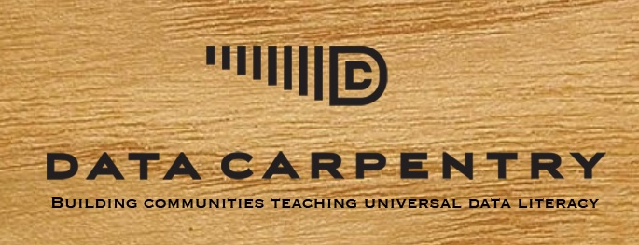
Data Carpentry Comes to the OSU Library
July 2017—Host our inaugural Data Carpentry Workshop using Python Curriculum
October 2017—Two-part R workshop
August 2018—Carpentries Inspired Workshop

Slide 20
OSU Libraries’ Participation Since 2015
OSU has hosted 23 workshops (24th is happening today)
Run in multiple formats to accommodate demand
5th-year anniversary
How has it gone?

Slide 21
Carpentries was a Natural Fit at OSU Libraries
The library has provided facilities
Enthusiastic response from library staff and strong support from administration was vital
The library acted as a central hub
OSU Library’s involvement with the Carpentries

Slide 22
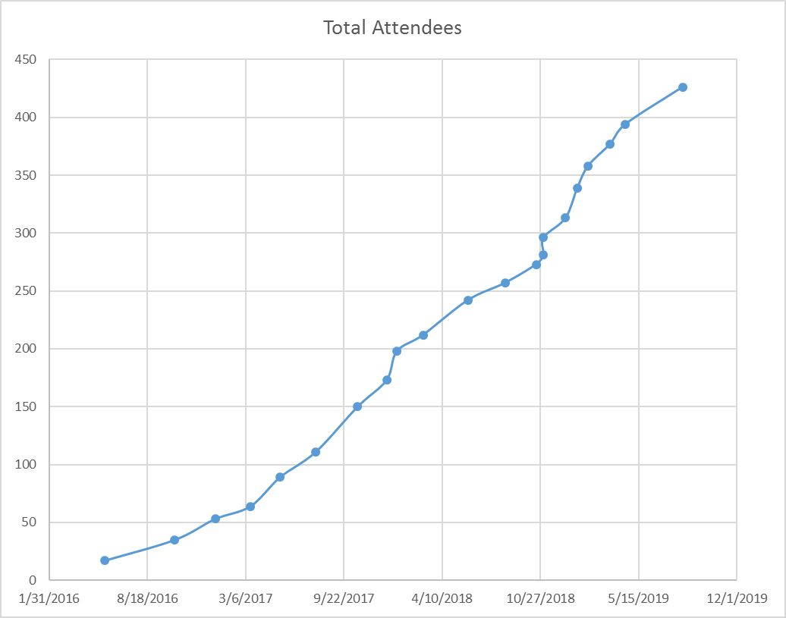

Slide 23
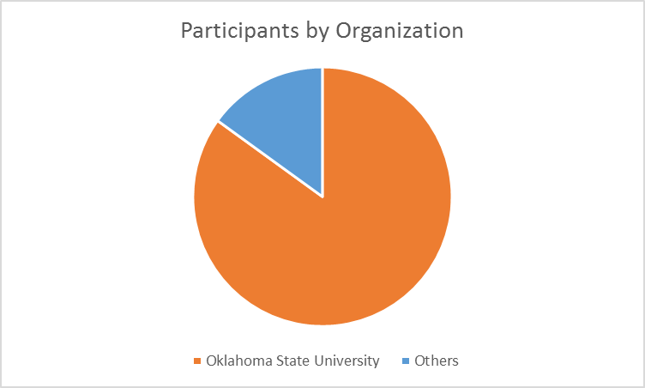

Slide 24
Other Institutions
Florida International University
Great Plains Network
Kansas City University of Medicine and Biosciences
Noble Research Center
Oklahoma Baptist University
Oklahoma Department of Career Teach
Rogers State University
The Land Institute
University of Arkansas
University of Central Oklahoma
Military
Kansas State University
Langston University
Southwestern Oklahoma State University
University of Oklahoma
Laureate Institute for Brain Research
University of Tulsa

Slide 25
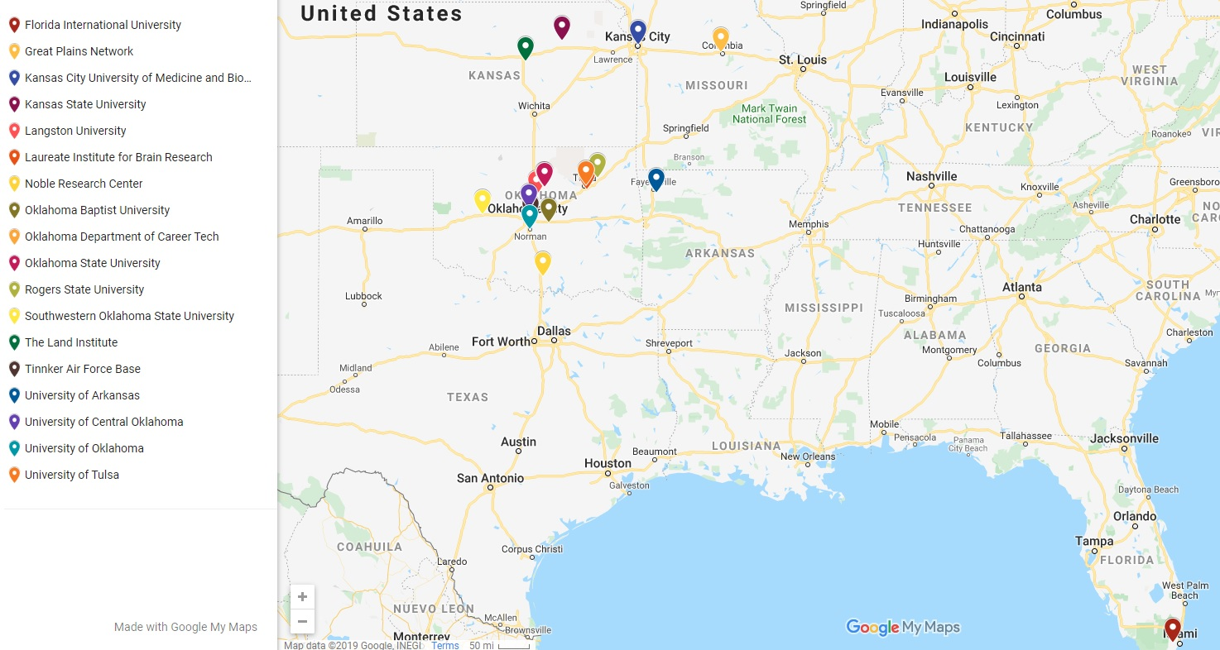
Other Institutions

Slide 26
future Growth of the OSU Carpentries
Madison Chartier, MLS
Metadata Librarian
Assistant Professor

Slide 27
Growing OSU Carpentries
Successes
Improvements
Library’s support
Established administrative team
Active volunteers
Regular workshop schedule
  Monthly workshops
  Data & Software Carpentries
Instructors
  See more instructors certified
  Increase available instructors
Campus-wide impact
  Draw more participants from across the university
  Use lesson plans to more disciplines
How do we sustain what we’ve built?
How do we enhance what we’ve built?

Slide 28
The Bedrock of
OSU Carpentries
Solid lesson plans
  Live-coding examples
  Real-life datasets
  Demonstrable application to multiple disciplines
Active instructor team
  Lead workshops
  Review and maintain lesson materials
  Regularly recruit and train new instructors
Fresh, diverse perspectives bring new insights and lesson updates.

Slide 29
Our Future Goals
1) Improve instructor recruitment
  Help more volunteers complete training
  See new instructors lead more workshops
  Increase engagement
2) Diversify lesson material
  Target more disciplines
  Attract broader range of volunteers
  Increase campus-wide involvement
… 3) Create post-workshop support
Sustain our team by growing our team.

Slide 30
Improve instructor recruitment
1)

Slide 31
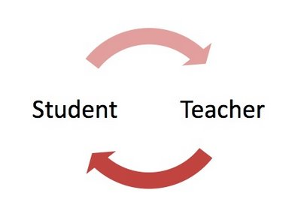
Why Internal
Recruitment Matters
Workshop participants are the future!
  Firsthand experience of curriculum structure
  Reflect on learning experience
    What worked well?
    When did I struggle?
    Why?
  Apply student experience to instructor role
Image retrieved from: “Science of Education: Student—Teacher.” [Blog post]. (5 Nov. 2013). Retrieved from: https://kkcd.wordpress.com/2013/11/05/science-of-education-2/
Learn <–> Comprehend <-> Apply

Slide 32


Instructor Requirements
1) Participate in a workshop
2) Assist in a workshop
Image retrieved from: Minsky, C. (9 Dec. 2016). “Best universities in the world for learning to code.” Times Higher Education. Retrieved from: https://www.timeshighereducation.com/student/news/best-universities-world-learning-code
Image retrieved from: Ramsdell, D. (10 April 2019). “Why college peer tutoring works.” [Blog post]. Retrieved from: https://www.joinknack.com/blog/2019/04/10/why-college-peer-tutoring-works/
A comfortable transition…

Slide 33
Certified Instructor Training
2-Day Workshop
3 Follow-Up Tasks
  Lesson Recommendation
  Community Discussion
  Live Demo
Lead First Workshop
3 months to complete follow-up tasks.
Teach first workshop within a year.

Slide 34

Our Problem…
  …not everyone completes their training.
How to motivate volunteers to complete their certification?
Image retrieved from: TNN. (13 May 2019). “Whould you ask for an extension of deadline? This is the right answer.” Times of India. Retrieved from: https://timesofindia.indiatimes.com/life-style/health-fitness/de-stress/should-you-ask-for-an-extension-of-a-deadline-this-is-the-right-answer/articleshow/69308114.cms

Slide 35
Our Solution…
To complete 3 tasks:
To lead 1st workshop:
Establish consistent communication
  Track progress
  Deadline reminders
  Answer questions
Hold practice sessions for live demo
Give newly certified instructors teaching priority
  First consideration
  Immediate involvement
  Community incorporation
Create a system of support.
Create a positive environment.

Slide 36
Diversify lesson material
2)

Slide 37
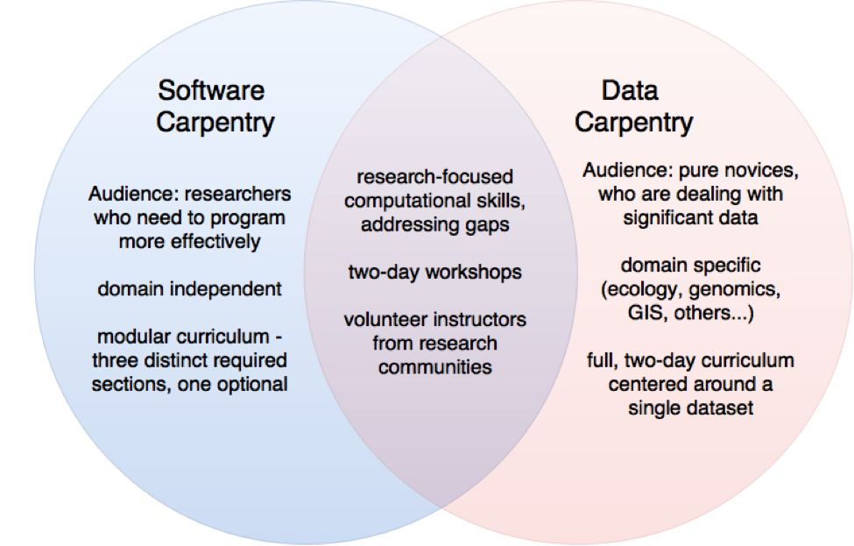
Lesson Material Already Available!
Image retrieved from: van Gelder, C. (n.d.). “Software and data carpentry.” Dutch Techcentre for Life Sciences. Retrieved from: https://www.dtls.nl/training-and-education/software-data-carpentry/
Explore more domains → Expand our appeal

Slide 38

Explore and Experiment
Spring 2020, initiating genomics workshop
Inaugural trial
  Measure student reaction and interest
  See disciplines represented
  Compare to ecology workshops
Explore further expansion
Image retrieved from: Baron, J. (22 Oct. 2018). “Don’t believe the headline hype when it comes to genomic research.” Forbes. Retrieved from: https://www.forbes.com/sites/jessicabaron/2018/10/22/dont-believe-the-headline-hype-when-it-comes-to-genomics-research/#622176486e5c
Nothing tried, nothing gained.

Slide 39
Create post-workshop support
3)

Slide 40

Encourage Carpentry Skills…
Image retrieved from: “Little Lake Health Center Continues Tradition of Brown Bag Lunches.” (Jan. 2015). MCHC Health Centers. Retrieved from: https://www.mchcinc.org/news/whats-happening/little-lake-health-center-brown-bag-lunches/
…BEYOND Carpentry Workshops!

Slide 41
Collateral Impact
Present reality
Future hope
Low attendance
Few instructors available
Not all instructors can answer certain questions
Appeal to more disciplines
Hold Brown Bags more regularly
Have more instructors, more experience, more answers
Create resonating impacts with targeted improvements.

Slide 42
Summary
OSU Carpentries is a continued work in progress.
  We had a need: Data literacy
  We established a foundation: OSU Libraries
  We keep growing and exploring.
    More instructors
    Broader discipline appeal
Keep answering campus needs by spreading campus impact
Discover new ways to spread data literacy
Create a solution; leave a legacy.

Slide 43
Thank you!
Are there any questions?

