Slide 1
Changing Hats, Changing Resources: Altering the Perception of the Academic Librarian
Presented by: Kaitlin Crotty, Alan Lawless, and Michelle Owens
While we’re waiting to being, please join our session by texting the code RSULIBRARIES500 to the number 37607

Slide 2
Notes:
Poll Title: What has been your favorite part of today's conference so far? https://www.polleverywhere.com/multiple_choice_polls/eFouEe7b1idHT6BmYk486

Slide 3
Poll Everywhere

Slide 4
Poll Everywhere
Have you ever used RSU Libraries before?
Where do you usually search for information?

Slide 5
Notes:
Poll Title: Where do you usually search for information? https://www.polleverywhere.com/free_text_polls/kulgScZ3XH081otxsTtp8

Slide 6
Poll Everywhere
Have you ever used RSU Libraries before?
Where do you usually search for information?
How confident would you feel RIGHT NOW if you needed to use RSU Libraries for research?
What filters are you most likely to use when searching for journal articles?
How often do you use e-Books?
After what you’ve learned today, how confident do you feel now about using RSU Libraries for research?

Slide 7
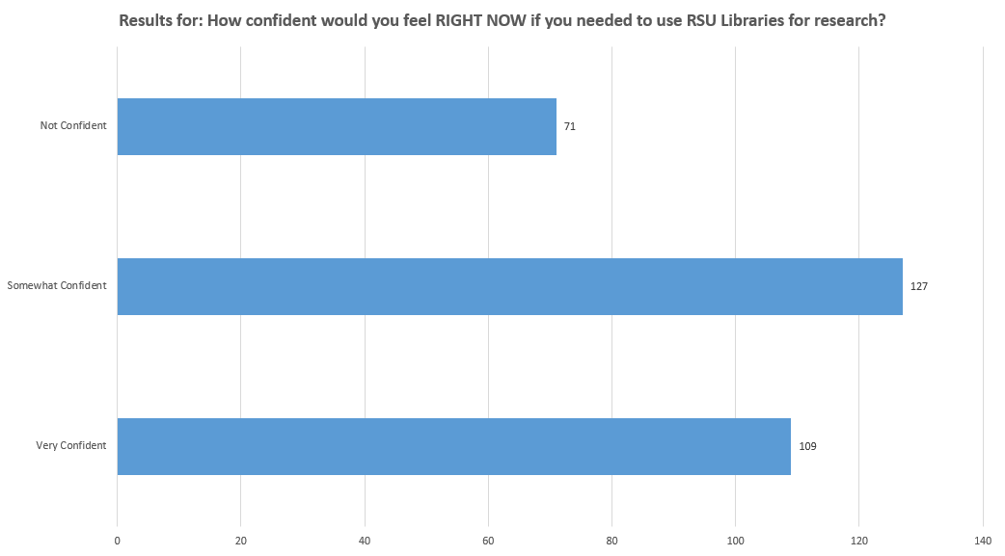
Poll Everywhere

Slide 8
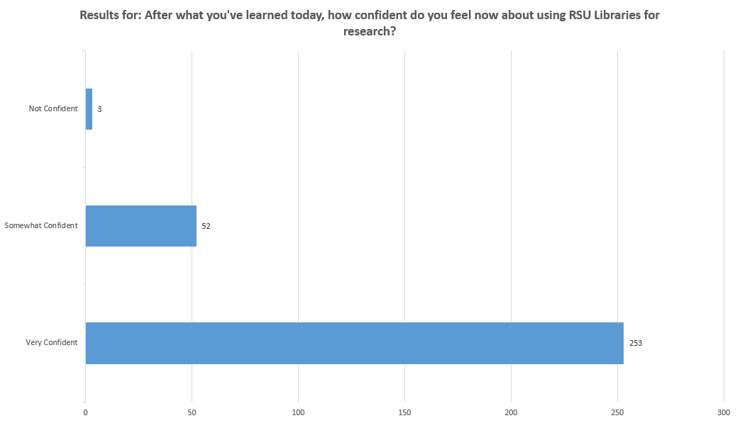
Poll Everywhere

Slide 9
Notes:
Poll Title: Do you feel Poll Everywhere, or a similar interactive system, would be useful in your own library instruction/information literacy sessions? https://www.polleverywhere.com/multiple_choice_polls/QD1FQbEJp1BCjmr71NRL0

Slide 10
Notes:
Poll Title: Do you believe that the Library plays a role in the successful retention of students? https://www.polleverywhere.com/multiple_choice_polls/UbXlOMaisKx794NWCsfOa

Slide 11
Notes:
Poll Title: Do you believe that recruitment is everyone's job? https://www.polleverywhere.com/multiple_choice_polls/OEUFCFS3LjouM79yBHllZ

Slide 12
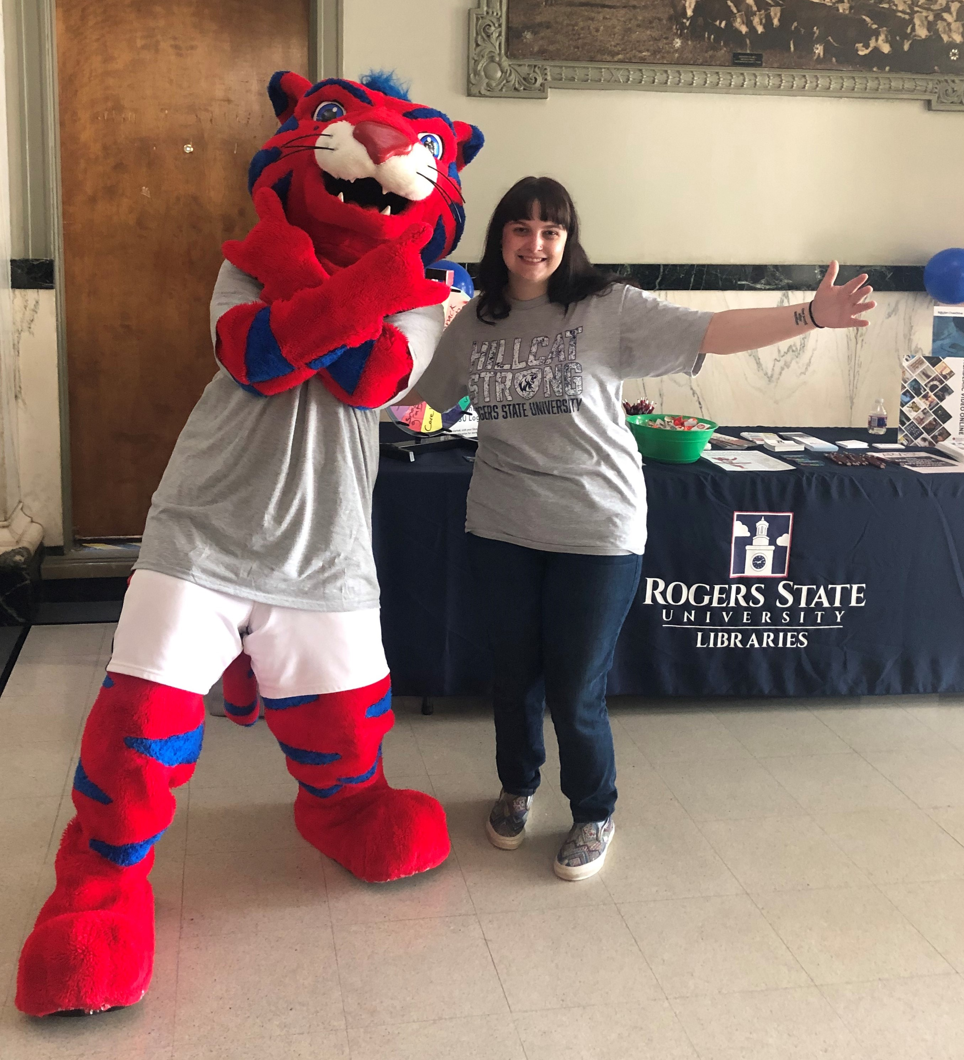
Collaboration With Enrollment & Retention
Motivations: Altruism and Practicality
Practical: Our operations budget is directly impacted by the amount of Library Fees that are paid into the university each fiscal year.
Altruistic: After numerous research appointments students who didn’t have clue how to use our simple search box, much less complete a decent Google search, and hearing Faculty continuously complain about how incoming students were woefully unprepared, we decided to take matters into our own hands.

Slide 13
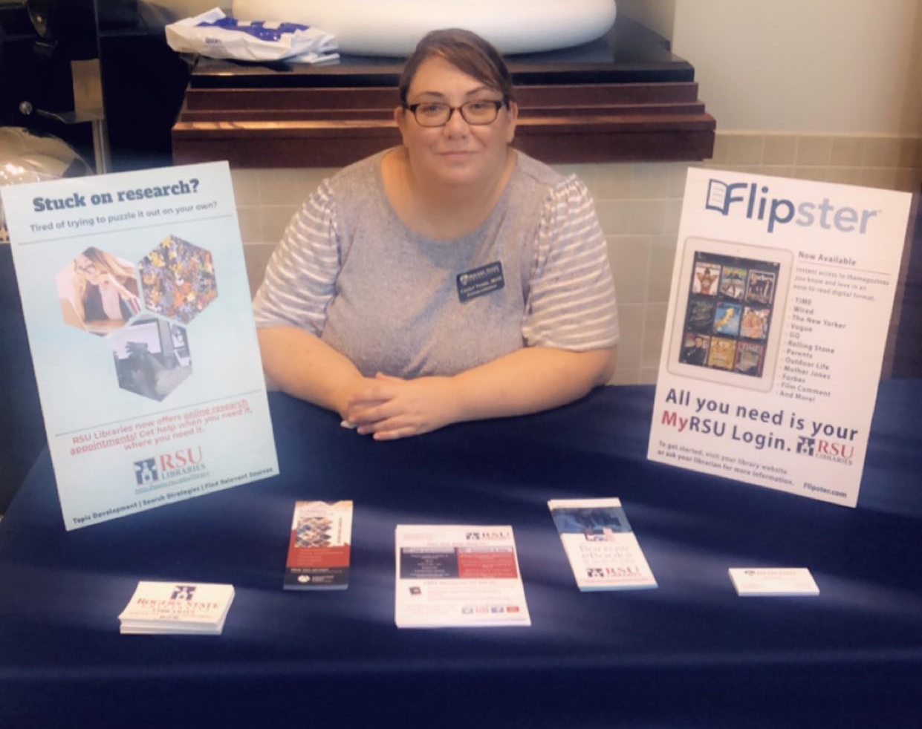
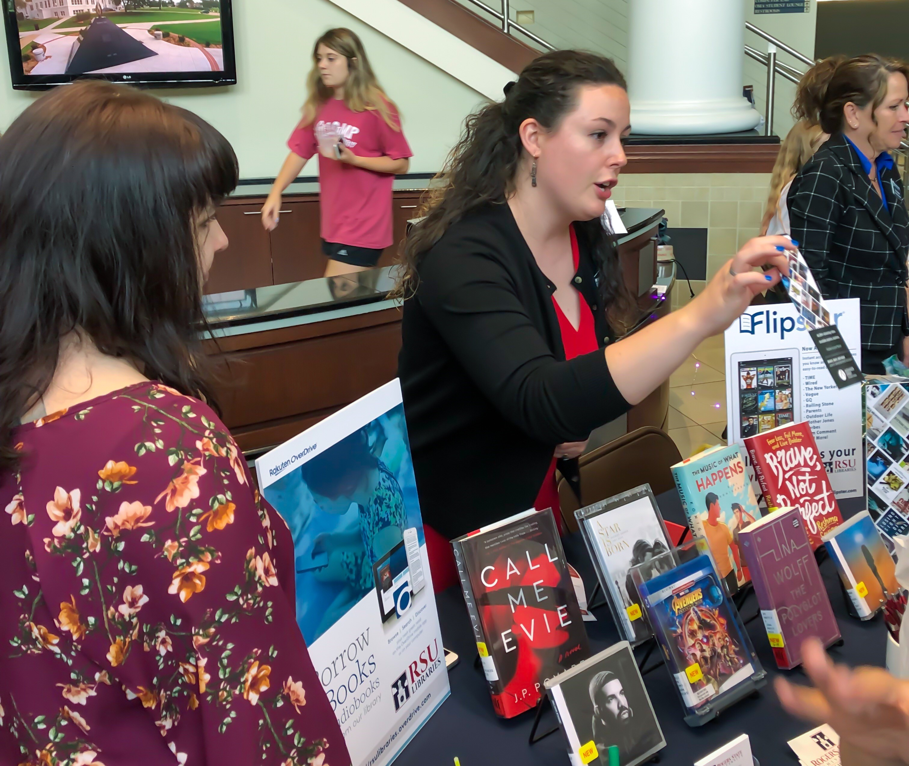
Collaboration With Enrollment & Retention
The Library as a Promotional Tool
What does this mean?
We need to have a strong, recognizable department brand
We need to make sure our promotional materials are part of the packet that every student gets when they enroll
We need admissions and retention to know what we do and what we are capable of
We need to be at admission and recruitment events on our campuses
We need to be aware of and participate in the tours that come through the library
We need to build relationships with local high schools

Slide 14
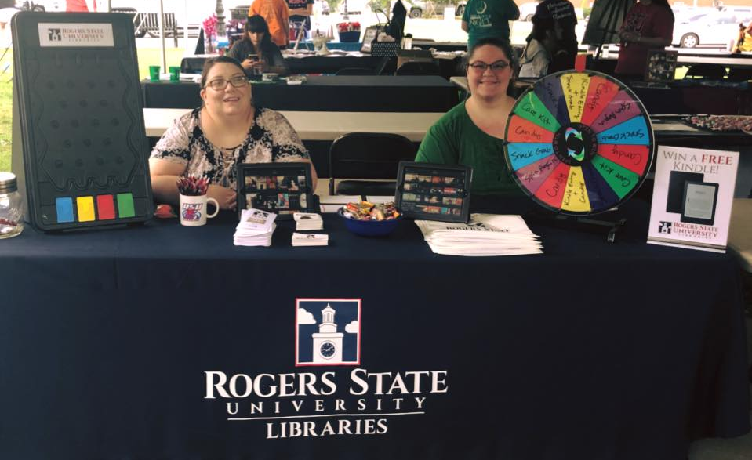
Collaboration With Enrollment & Retention
Where did we start? Research, of course.
Oakleaf, M. J., & Association of College and Research Libraries. (2010). The value of academic libraries: A comprehensive research review and report. Chicago, Ill: American Library Association
“Future assessments of library performance should be defined and shaped by its connections and contributions to outcomes associated with student social and academic integration, including enhancement of student/library faculty interaction and the development of student information skills to positively impact student academic success, as well as institutional goals, such as retention.”

Slide 15
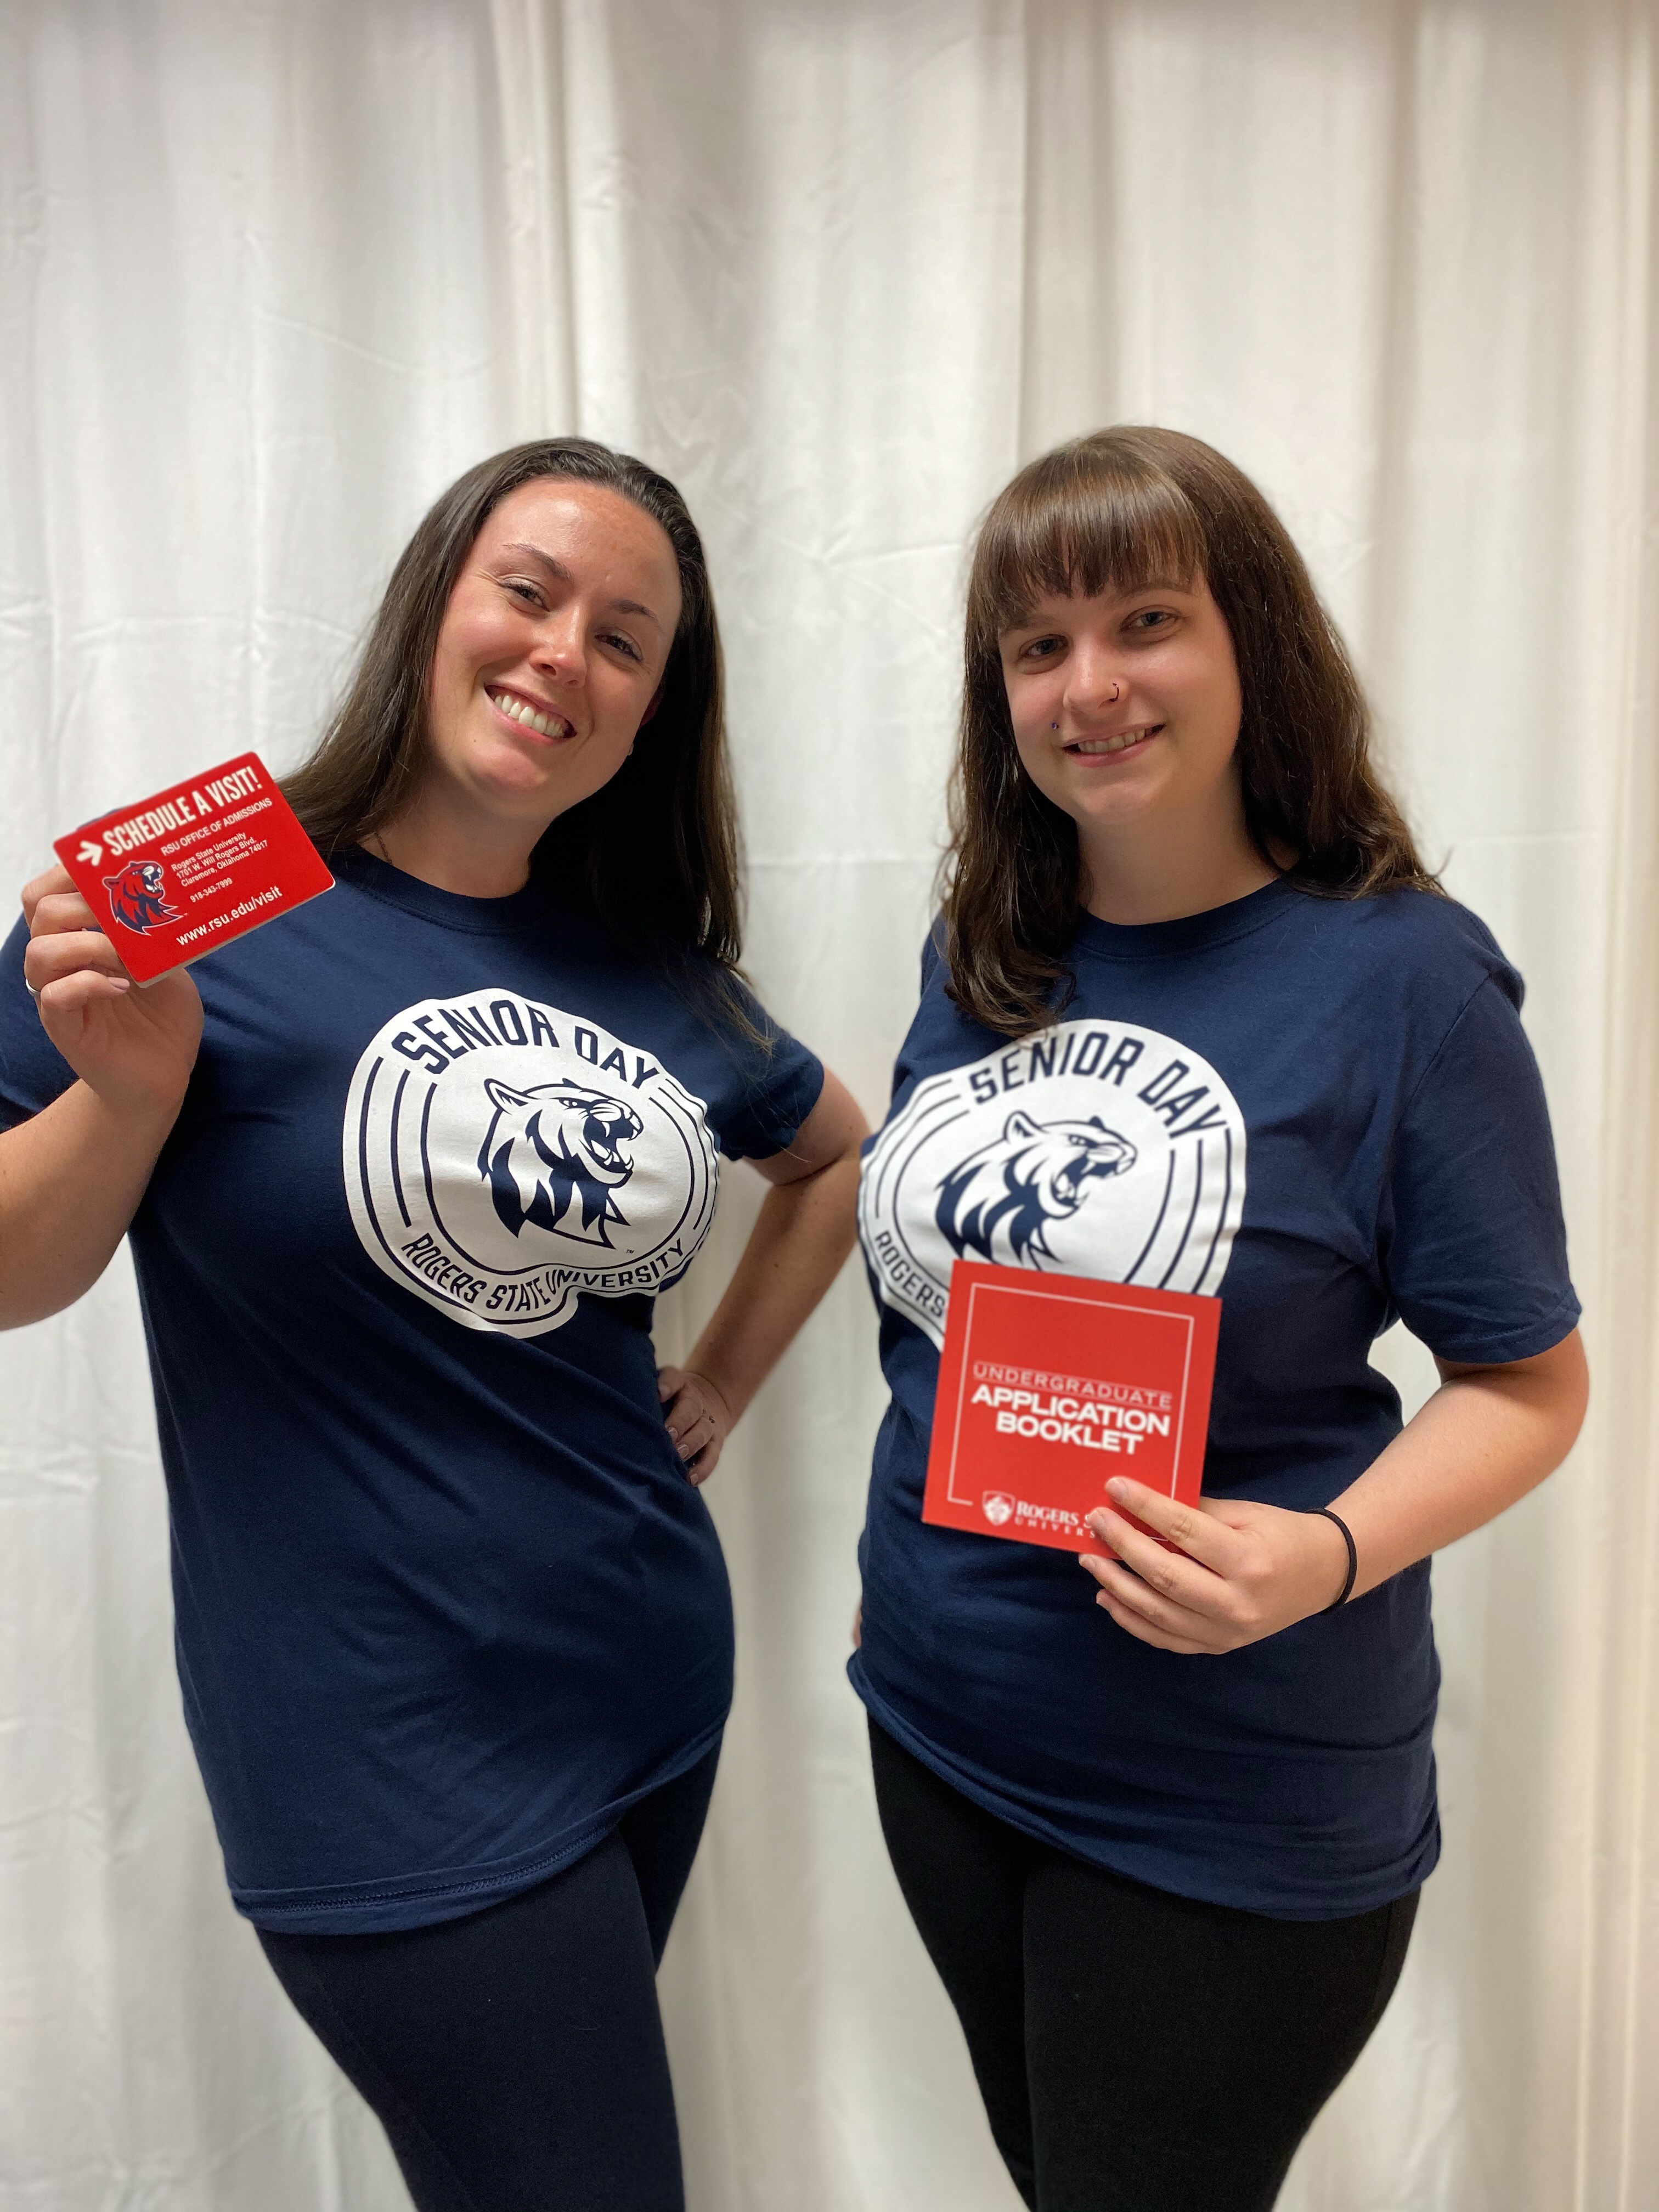
Collaboration With Enrollment & Retention
RSU Student Pain Points:
Have you ever recommended Library services to student who were at risk of dropping out?
100% Yes
Were your at-risk students already library users?
100% No
Have your students ever expressed reluctance to use the Library or its services?
50% said Yes and 50% said No

Slide 16
Collaboration With Enrollment & Retention
RSU Student Pain Points:
What do you think are the top reason for student attrition at RSU?
Financial issues and lack of funding
Poor grades due to academic struggles
Personal issues and difficulty with work/life balance
Lack of communication with University departments
Failing to connect with the University
To your knowledge, has using Library services helped students improve their academic standing and remain in college?
100% yes.
Do you have any suggestions for ways that the Library can support your retention efforts?

Slide 17
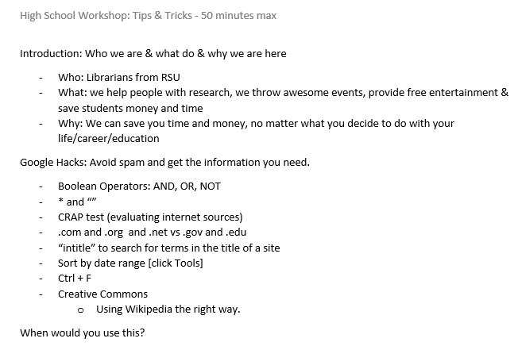
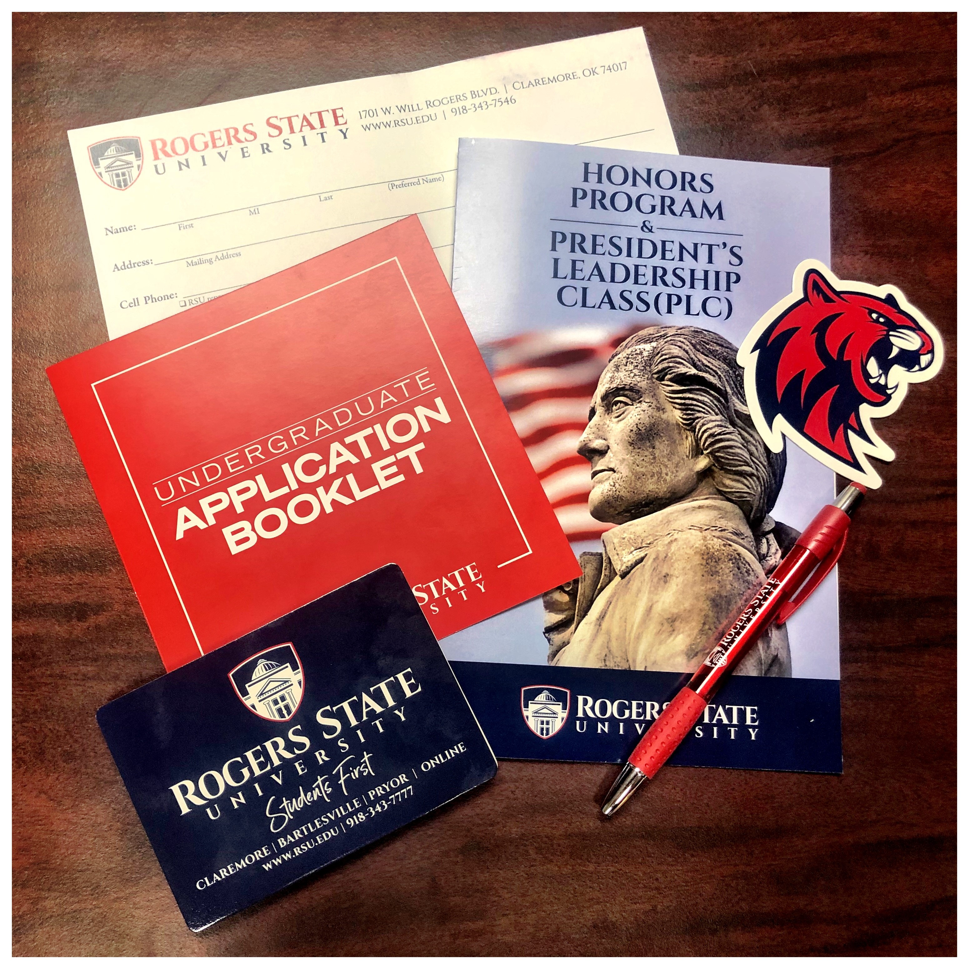
Collaboration With Enrollment & Retention
Catching Them on the Front End: Passive Recruitment
We had a productive meeting with the VP of Enrollment
We started working with admissions to create an information packet/mailer
We set up ride-alongs with an Admissions Counselor
While on these visits, we separated ourselves and met with Counselors, Librarians, and Principles
We also spoke with quite a few students
We have now created an outline for our workshops

Slide 18
Collaboration With Enrollment & Retention
Gaining Acceptance in Our New Role:
We are now included (without us asking first) on:
Upcoming admissions events
Campus tours
Cross promotional opportunities
FREE T-SHIRTS!
Further support of retention efforts will require more strategic planning and possibly another Librarian, but we are getting there!

Slide 19
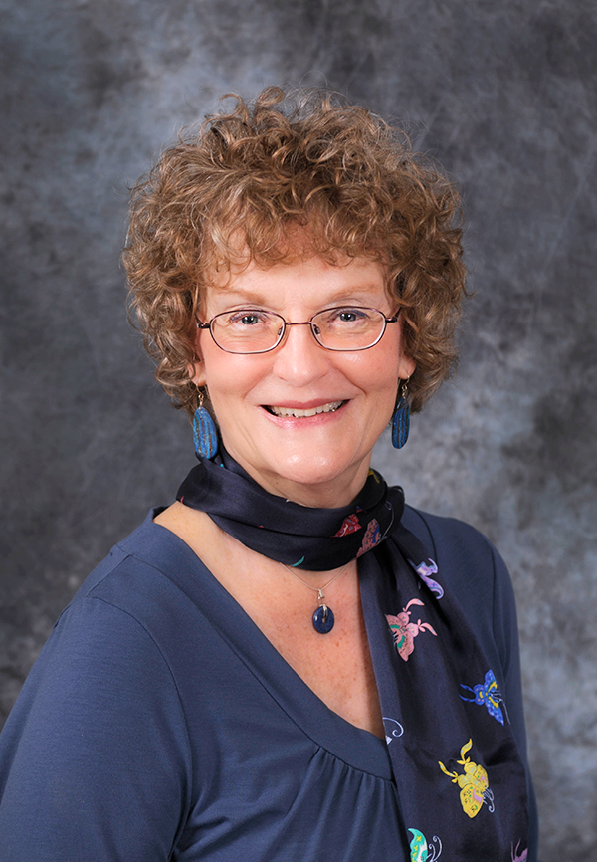
Faculty committees
Voted into Faculty Association membership on April 27, 2007
Thanks to support from tenured professor Dr. Emily Dial-Driver
As recommended by the American Association of University Professors
RSU Librarians Presently Serve On:
The Academic Technology Committee shall make recommendations on the evaluation, acquisition, and use of technology in scholarship and instruction. The Committee will consider policies and procedures pertaining to the areas of distance learning technology, university computer labs, computer hardware and software and other technology.
The Curriculum Committee will meet at least twice each of the fall and spring semesters. The committee shall submit recommendations to Academic Council.
The Faculty Development Committee’s purpose is to investigate, plan and implement faculty activities in order to provide opportunities for the enhancement and evaluation of teaching and professional skills.

Slide 20
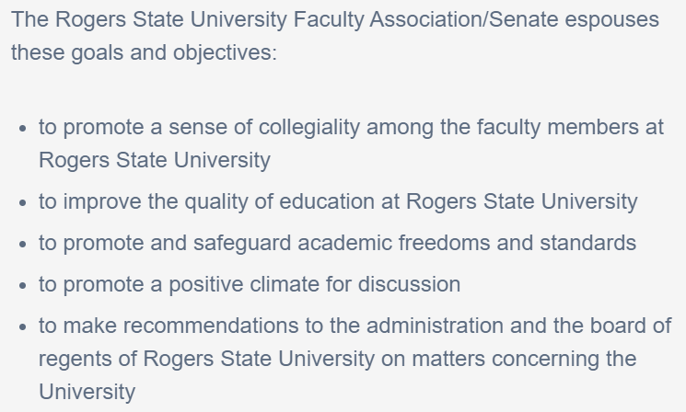
Faculty Senate
FY 09-10 Janice Ferris
FY 10-11 Janice Ferris
FY 11-12 Carolyn Gutierrez
FY 12-13 Carolyn Gutierrez
FY 13-14 Allison Embry
FY 14-15 George Gottschalk
FY 15-16 Sarah Clark
FY 16-17 Sarah Clark
FY 17-18 Sarah Clark/Kaitlin Crotty
FY 18-19 Kaitlin Crotty
FY 19-20 Michelle Owens

Slide 21
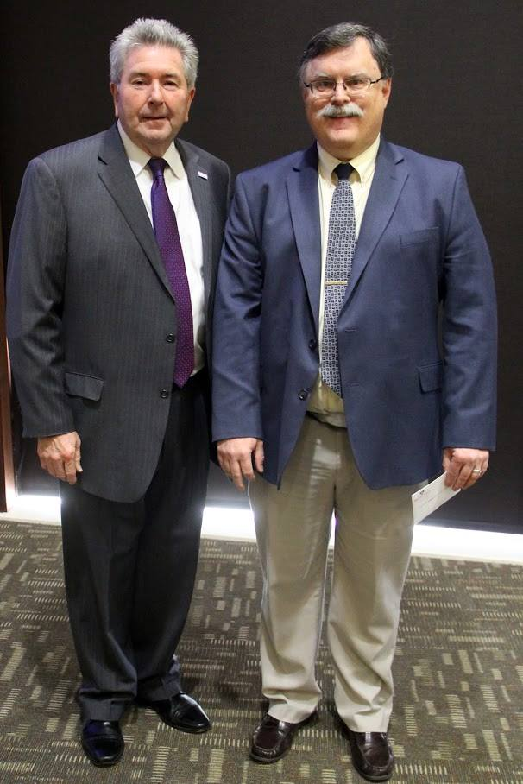
Faculty Committees & Faculty Senate
Benefits of Librarian Presence on Faculty Committees & Faculty Senate:
Consistent factor in achieving quorum at meetings
Provide broader perspective due to departmental neutrality
Awareness of proposed change
Awareness of program development
Awareness of program discontinuation
Awareness of institutional initiatives
Awareness of faculty interest & research efforts
Ability to align the library’s strategic plan to support university goals
Participation in hiring committees & ad hoc committees
Improved relationship building across campus
Contribution to important campus decisions

Slide 22
Notes:
Poll Title: Are you interested in becoming a member of your institution's faculty association? https://www.polleverywhere.com/multiple_choice_polls/6uD5xEzKycNqktMlpC7JZ

Slide 23
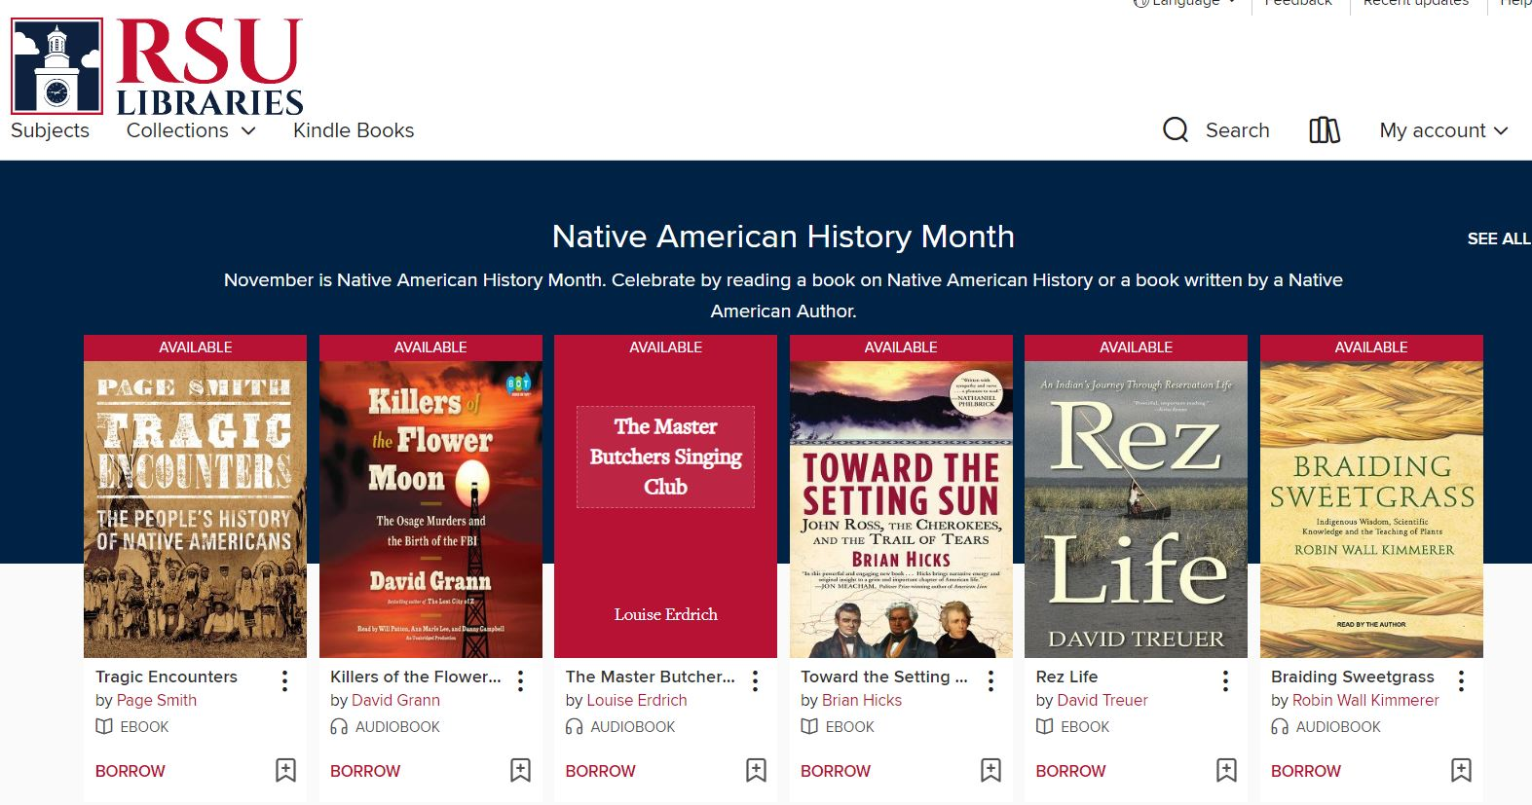
Overdrive
Why did we decide to try this?
How did we start?

Slide 24
Notes:
Poll Title: Does your library have a way for users to access popular eBook titles? https://www.polleverywhere.com/multiple_choice_polls/CUWrjHSSUDKmMonEUPpiI

Slide 25
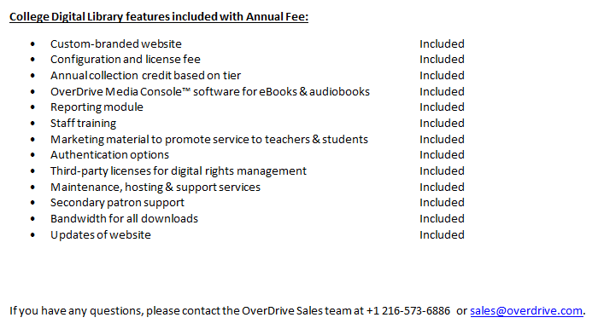
Overdrive
What happened when we decided to take the plunge?

Slide 26
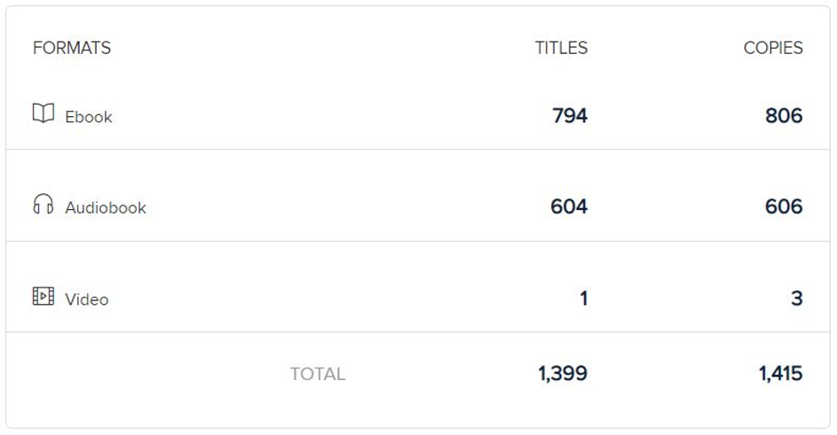
Overdrive
As the Admin, this interface is a dream for me.
Add and remove Marketplace users
Add and remove user privileges
View Insights
Create and share carts
Create custom and automated collections
Managing the collection is a piece of cake
All marketplace users can easily create their own carts, and easily share them with the admin.

Slide 27
Overdrive
As a User, this interface is more fun and much easier
As of November 5, 2019 we have had Overdrive for just 1 year
We have 140 active users

Slide 28
Overdrive
University Wide Book Club

Slide 29
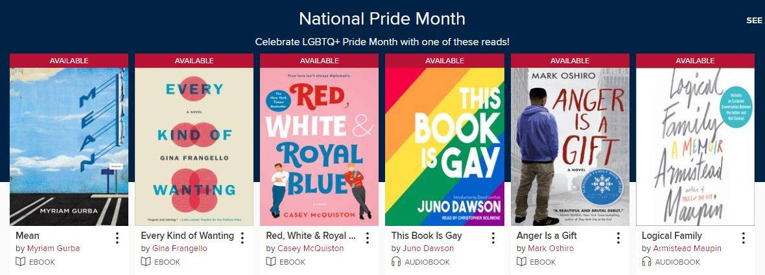
Overdrive
University Wide Book Club
New Collections

Slide 30
Overdrive
Final Thoughts
Honestly, we haven’t even tapped the full potential of this resource. We are just now considering trying out streaming video services and we haven’t made use of the hosting capabilities at all.

Slide 31
Notes:
Poll Title: Would you be interested in learning more about forming a consortium with us? https://www.polleverywhere.com/multiple_choice_polls/WLMO7qH3HpiQrMAtDagVf

Slide 32
Notes:
Poll Title: Questions? https://www.polleverywhere.com/free_text_polls/aWBQ0NzbzZFo424bZIQ5f

