Slide 1
The Pop-Up Librarian: Bringing Liaison
Services To The Patrons
Karl G. Siewert, MLIS – Nsu Broken Arrow Library

Slide 2
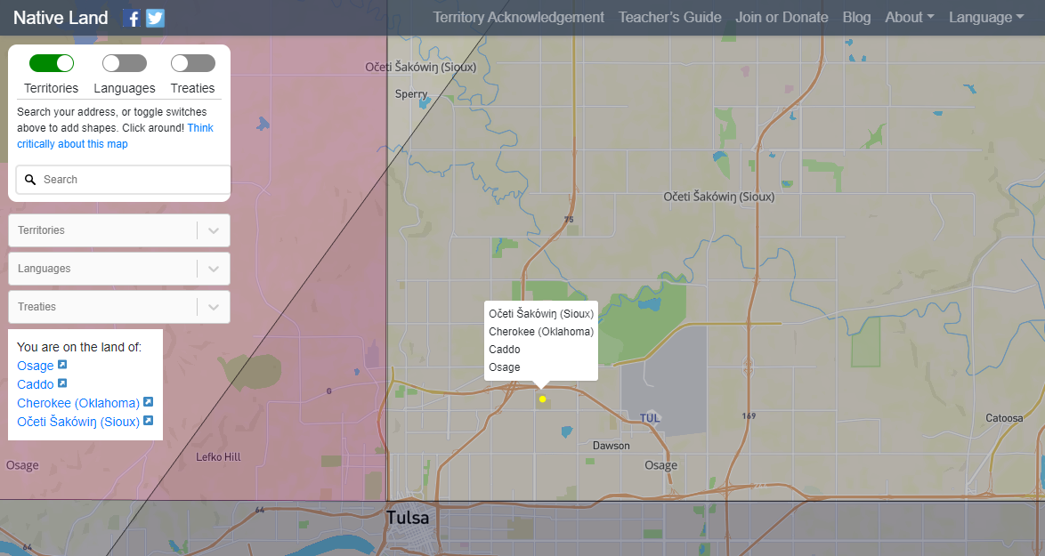
Territory Acknowledgement
https://native-land.ca/

Slide 3
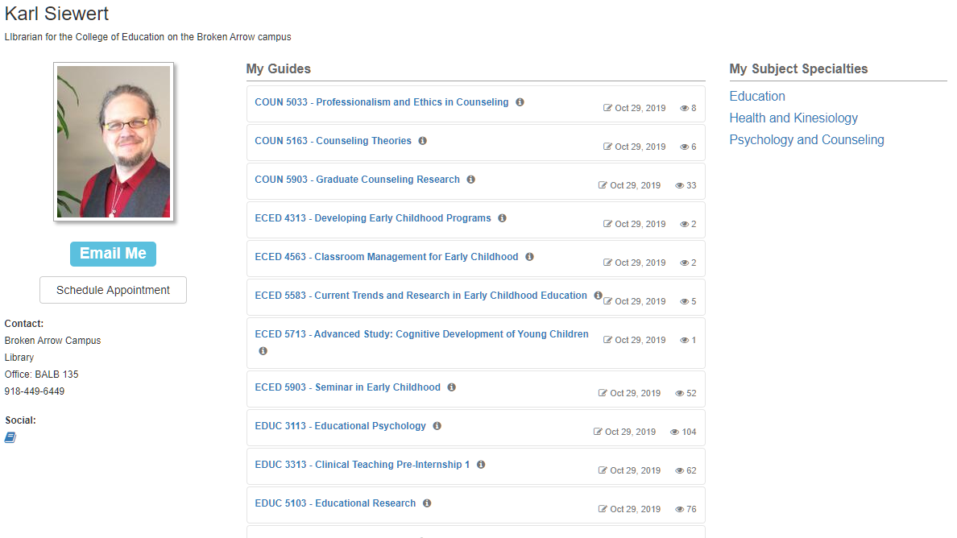
INtroduction

Slide 4
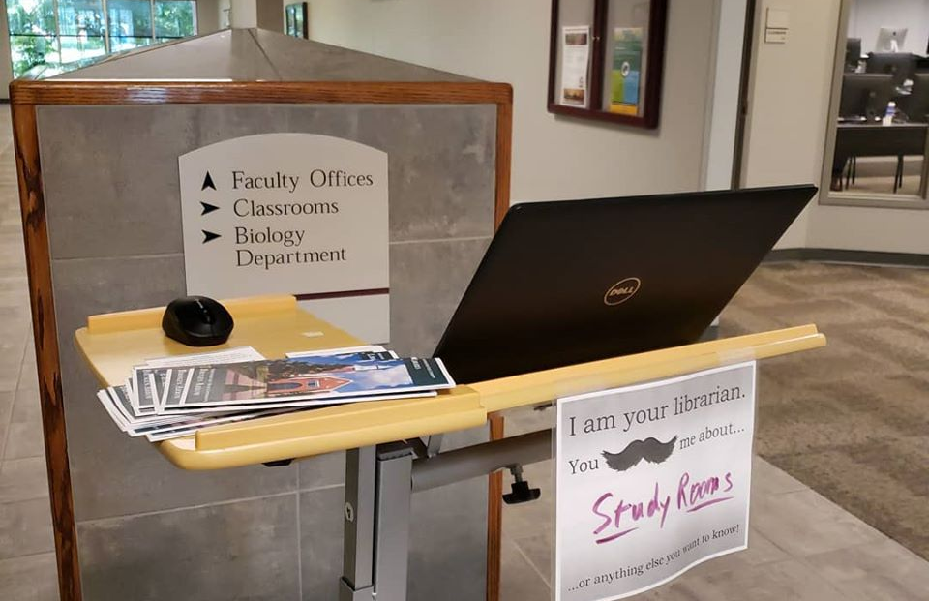
Pop-up in BAED

Slide 5
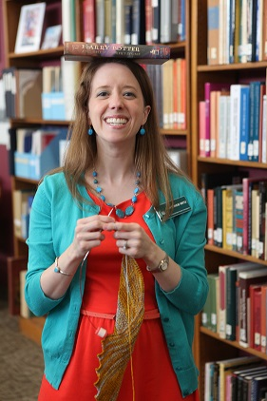
Why?
Community and Collaboration Day
  Assessment focus
  College of Education
  Re-evaluation of Bibliographic Instruction
Sarah Whittle –”Roving Reference”

Slide 6

Goals
To be seen
To answer questions
https://www.needpix.com/photo/92452/goal-football-net-soccer

Slide 7

Process
Seek advice from building administrator for time slot and location
Gather materials
Plan
  Consistent time slot
  Weekly theme
  Marketing to faculty
https://pixabay.com/illustrations/process-business-cycle-project-3936336/

Slide 8

Data collection
Initial plan
  Count everyone I see
  Note questions asked
Adjustments
  More granular timeframes
  Issues of double-counting and recognition
https://www.needpix.com/photo/1297886/survey-poll-pencil-icon-checkbox

Slide 9

Results
http://www.picserver.org/r/results.html

Slide 10
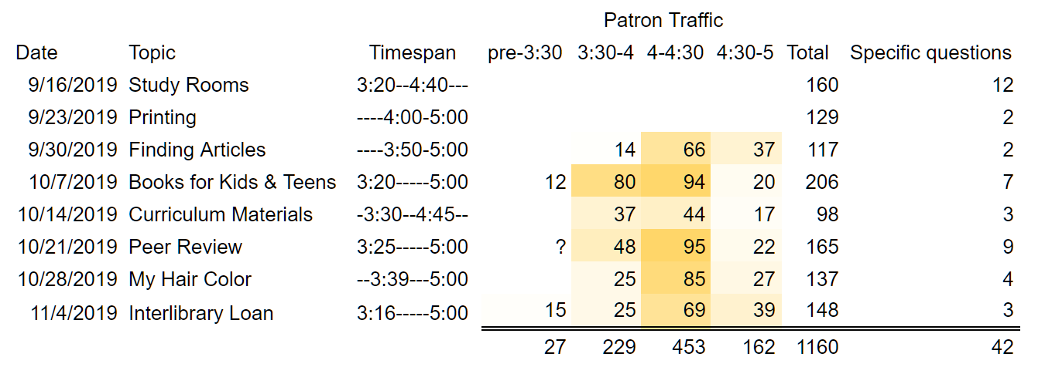
GEneral

Slide 11
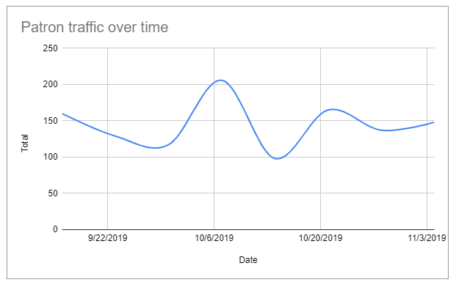
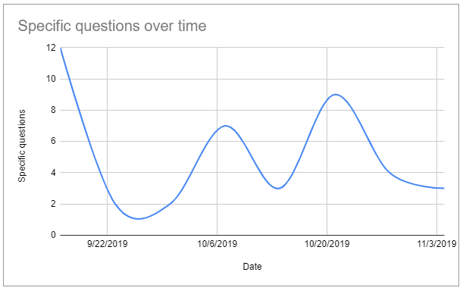
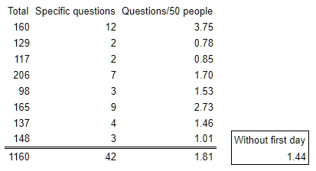
Patterns

Slide 12
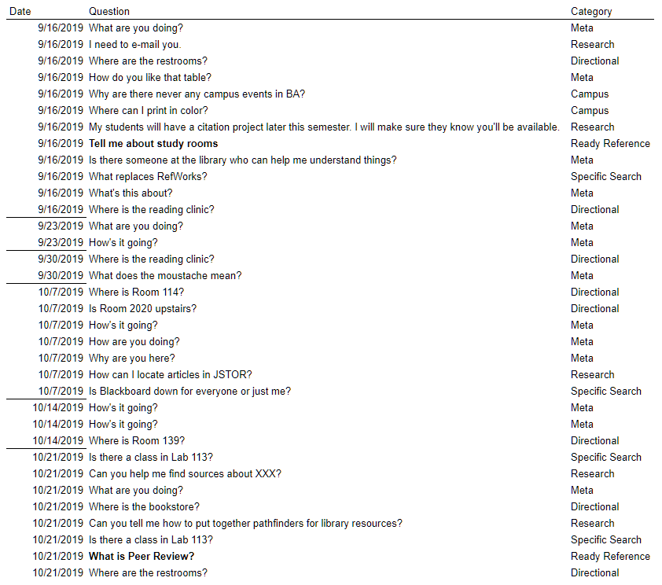
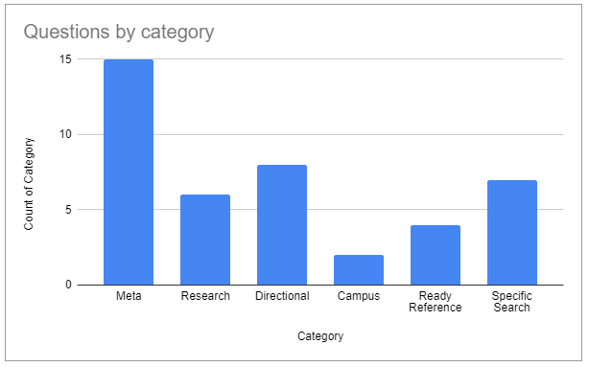
Specific questions
Introduction to Reference Work V.2: Reference Services and Reference Processes, William A. Katz

Slide 13
“Can you show me how to find articles on JSTOR?”
“Is there someone at the library who can help me understand things?”
“I’m so glad you’re here!
I needed to ask you how to find articles about….”
“My students will have a citation project later this semester. I’ll make sure they know you’re going to be here.”
“Does the library have Carl Jung’s The Red Book ?”
“…the library…”

Slide 14
What next?
Finish the semester
Continue to gather data
Commit to consistent schedule for Spring
Colleague involvement
  More marketing and promotion
  Opportunity to compare data
Article?

Slide 15

Questions? Comments? Suggestions?
https://www.publicdomainpictures.net/en/view-image.php?image=160217&picture=question-mark

