Slide 1
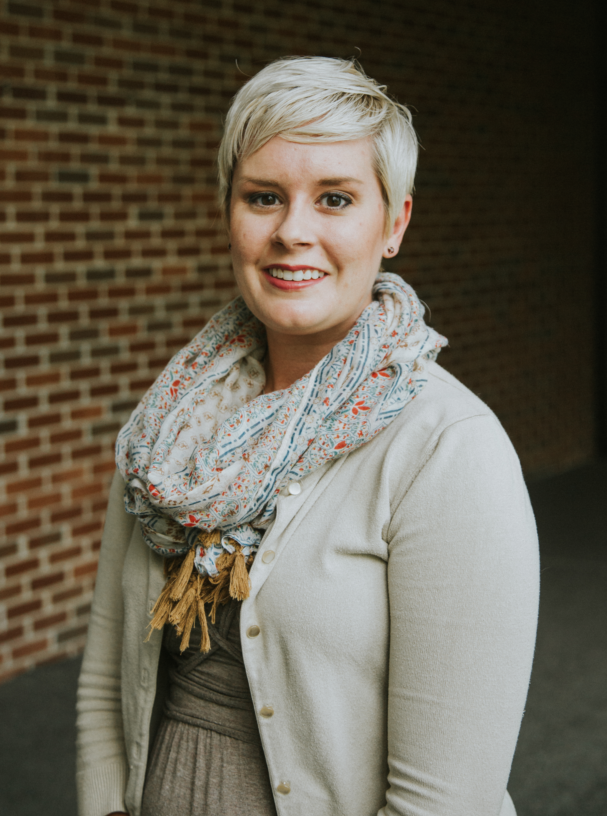
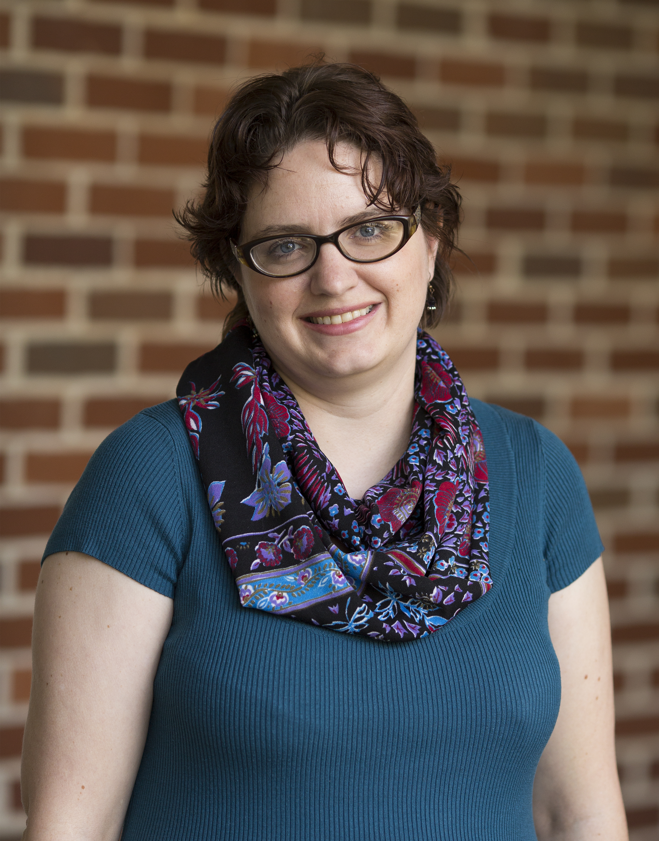
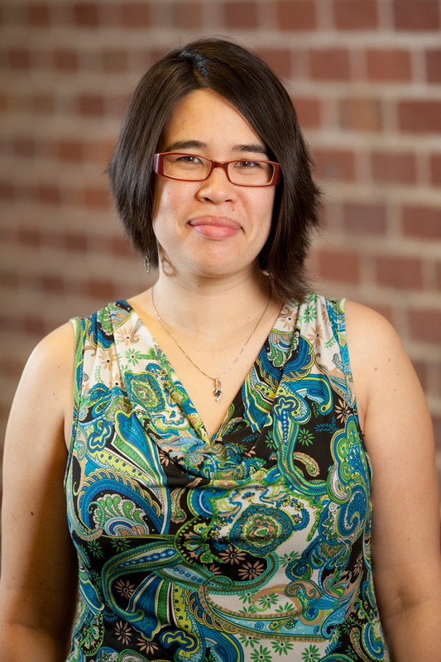
Let Us introduce Ourselves
Taylor Vanlandingham
Rachel Maxson
Marikit Fain

Slide 2
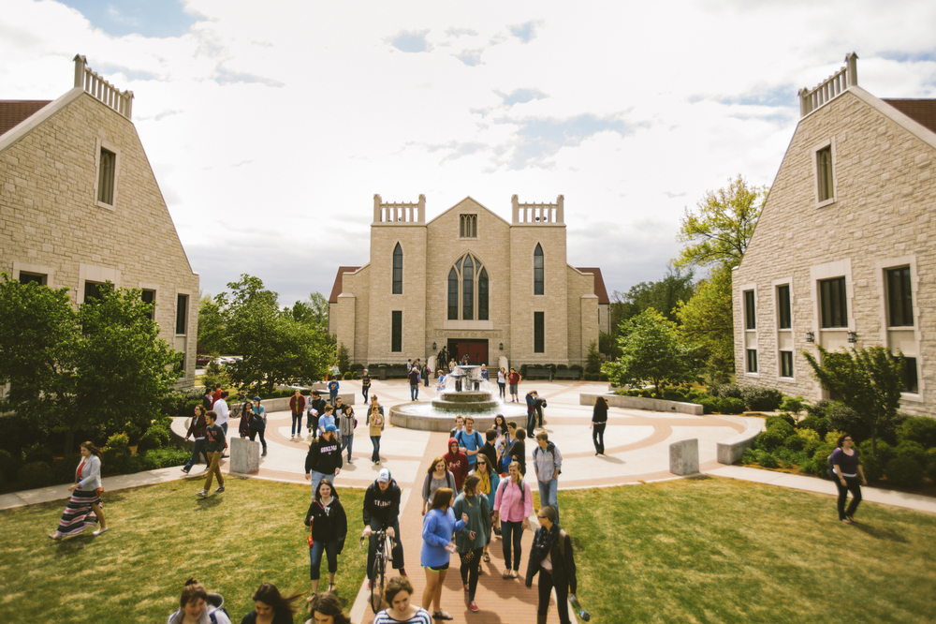
John brown University
FTE Enrollment: 1763
Traditional Undergrads: 1272
Library Staff:
FTE Adulty Adults: 8
Degreed Librarians: 6
Paraprofessionals: 5
Work Studies: 21
Library: 16
Archives: 5

Slide 3
Doing More With less
How to make it work

Slide 4
The first Part
Or How we used software the university was already paying for anyway to improve student worker management

Slide 5
teams

Slide 6
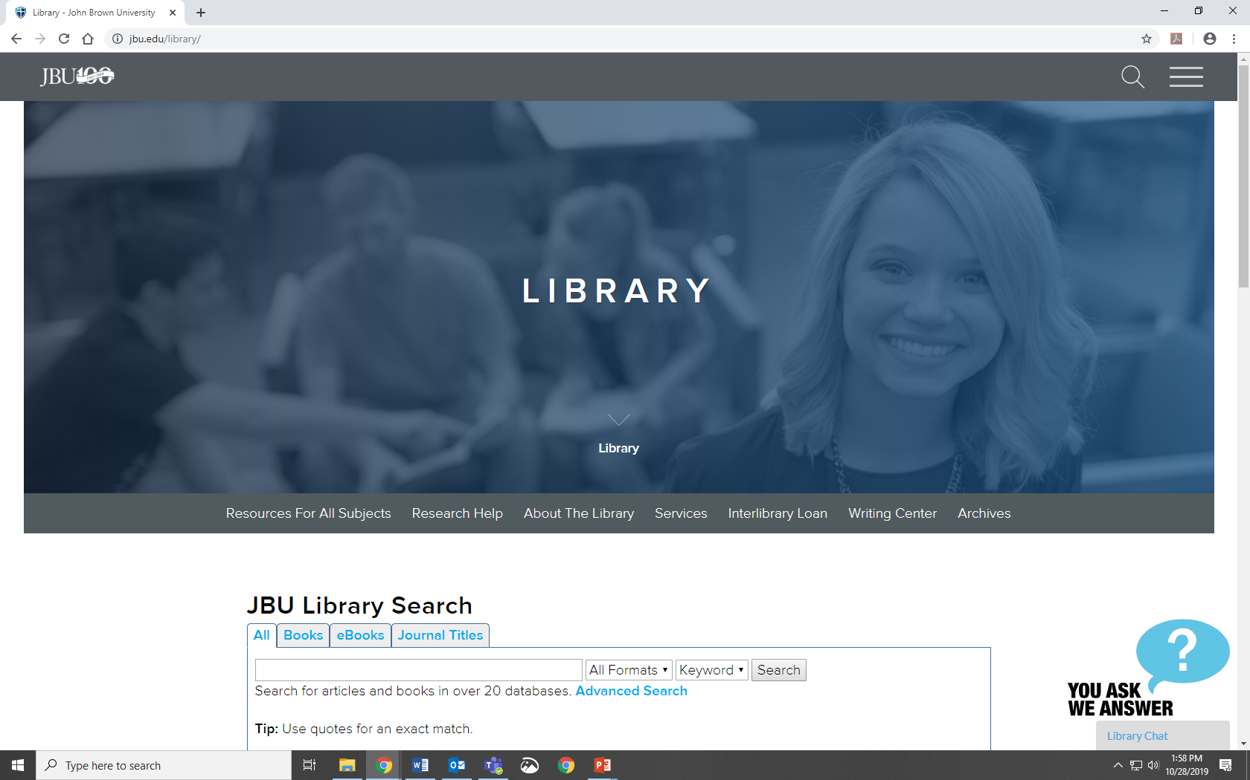
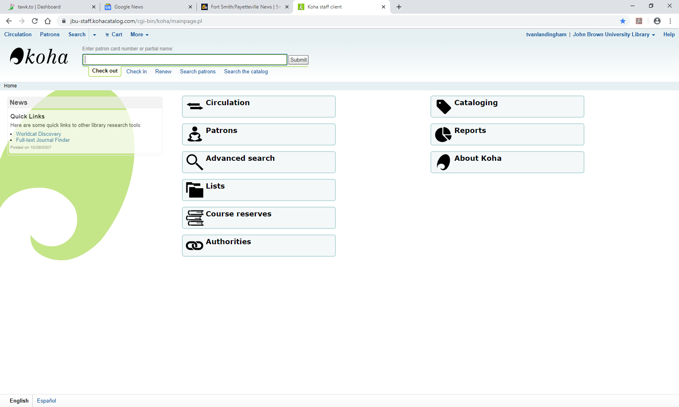
STEP One: Reference Training

Slide 7
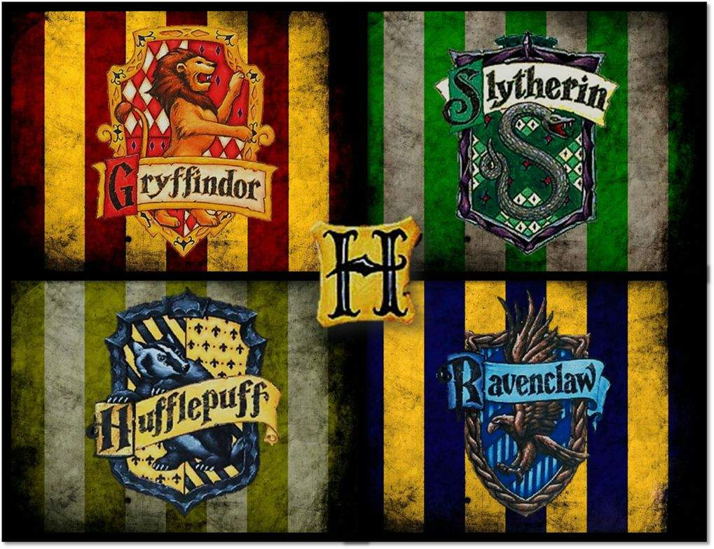
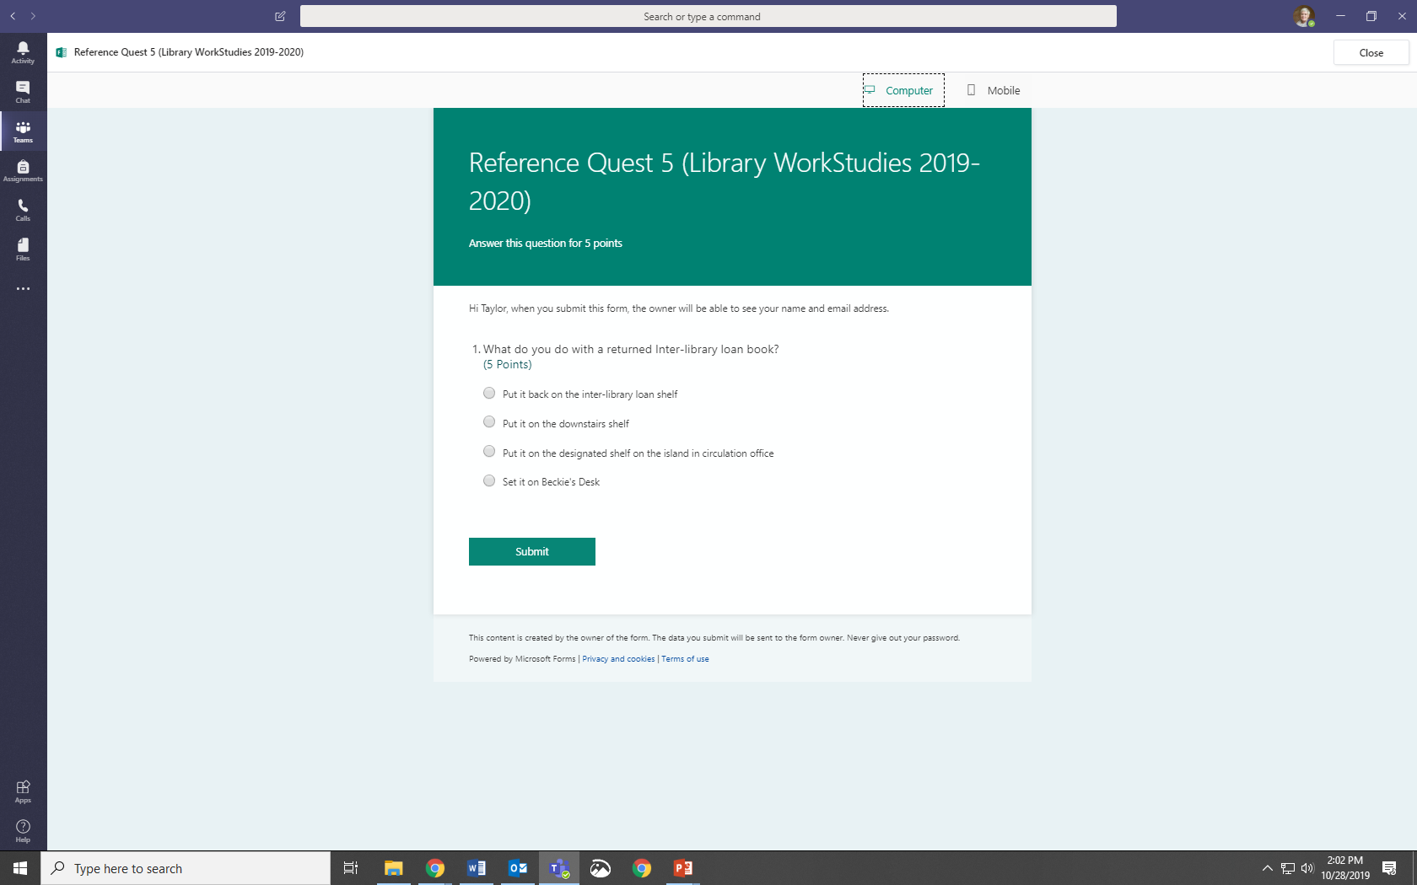
Step two: Let’s gamify this Thing
https://www.deviantart.com/kooro-sama/art/Hogwarts-Flag-237279817

Slide 8
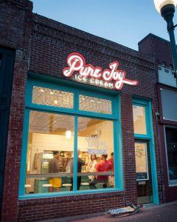
Step Three: Reward
Monthly rewards
Ice cream tokens
Candy
Pencils
Semester Rewards
House (coffee) cup filled with candy
Spring 2019: Hufflepuff

Slide 9
Step four: Repeat

Slide 10
Library: Manual

Slide 11
Library: Quizzes

Slide 12
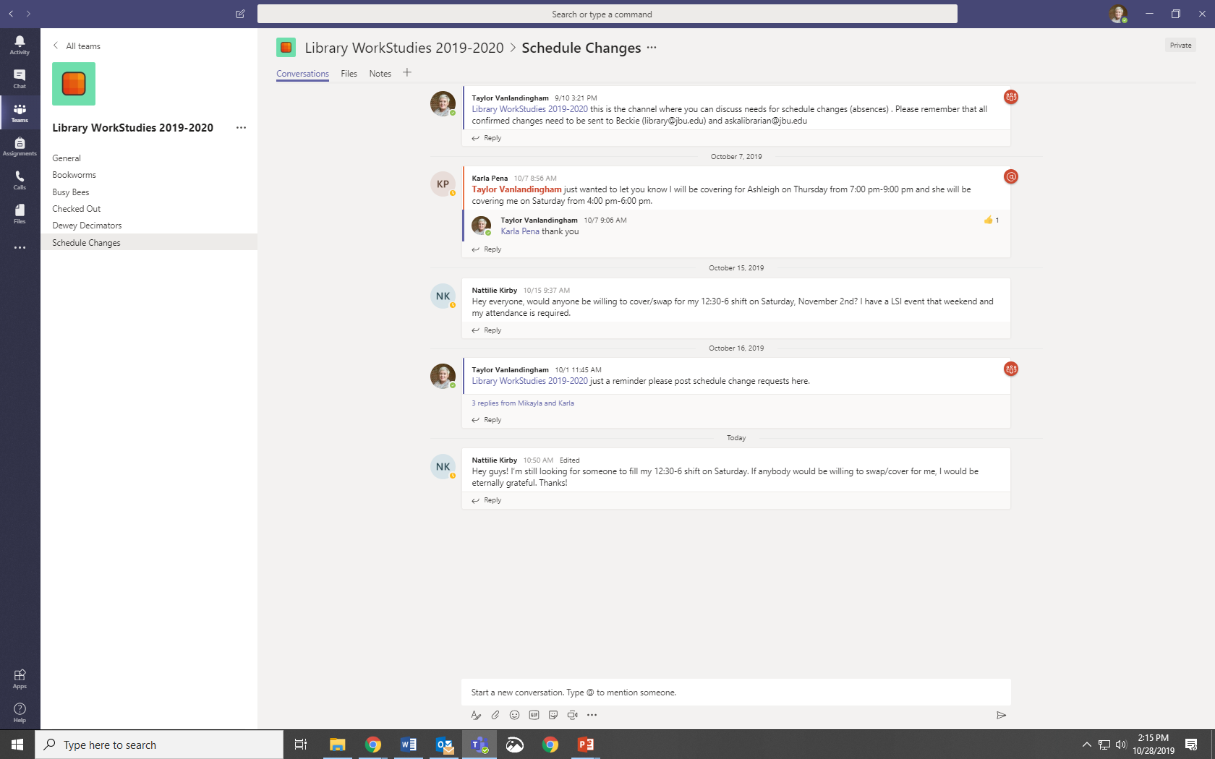
Library: Schedule

Slide 13
Library: Budget
Software: $0 (Included in university’s Office 365 subscription)
Prizes
Spring 2019: $46
Fall 2019: $30
Typical Expected Per Semester: $35

Slide 14
Archives Work Studies

Slide 15
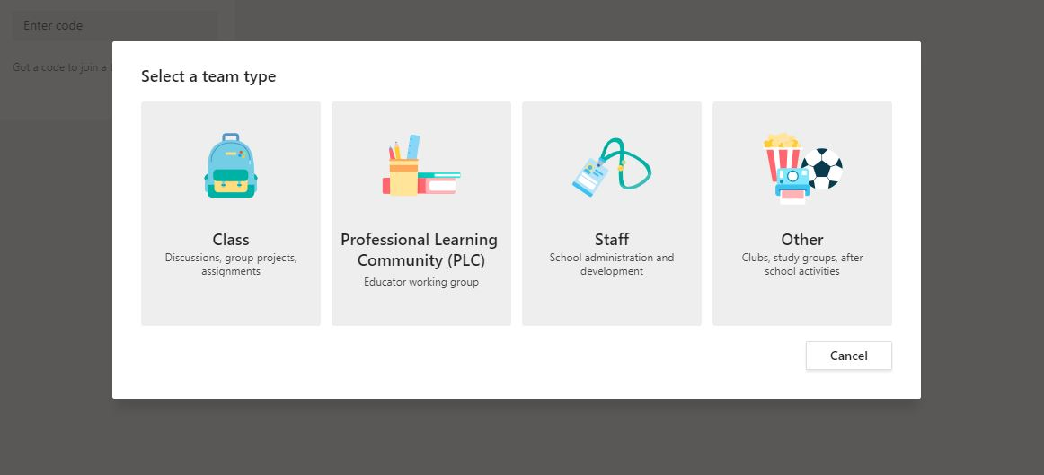
Initial Setup

Slide 16
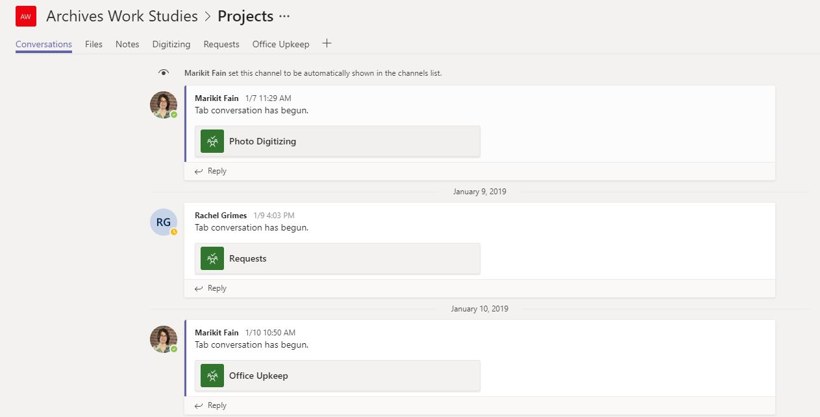
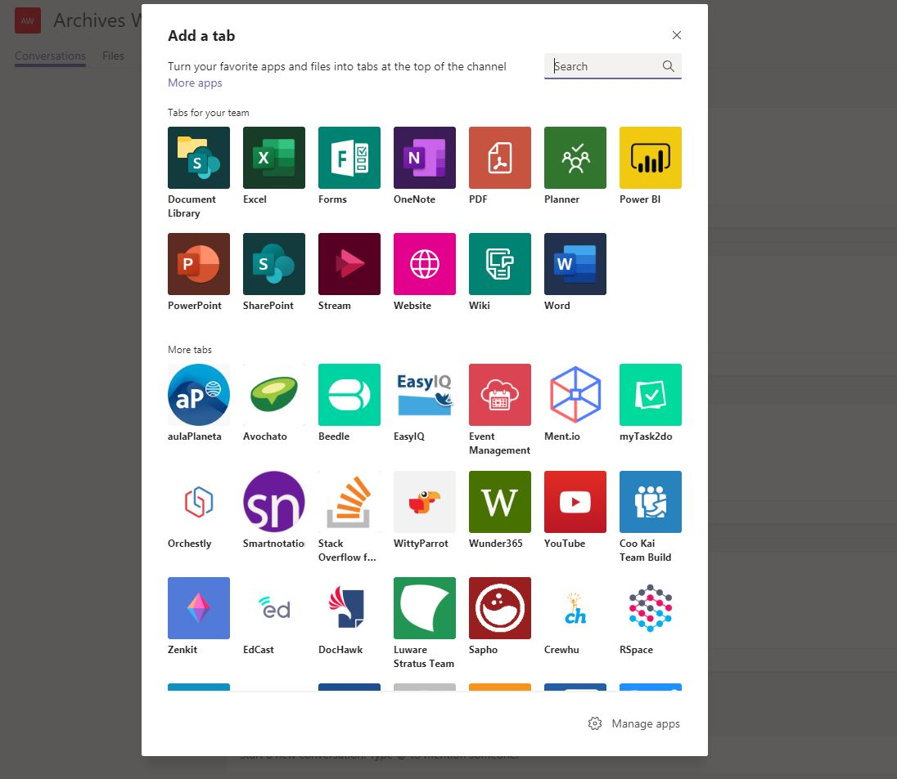
Initial Setup

Slide 17
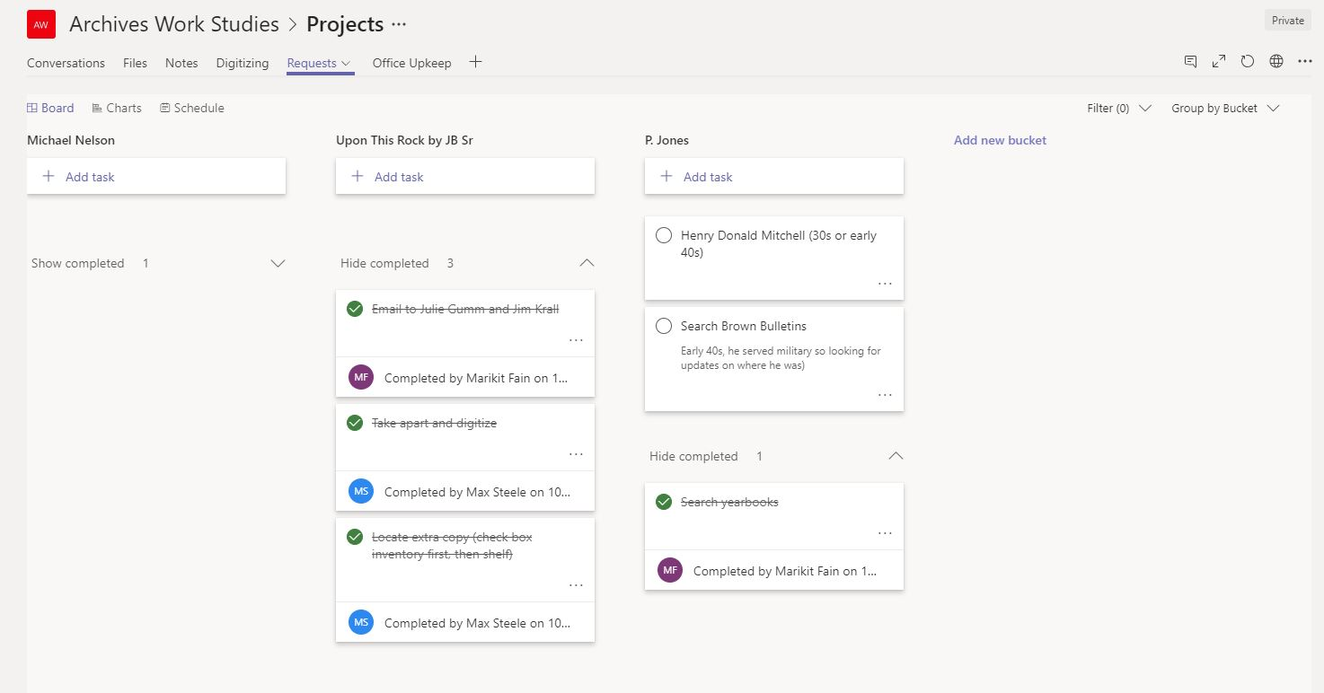
Archives: Project Management

Slide 18
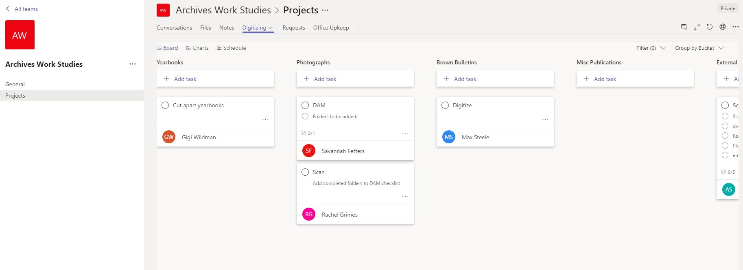
Archives: Project Management

Slide 19
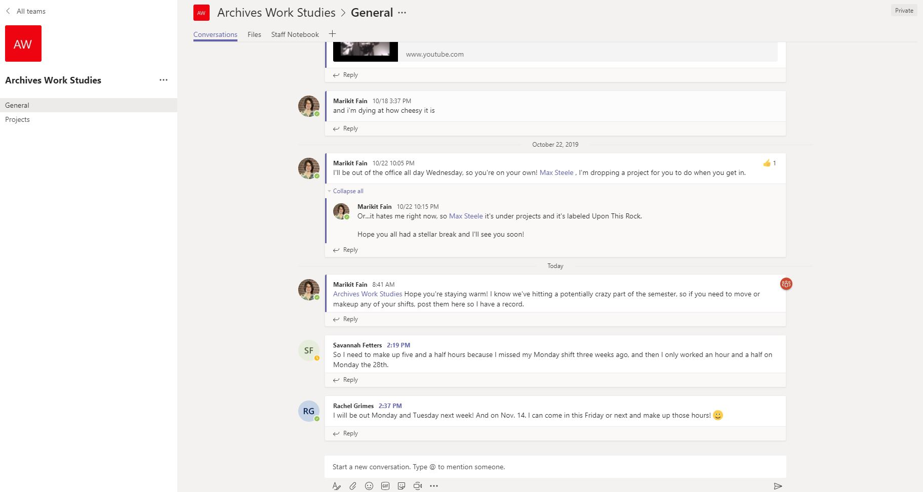
Archives: Communication

Slide 20
We are training them for Future Endeavors
Many of our students do not check their e-mail
Many of our work studies have no previous work experience
Many employers use a project management and communication platform
Teams, Slack, Sharepoint, etc.
How to communicate
E-mails, phone etiquette, just to communicate

Slide 21
The Second Part
Or How I, the former programming Librarian, learned to reach out and ask for help

Slide 22
The Second Part
Or How I, the former programming Librarian, learned to reach out and ask for help
… and in the process made the non-programming librarians’ dreams come true.

Slide 23
Taylor’s Background
Children’s Librarian 6 years
3-6 programs a week
Up to 8 during the summer
Ages 0-12
Weekly Story times – one time special programs – weekly outreach

Slide 24
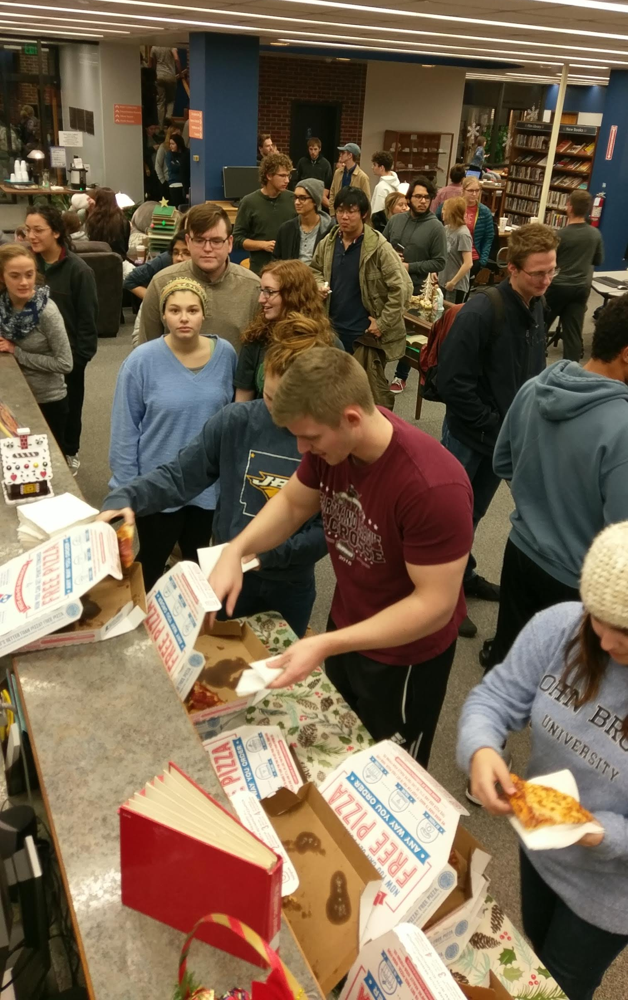
Finals Week 2018
Pinning Ideas
Long Night Against Procrastination
Short and sweet title: Late Night at the Library
SGA- Student Government Association
Pizza
Marketing: Toilet Paper
People
Required to attend
They brought friends

Slide 25
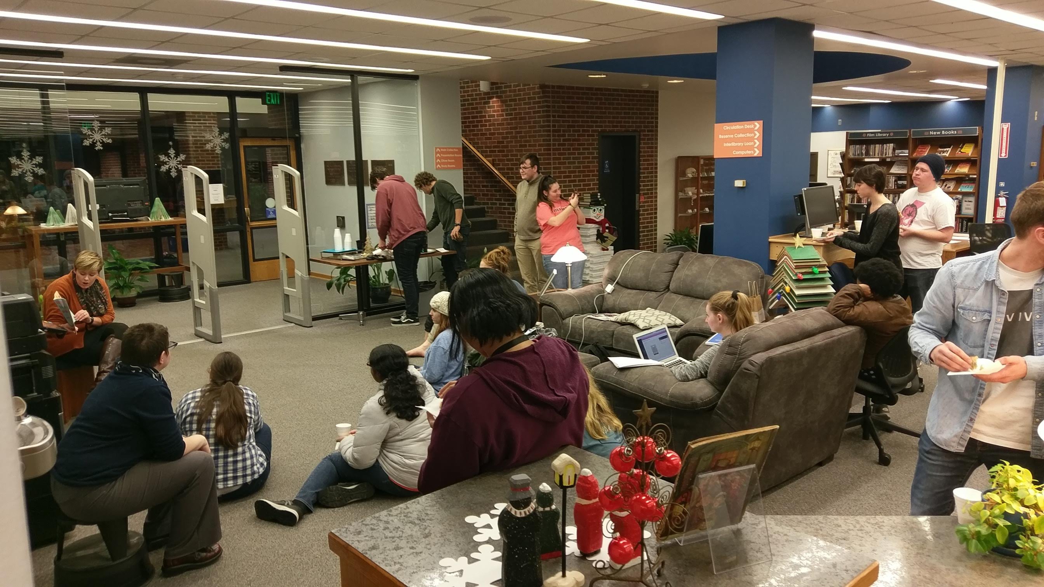
Late Night At the library Plan
Healthy Snacks
Pizza
Brain Breaks
Yoga
Active Games
Story Time
Passive stress relieving activities
Playdough
Legos
Coloring

Slide 26
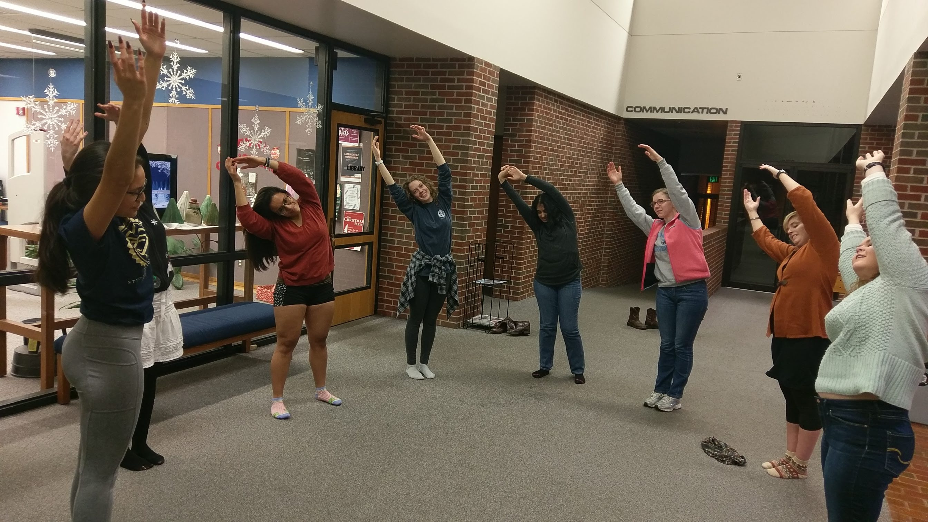
Results (what Worked)
Wednesday Night
Holding the event the week before finals
Partnering with a student organization
Food
Passive brain breaks
200 students

Slide 27
Results (What we learned for this year)
Plan as early as you can (May 2019)
The more food the better
More Legos (real Legos )
More passive things for them to do
Create their own study breaks
Provide ear plugs for those who need a quieter environment

Slide 28
Game Night(s)
A Study in Trial and Error

Slide 29
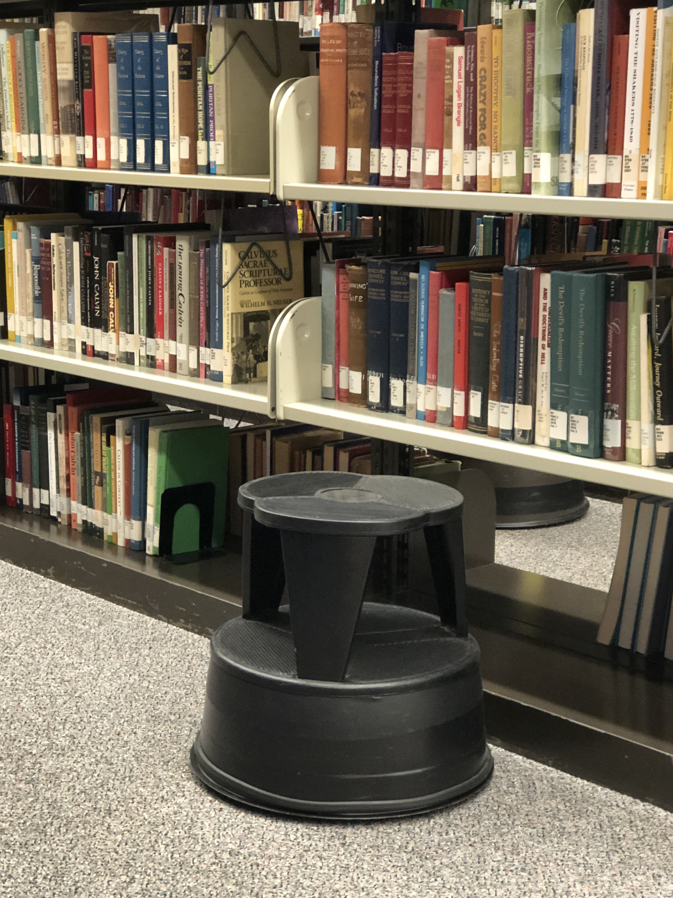
Game Night 1.0
Friday, March 11, 2016
Co-hosted with Student Events and Activities
Promotion
Debuted circulating game collection
10 games
Included table games, Hide & Seek in the dark
SEA headed game upstairs
40 students
“I didn’t really know what to expect, but it was different than I thought it would be. It was surprisingly fun.”

Slide 30
Game Night 2.0
Did not partner with student organization
We wanted to build on the success of Late Night
Highlighting our new games added to the game collection
Friday, March 29, 2019
In-house marketing
Snacks
20 students

Slide 31
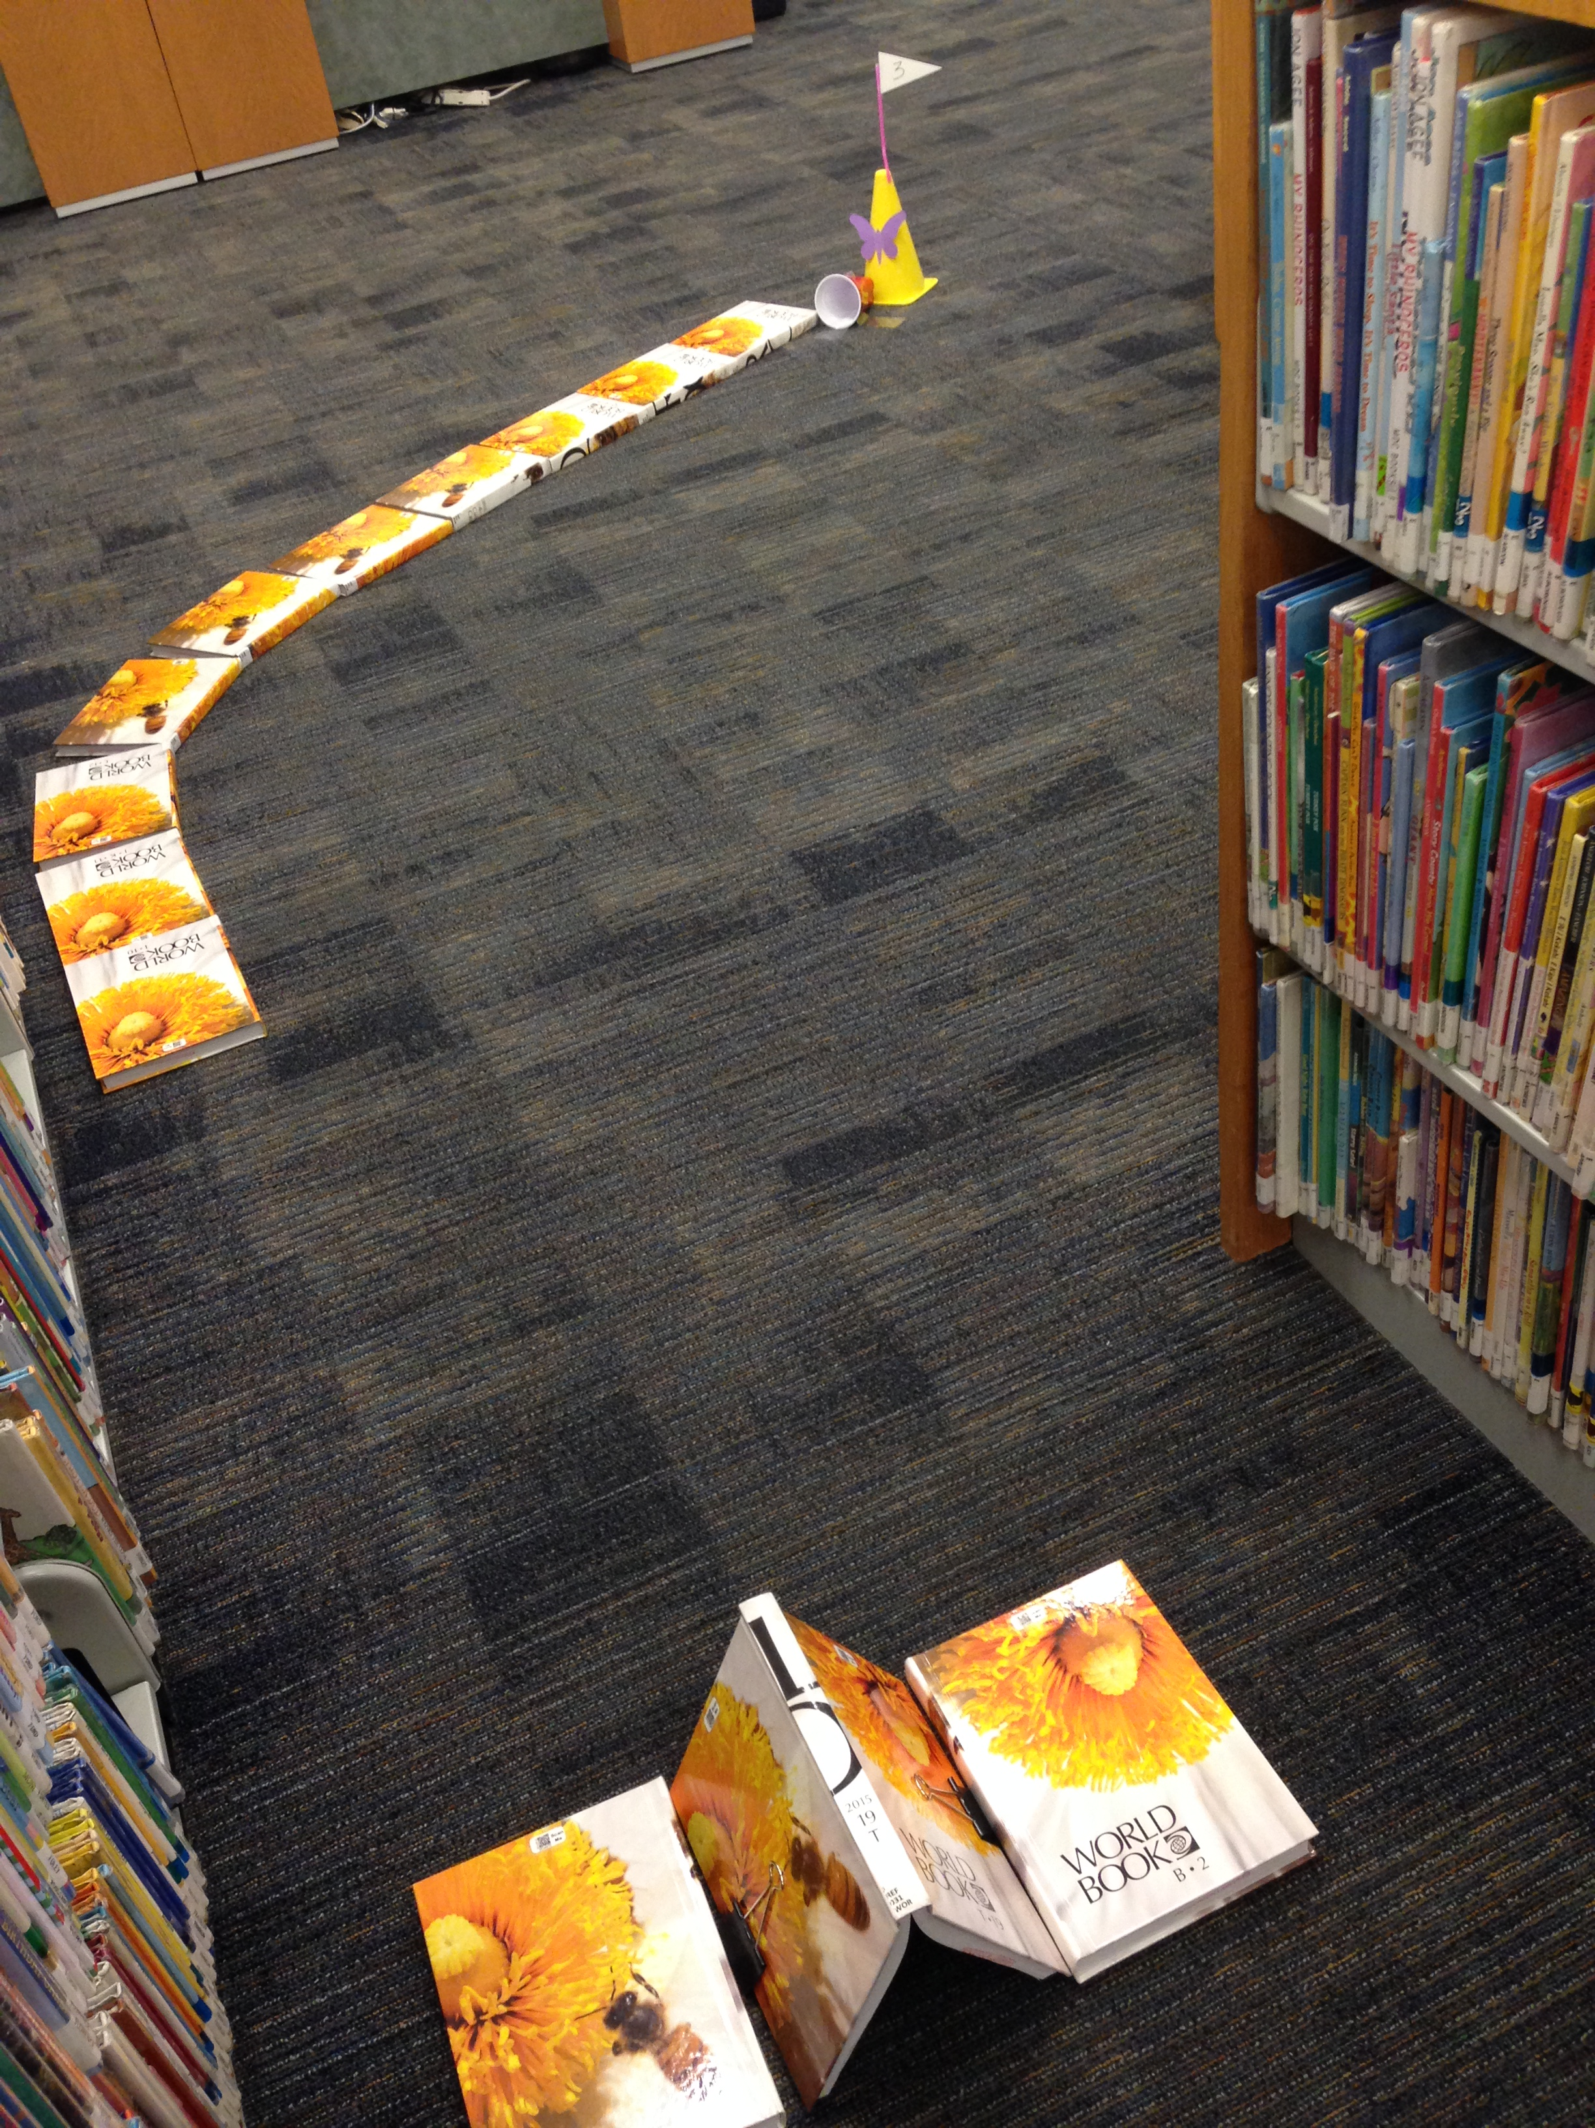
Game Night 3. 0
Reaching out to SGA in May
Provide marketing
Set up Mini golf course
Holding event on a Wednesday
Added a bigger element (Mini Golf)
Results
Stay Tuned
https://librarymaura.wordpress.com/tag/library-mini-golf/

Slide 32
Random snacks of kindness
Spontaneous Outreach: Sunday evening before Spring Finals
Various campus departments provide snacks and coffee during exam week (including free coffee in the library), but the night BEFORE exams begin is ignored.
Encourages students during a high-use time for the library
This year: starting free coffee the day before exams

Slide 33
What Did it cost?
Work Study “House Cup” Competition:
Software: $0 (Included in university’s Microsoft 365 subscription)
Prizes:
Spring 2019: $46
Fall 2019: <$30
Anticipated annual average: ~$70
Programs:
Late Night at the Library:
Pizza: Provided by SGA
Other Snacks & Materials: $60
Game Night:
Snacks: $35
“Random Snacks of Kindness”: $20
Anticipated annual average: ~$120
Other Expenses:
Additions to the board game collection: $100 (every other year)
Legos: $30
GRAND TOTAL: <$300/year

Slide 34
What would you like to Know More about ? Any Questions?
Taylor : tvanlandingham@jbu.edu
Rachel: rmaxson@jbu.edu
Marikit: mschwartz@jbu.edu

