Slide 1
The Expanding Role of the Academic Librarian
Panel for 2019 OK-ACRL

Slide 2
? Nontraditional PhD ?
Education
  BS Physics
  University of Kentucky
  MS Meteorology
    Pennsylvania State University
  PhD Meteorology
  Pennsylvania State University
Work
  Support scientist for Atmospheric Radiation Measurement program
  Computer Specialist for Florida State Department of Meteorology
  Computer Systems Coordinator and Adjunct Faculty for OU School of Meteorology

Slide 3
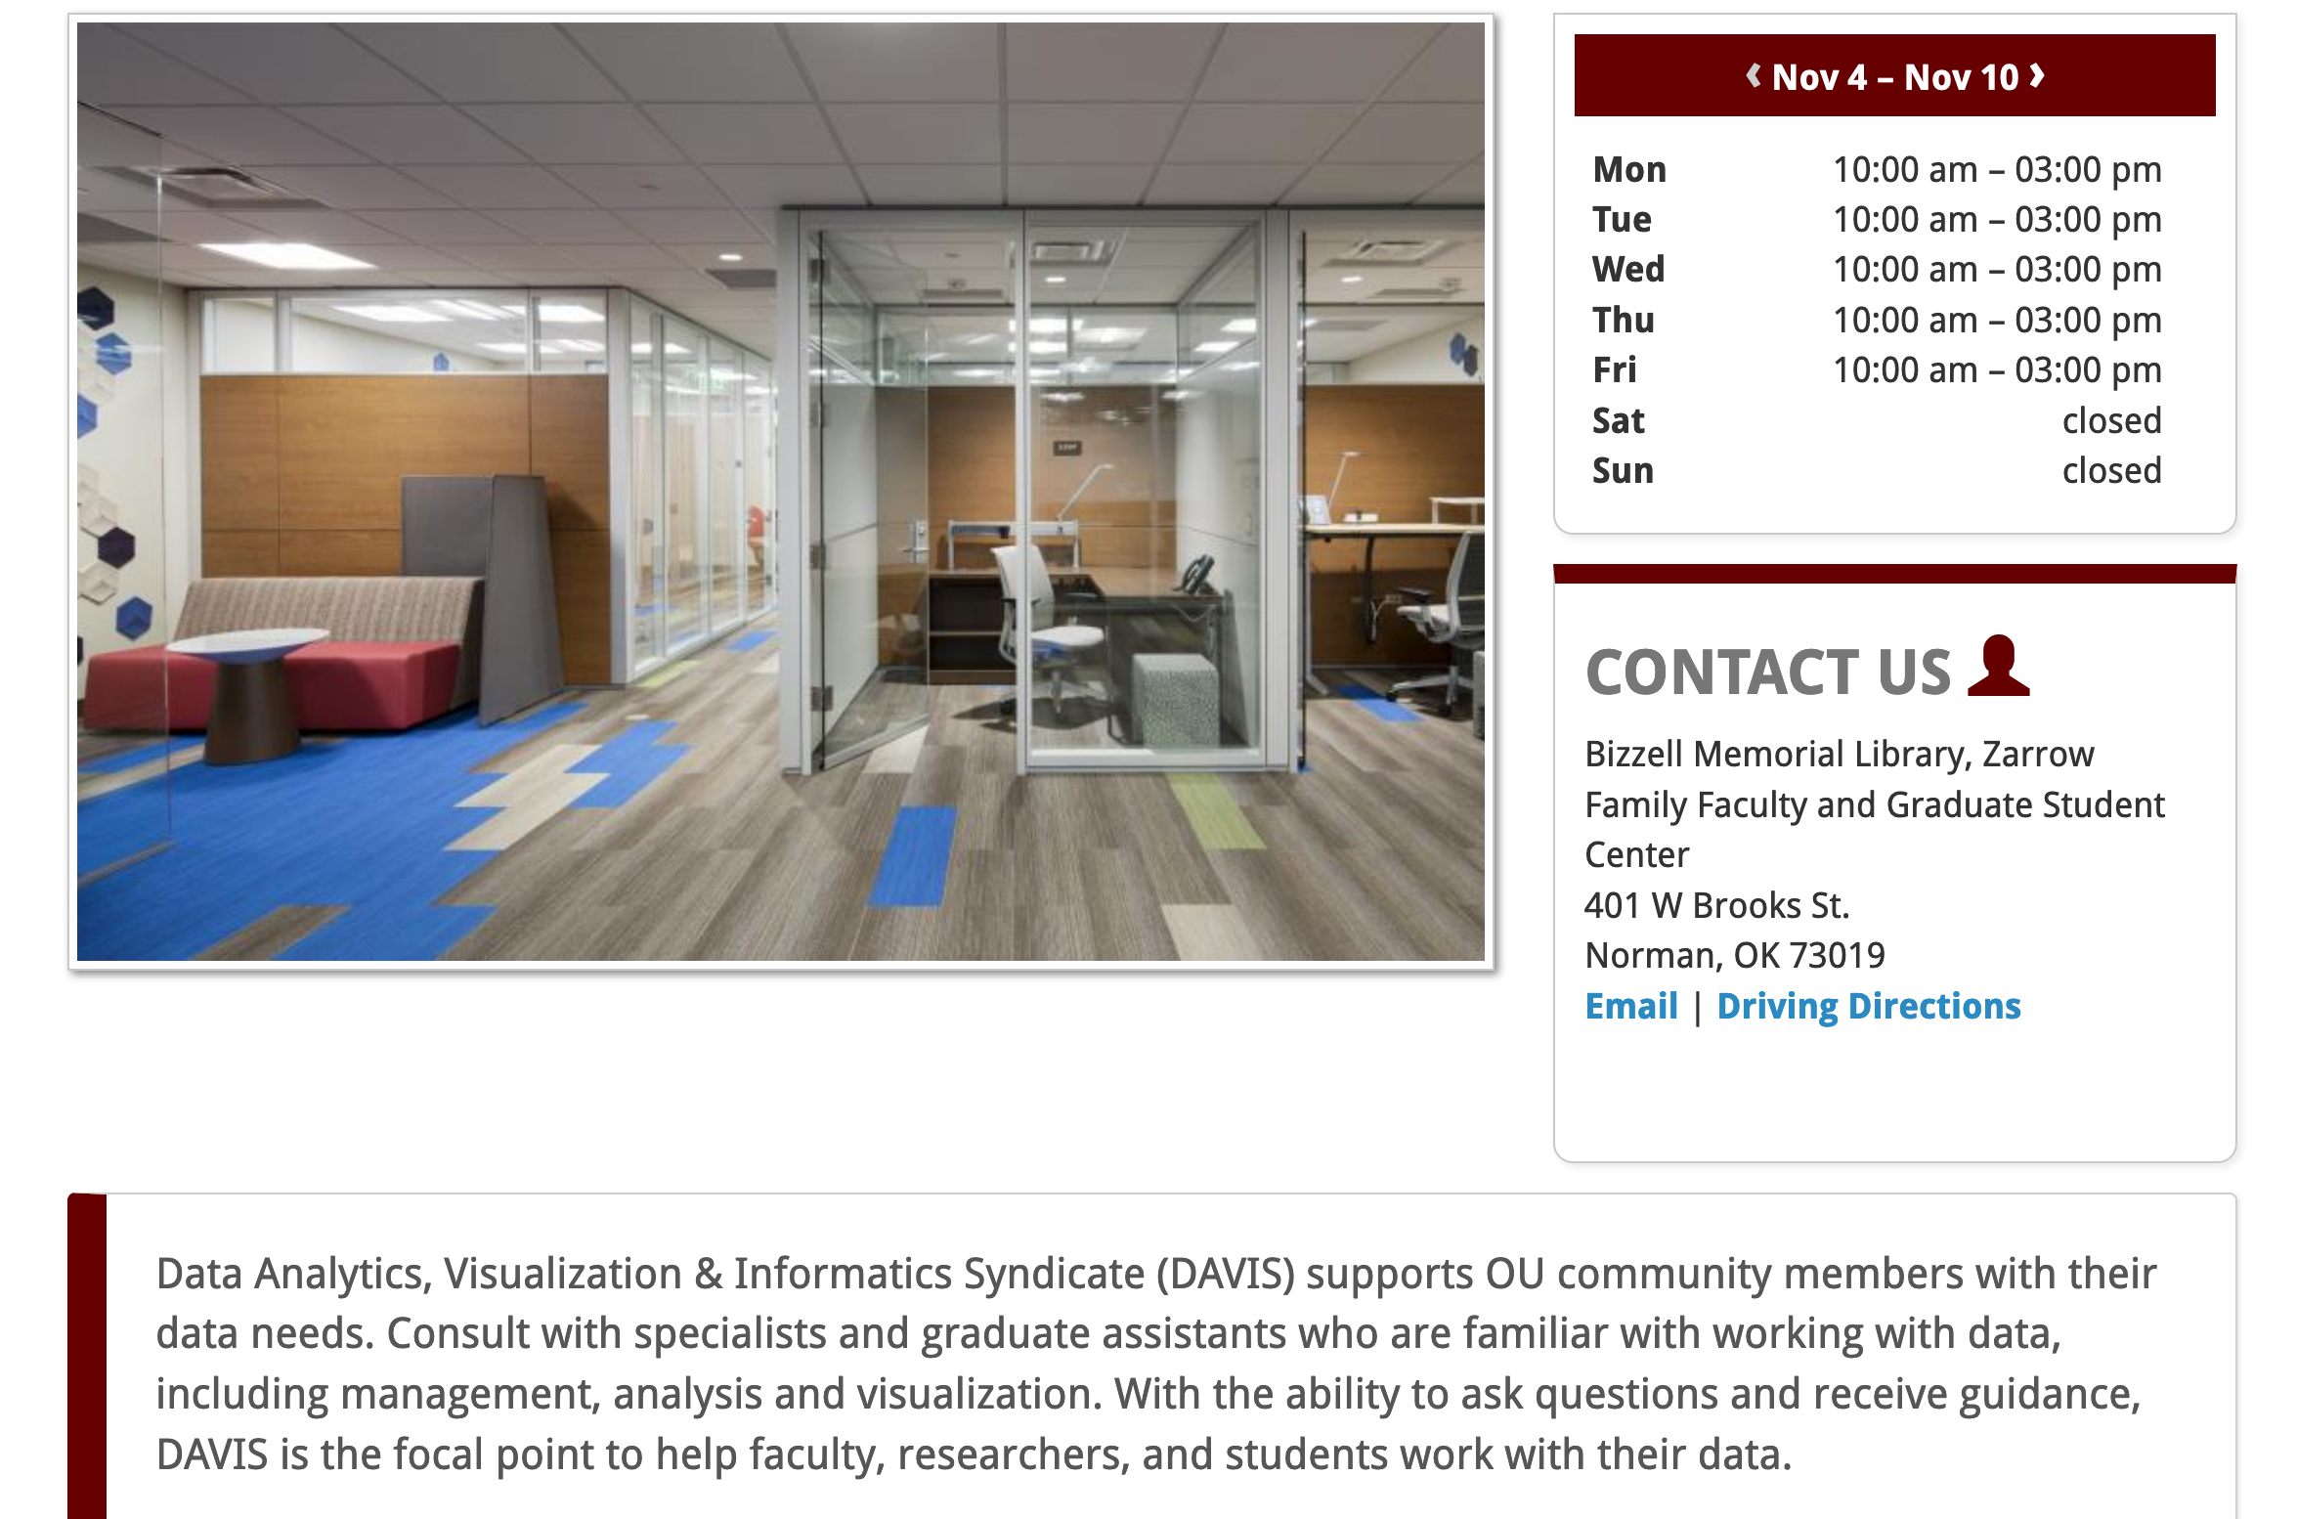
Consultation & Collaborative Spaces: DAVIS

Slide 4
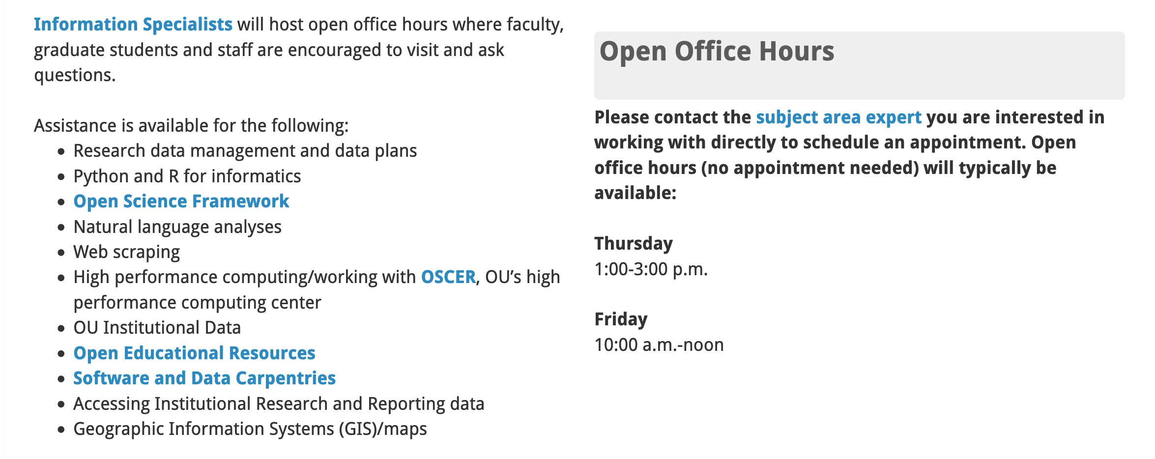
Data Analysis Visualization Informatics Syndicate

Slide 5
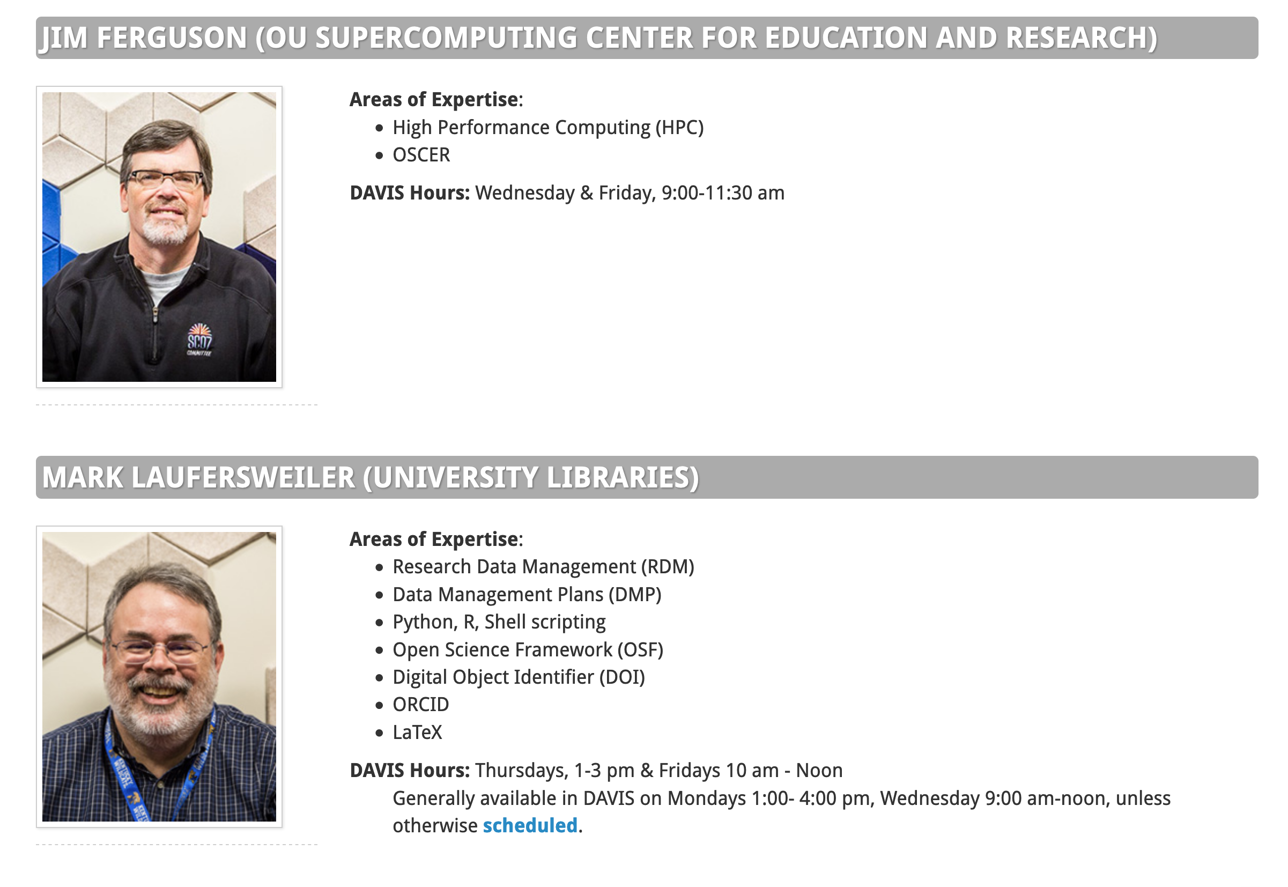
Information Specialists

Slide 6
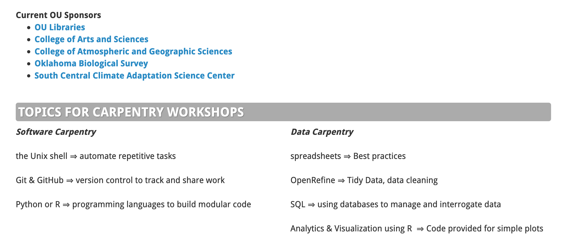
The Carpentries

Slide 7
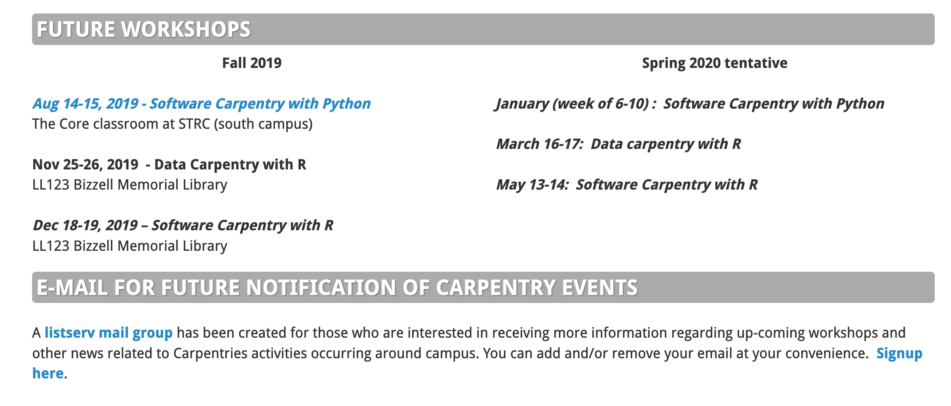
The Carpentries

Slide 8

UL Workshops

Slide 9
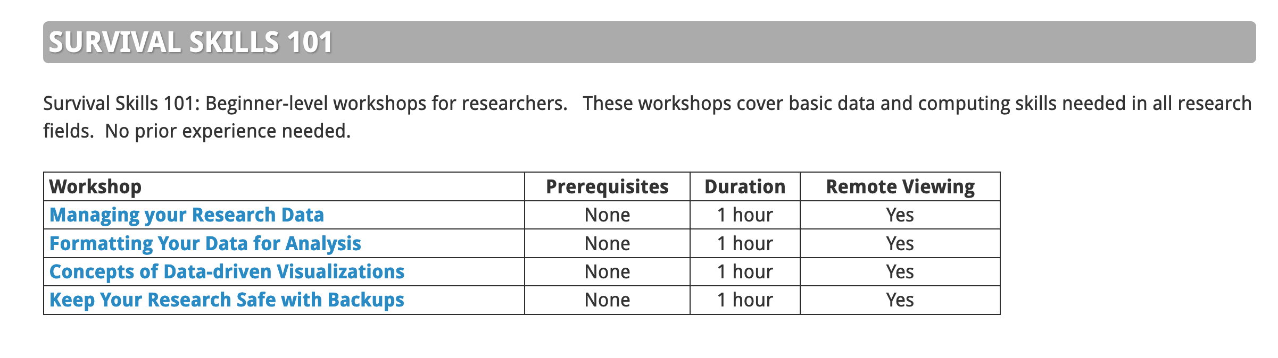
UL Workshops

Slide 10
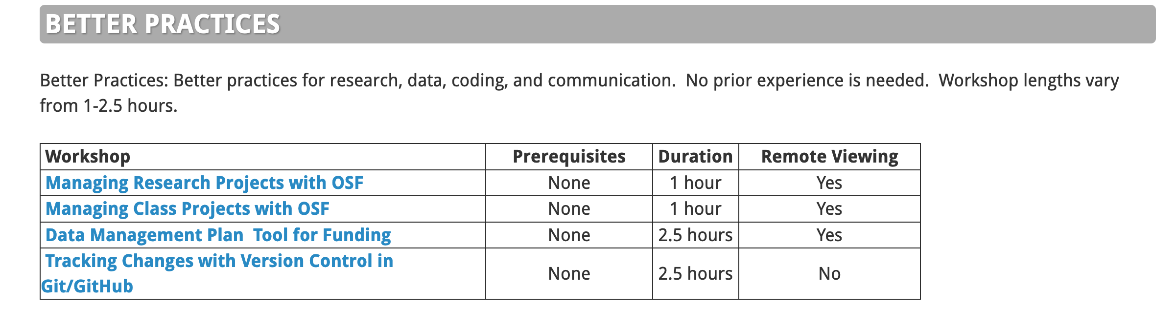
UL Workshops

Slide 11
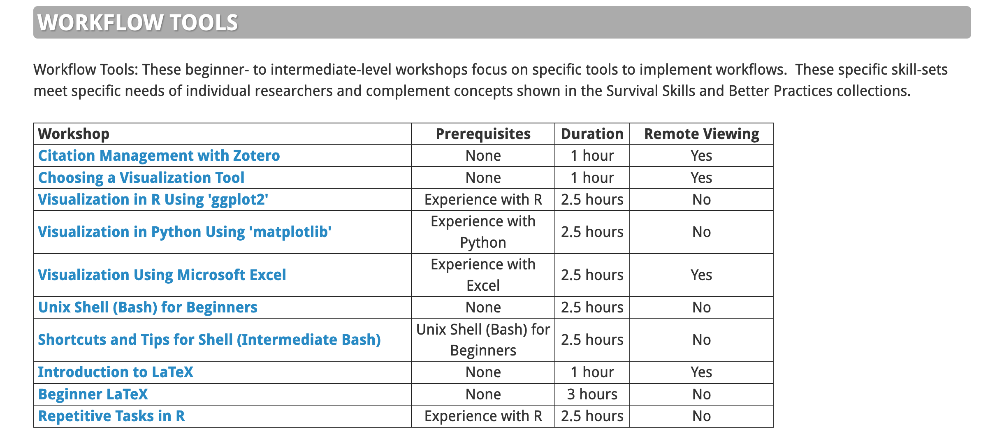
UL Workshops

Slide 12
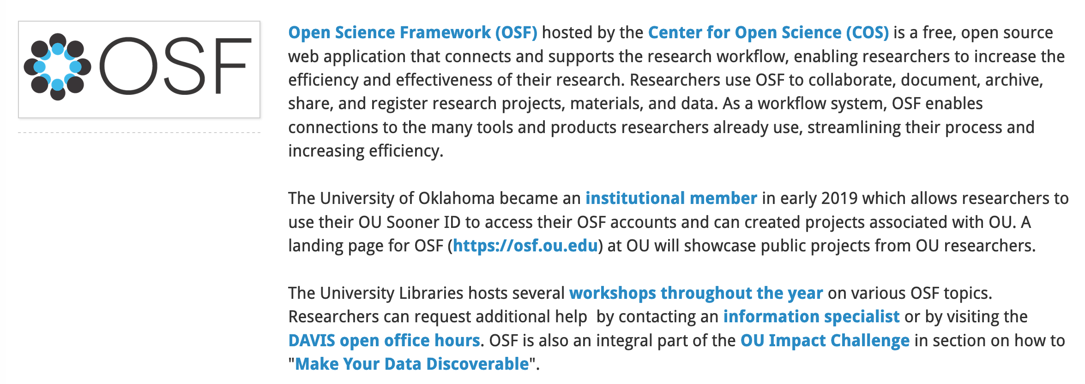
Open Science Framework https://osf.ou.edu

Slide 13
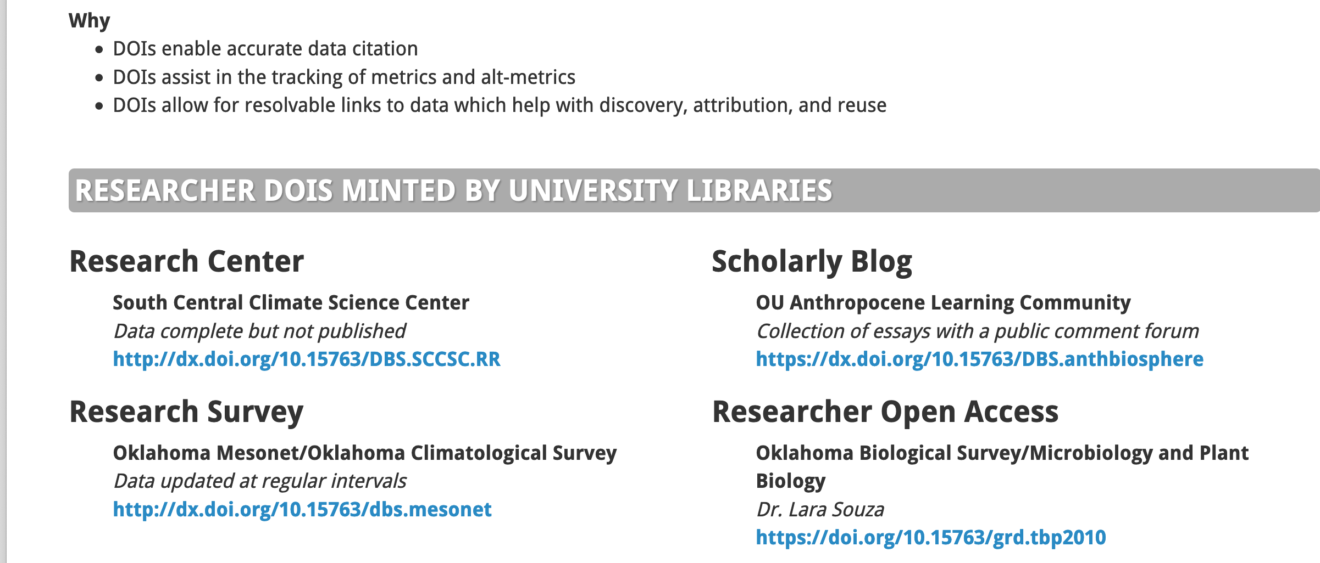
Digital Object Identifiers DOIs

Slide 14
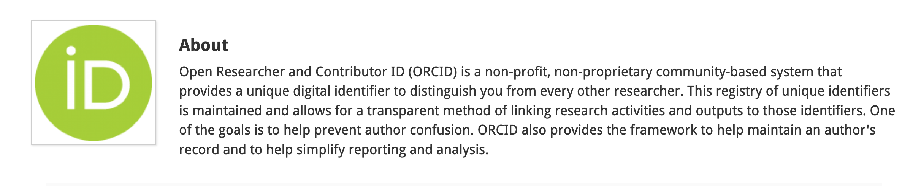

ORCID

Slide 15
Thank you
Dr. Mark Laufersweiler
Research Data Specialist
University Libraries
laufers@ou.edu
@laufers
@OULibData
ORCID: 0000-0001-5544-0976

